Slide 1
Political Parties
Major Parties – Two Party System
Republican Party
Democratic Party
Independent
Libertarian
Green
Consitution

Slide 2
Liberals and Conservatives
Liberals
Conservatives
Liberals believe in government action to achieve equal opportunity and equality for all. It is the duty of the government to alleviate social ills and to protect civil liberties and individual and human rights. Believe the role of the government should be to guarantee that no one is in need. Liberal policies generally emphasize the need for the government to solve problems.
Conservatives believe in personal responsibility, limited government, free markets, individual liberty, traditional American values and a strong national defense. Believe the role of government should be to provide people the freedom necessary to pursue their own goals. Conservative policies generally emphasize empowerment of the individual to solve problems.

Slide 3
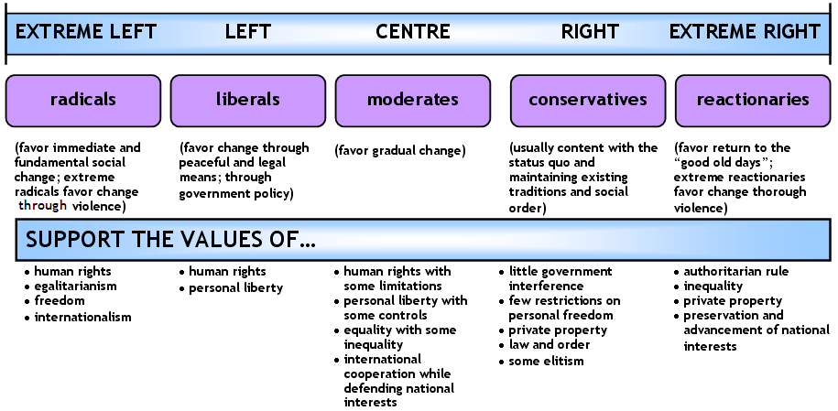

Slide 4
ABORTION
LIBERALS
CONSERVATIVES
Women have a right to decide what happens to their body.
Gov’t should fund (taxpayer $) abortions for people who can’t afford them.
Decision about abortion is personal and government must protect that right.
Human life begins at conception. An unborn baby has independent rights.
Government should not fund (taxpayer $) abortions.
Support a government ban of abortions, especially Partial Birth Abortions.

Slide 5
Affirmative Action
LIBERALS
CONSERVATIVES
Minorities have been deprived of rights due to past racism.
Government must work to make up for deprivation of rights because America is still a racist society.
Government must create equal opportunities for all.
Decisions should be based entirely on ability.
Unfair to use race as a factor in the selection process.
Reverse-discrimination is NOT a solution for racism.
America is not a racist society.

Slide 6
Death Penalty
LIBERALS
CONSERVATIVES
Death penalty should be abolished.
It is “cruel and unusual” punishment
Killing one innocent person is too great a risk.
Death penalty is a punishment that fits the crime of murder.
This is an appropriate response for heinous crimes.

Slide 7
Economy
LIBERALS
CONSERVATIVES
Market system with government regulation is best.
Government must protect its citizens from Big Business.
Government regulation is needed to even the playing field.
Free market system, competitive capitalism and private enterprise create the greatest opportunity and highest standard of living.
No government regulation – free markets produce better results.

Slide 8
Education
LIBERALS
CONSERVATIVES
Public schools are the best way to educate students.
Vouchers take money away from free and equal public education.
Government should fund public schools, raise teacher salaries and reduce class size.
School vouchers create competition and improve school performance.
Vouchers give all parents the right to choose schools, not just those who can afford private schools.

Slide 9
Embryonic Stem Cell Research
LIBERALS
CONSERVATIVES
Support the use of stem cells for research. Which assist scientists in research for diseases.
An embryo is not a human (blastocyst has no human features.
These cells are extremely valuable in curing diseases.
Adult and umbilicial cord stem cells ONLY should be used in research.
It is morally and ethically wrong for government to fund embryonic stem cell research.
Human life begins at conception-extraction of stem cells requires embryo to be “killed.”

Slide 10
ENERGY
LIBERALS
CONSERVATIVES
Oil is a depleting resource.
We must seek alternative energy sources. Government should assist with funding for these efforts. (Wind/Solar)
Government control of Gas and Electric
Oil, gas and coal are abundant resources.
US oil drilling should be increased which will lead to lower prices and less dependence on foreign oil.
Support increased production of nuclear energy. Wind and solar will never be enough.
Private ownership of gas/electric companies.

Slide 11
Global Warming-Climate change
LIBERALS
CONSERVATIVES
Global warming is caused by increased production of Carbon Dioxide (from burning Fossil Fuels)
US is the major factor (25% of world’s CO2)
We need laws to regulate Carbon Emissions
Change in global temperatures is a natural occurrence.
Science has not shown the humans can have a lasting impact on the earth’s temperature.
Laws to regulate emssions will not help the environment and will drive prices up.

Slide 12
Gun Control
LIBERALS
CONSERVATIVES
The 2nd Amendment does not give citizens the right to keep and bear arms, instead it is about State Militias (National Guard)
Individuals do not need guns for protection, that is the duty of the state
Gun control laws are necessary to stop gun violence and limit the ability of criminals to obtain guns.
More guns=more violence
The 2nd amendment gives all citizens the right to bear arms.
Individuals have the right to defend themselves.
There are too many gun control laws already.
Gun control laws do not prevent crime or reduce violence.
More guns=less crime/violence

Slide 13
Healthcare
LIBERALS
CONSERVATIVES
Free or low-cost government controlled health care.
Healthcare is a basic right of every American.
Government should ensure equal benefits for all (regardless of ability to pay)
Competitive, Free Market Health Care System
Free and low-cost government programs result in higher taxes and costs and lower quality of care.
Health care should remain privatized.
The problem of “uninsured” individuals should be solved by the private market.

Slide 14
Immigration
LIBERALS
CONSERVATIVES
Support legal immigration
Support blanket amnesty for those who enter the US illegally.
Believe undocumented immigrants have the same rights as Americans:
Education
Health care
Welfare
Etc.
It is unfair to arrest undocumented immigrants
Support legal immigration only
Oppose amnesty for those who enter the US illegally.
Illegal immigrants do not have the same rights as those who enter legally.
Borders must be secured before addressing the problem of immigrants in this country.

Slide 15
Religion and Government
LIBERALS
CONSERVATIVES
Separation of Church and State is paramount
Religious expression has no place in government
Government should not support religious expression in any way.
All references to religious should be removed from public locations.
“Separation of church and state” is not in the constituion.
The 1st amendment “Congress shall make no law respecting an establishment of religion or prohibiting the free exercise thereof”
This does not prohibit God from government.
Government should not interfere with religious freedom.

Slide 16
Same Sex Marriage
LIBERALS
CONSERVATIVES
Marriage is the union of two people. It should be legal for gay, lesbian, bisexual and transgender individuals to ensure equal rights.
Oppose a constitutional amendment establishing marriage as a union between a man and a woman.
Prohibiting same sex marriage is denying equal rights.
Marriage is the union of man and woman.
Oppose same-sex marriage.
Support Defense of Marriage Act (DOMA) passed in 1996 which affirms the right of states not to recognize same-sex marriage licenses from other states.
Requiring citizens to recognize same sex marriage violates the rights of many

Slide 17
Social Security
LIBERALS
CONSERVATIVES
Social Security system should be protected at all costs.
Social Security provides a safety net for the poor and needy.
Social Security system is in serious financial trouble.
Major changes are urgently needed.
Social security should be privatized.

Slide 18
Taxes
LIBERALS
CONSERVATIVES
Higher taxes (for the wealthy) and a larger government are necessary to address inequity/injustice in society.
Taxes enable the government to provide jobs and welfare programs for those in need.
Lower taxes with smaller government will improve the standard of living for all.
Lower taxes create more incentive for people to work, save, invest and engage in private business.
Government support encourages people to be lazy.

Slide 19
United Nation
LIBERALS
CONSERVATIVES
UN Promotes peace and human rights.
US has a moral and legal obligation to support the UN.
We need to act as a member of a world community.
US should respect and abide by the authority of the UN
The UN has repeatedly failed in its mission.
The US and not the UN should be the global force for freedom, prosperity, tolerance and peace.
National interests should remain superior to those of the UN.

Slide 20
War on Terror
LIBERALS
CONSERVATIVES
Global Warming, not terrorism poses the greatest threat to society.
Terrorism is the result of failed US foreign policy.
Good diplomacy is the best way to deal with Terrorism.
Terrorism poses one of the greatest threats to the US.
Militant and radical Islamists cannot peacefully co-exist with the western world.
Terrorists must be stopped and destroyed at all costs.

Slide 21
Welfare
LIBERALS
CONSERVATIVES
Support welfare as a safety net individuals in need.
Welfare is necessary to bring fairness to US economic life.
Opposed to long term welfare.
Opportunities should be provided for those in need to become self reliant.
People can’t remain dependant on the government for provisions.

