Slide 1
Introduction to World War I

Slide 2
WWI is about…rising tensions and conflict in Europe.
CAUSES | MAJOR EVENTS | IMPACTS
Militarism | “The Spark” – Assassination of Archduke Ferdinand | Germany Devastated
Alliances | The Ultimatum | Millions Dead/Injured
Imperialism | Two-Front War “Schleiffen Plan” | Tension in Europe
Nationalism | U.S. Involvement | Treaty of Versailles

Slide 3
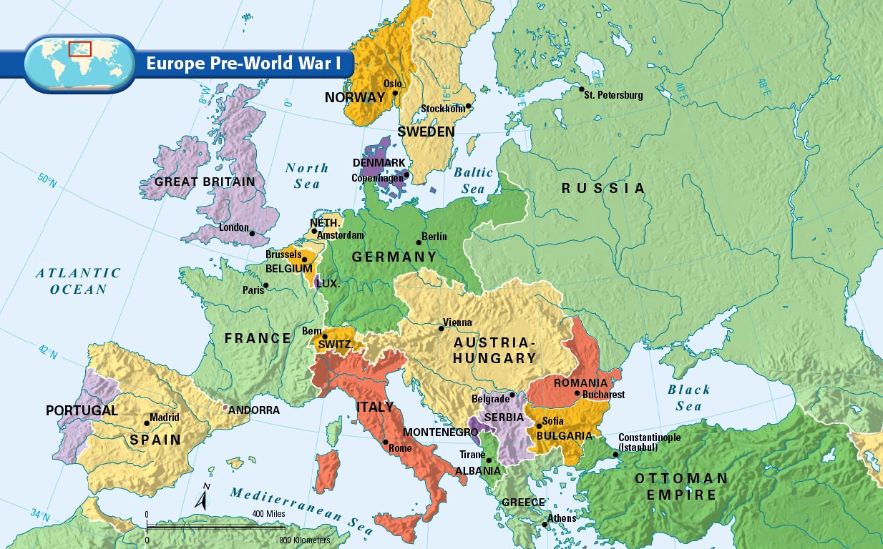

Slide 4
Key Terms
Alliances – Groups of nations that promise to support each other.
Propaganda – Utilizing media outlets to support government policies and programs (Gov’t Advertising)
Total War – War in which all of a countries political, social and economic resources are dedicated to the war effort.
Aggression – Using violent and assertive actions to achieve national goals.
Ultimatum – a demand accompanied by a threat to inflict some penalty if the demand is not met.
Militarism – Using a powerful military to achieve national goals, glorifying the military.

Slide 5
Rising Tensions Cause WWI
M - Militarism
A - Alliances
I - Imperialism
N - Nationalism

Slide 6
Militarism – Glorification of the miliatry
Examples:
Bismarck – “Blood and Iron”
Russian “Mobilization”
Security Dilemma→ Arms Race in Europe
Militarism leads to more powerful military and greater potential for violent conflict.

Slide 7
Alliances – Groups of nations that band together for common benefit.
Major Powers in Europe are Divided
Examples:
Triple Alliance – Germany, Austria, Italy
Triple Entente – Bound Britain, Russia and France
Alliances lead to war by involving more countries in disputes and increasing TENSION. Germany declares war on RUSSIA AND FRANCE.

Slide 12
Imperialism – When a stronger country takes over a weaker country.
Examples:
Scramble for Africa – Berlin Conference
Spheres of Influence in China – Opium Wars
British in India – “Crown Jewel”
LEADS TO WAR..it creates competition over colonies which leads to conflict. The increases in POWER AND WEALTH INCREASE TENSION

Slide 13
Nationalism – Deep feelings of pride in one's nation.
Examples:
Nationalism is used to UNITE Italy and Germany.
Nationalism leads to the BREAKUP of the Ottoman Empire and Austria-Hungary (ethnic tensions)
Nationalism leads to competition in W. Europe, increases tension and creates conflict.

Slide 15
The Spark that caused the war
Archduke Franz Ferdinand and his Wife are Assassinated
Shooter – Gavrilo Princip
Serbian – Member of the Black Hand Society

Slide 16
Problems in the Balkans
Balkans are the “Powder Keg” of Europe
Breakup of Ottoman Empire
SERBIA – Intense Nationalism

Slide 17
Timeline of Events
Date | Events | Reaction
1908 | Austria Hungary Annexed Bosnia and Herzgovina | Serbia OUTRAGED
June 28, 1912 | Serbia regains freedom from Ottoman Empire | Nationalism Grows
June 28, 1914 | Archduke FF Assasinated by Serbian Terrorist | Austria-Hungary blames Serbia/issues ultimatum
July 28, 1914 | Austria Hungary declares war on Serbia after they refuse ultimatum | Russia mobilizes army to support Serbia
August 1, 1914 | Germany declares war on Russia and France | WWI Begins

Slide 21
CENTRAL POWERS
ALLIED POWERS
Germany
Austria-Hungary
Joined Later By
Bulgaria
Ottomans
Russia
France
Great Britain
Joined Later By
Italy (From Central)
Japan

Slide 22
The End of World War I

Slide 23
US INVOLVEMENT begins with GERMAN AGGRESSION
TWO FRONT WAR
Western Front (France)
“Bloody Stalemate”
Trench Warfare
Eastern Front (German/Russian Border)
Russian supply lines are SLOW
Russia’s strength is its SIZE
GERMAN AGGRESSION
A) Unrestricted Submarine Warfare
Germans sink US “Lusitania”
B) Zimmerman Telegram
Intercepted Message from Germany to Mexico asking for help

Slide 28
Eastern Front

Slide 29
New Weapons of WWI
Poison Gas
Machine Guns
Tanks
Submarines

Slide 35
Russia Withdraws
Civil unrest in Russia forces them to withdraw (Russian Revolution)
Germany and Russia signed Treaty of Brest-Litovsk (Ends War) – END OF EASTERN FRONT

Slide 36
Central Powers Collapse (Triple Alliance)
German Troops are TIRED → Allied troops are FRESH (Thanks to US Troops)
Bulgarians and Ottomans Surrender (give up)
Revolution in Austria-Hungary

Slide 37
Germany Loses
German troops Mutinied (quit)
Germany and France signed an Armistice (Cease Fire)

Slide 38
Legacy of the War
8.5 Million Dead
21 Million Wounded
Severe Economic Strain
Tense Relationships (total war)

Slide 39
The Treaty of Versailles

Slide 40
The Big Four
Woodrow Wilson – US
Georges Clemenceau – France
David Lloyd George – Great Britain
Vittorio Orlando - Italy

Slide 41
Major Provisions -Treaty of Versailles (Signed June 28, 1919)
1. Punished Germany
Article 231 – “War Guilt Clause” (Sole responsibility)
Forced to REPARATIONS (Payments for damage in war)
Military Restrictions
Germany Loses Territory
Alsace Lorraine and Saar Basin to France
Poland Created
2. Creates a League of Nations
3. Map of Europe is Redrawn
New Nations better reflect ethnic groups
Based on the principle of SELF DETERMINATION (right to rule your own nation)

Slide 42
US President Woodrow Wilsons 14 Points
Goal – Achieve a just and lasting peace in Europe
Create a General Association of Nations
Change Borders and Create New Nations
End Secret Treaties
Free Trade
DOESN’T WORK – France and Britain want MORE (to the VICTOR go the SPOILS)

Slide 43
New Map of Europe

Slide 44
Problems with the Treaty
US Rejected Treaty
US is not in the League of Nations
Mandated (Colonial) Territories wanted Independence
Germany – Angry for taking FULL blame
Japan/Italy – Feel slighted because they didn’t get anything.

Slide 45
New Nations are Created
Austria
Hungary
Czechoslovakia
Yugoslavia
Turkey
Romania
Poland
Territories in the Middle East go back to Britain and France

Slide 52
TOTAL WAR

Slide 53
A Total War
Total War – All of a nation’s resources are dedicated to the war effort.
Rationing – Limited the amounts of war goods that could be bought
Suppressed – held down, all anti-war activity was banned
Restrain – Hold Back
Belligerent – Warlike, Aggressive
Marshaled – Arranged, Put in order
Conscription – Forced to join
Incitement – To encourage
Compulsory – Forced

Slide 54
Unprecedented – Never before
Dissident – Speaks out against the government
Propaganda – Advertising to spread ideas
Censorship – Government regulation of media
Embittered – Made angry/upset
Diplomacy – Political interactions other than war
Competency – Ability, Capable
Innovation – Invention or advancement

Slide 65
REVIEW

Slide 66
Key Terms
Aggression – Using violent and assertive actions to achieve national goals.
Alliances – Groups of nations that promise to support each other.
Armistice –Cease Fire
Balance of Power – Even distribution of power between European countries leads to PEACE
Blood and Iron – Bismarck’s policy to Unite Germany through war and sacrifice.
Congress of Vienna – Meeting of European powers in 1814-1815 to create peace in Europe by establishing a balance of power.
Militarism – Using a powerful military to achieve national goals, glorifying the military.
Multi-National Empire – Empire comprised of Multiple ethnicities and nationalities (i.e. Ottoman, Austria-Hungary)

Slide 67
Nationalism - Feeling of strong loyalty and pride to one’s country and culture.
“Powder Keg” of Europe – Description of the volatility of the Ottoman empires NATIONALISTIC TENSIONS
Propaganda – Utilizing media outlets to support government policies and programs (Gov’t Advertising)
Realpolitik – Realistic politics aimed at growing the economy and military
Self Determination – People have a right to rule their own nations
Total War – War in which all of a countries political, social and economic resources are dedicated to the war effort.
Ultimatum – a demand accompanied by a threat to inflict some penalty if the demand is not met.
Unrestricted Submarine Warfare – German wartime policy to blockade all shipments to Britain
Xenophobia: Intense fear or dislike of people from another country.

Slide 68
What are the common bonds people in a NATION share?
Borders, Government, Language, Religion, Culture
What regions were UNITED using nationalism?
Germany, Italy
What empires were DIVIDED by nationalism?
Austria-Hungary, Ottoman Empire
What were the goals of Otto Von Bismarck’s “Blood and Iron” policy?
Build German Military
Unite Germany through War
Realpolitik – Realistic politics
State over Individual

Slide 69
What problems arise in a Multinational Empire?
Ethnic Tensions, Nationalistic Rivalries, Group over Nation
What role did Geography play in WWI conflicts?
Ottoman Empire – Strategic Location
Suez Canal, Med. Sea, Indian Ocean
Competition for colonies in Middle East as Empire breaks up
Why is nationalism such an important force in Europe?
Many nations, close together, shared borders
What are the MAIN causes of WWI?
Militarism, Alliances, Imperialism, Nationalism

Slide 70
How did the Assassination of Archduke Franz Ferdinand lead to WWI?
Austria Hungary Issues Ultimatum → Russia Mobilizes troops → AH declares war on Serbia → Germany declares war on France and Russia
What were the most significant turning points of WWI?
US Involvement (Unrestricted Submarine Warfare, Zimmerman Telegram)
Russia Backs Out – Treaty of Brest-Litovsk
Revolt in Austria Hungary
Breakup of Ottoman Empire
What were the major alliances formed in WWI?
Central Powers: Germany, Austria-Hungary, Ottomans, (ITALY)
Allied Powers: France, Russia, Britain, (US), (Italy)
What were the major provisions of the Treaty of Versailles?

Slide 71
What were the major provisions of the Treaty of Versailles?
1. Punished Germany: REPARATIONS, Military Restrictions, Loss of territory
2. Creates a League of Nations
3. Map of Europe is Redrawn-NEW NATIONS
What were the major problems of the Treaty of Versailles?
US Rejected Treaty
US is not in the League of Nations
Mandated (Colonial) Territories wanted Independence
Germany – Angry for taking FULL blame
Japan/Italy – Feel slighted because they didn’t get anything.
How did the map of Europe change as a result of WWI?
NEW NATIONS: Austria, Hungary, Czechoslovakia, Yugoslavia, Turkey, Romania, Poland

