Slide 1
Aim: How did the Cold War Begin?

Slide 2
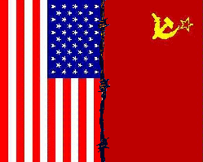
The Cold War
1945-89

Slide 3
Cold War – Struggle over political differences carried on by means short of military action or war.
Two Superpowers (Bi-Polar): US and Soviet Union
“Means Short of Action/War?” Strategies: Alliances, Containment, Space Race, Arms Race, Brinkmanship, Diplomacy, Economic Military Aid

Slide 4
I. Agreements at the end of WWII
Yalta Conference
1) Germany Disarmed/Divided
2) Stalin Agrees to Free Elections in Eastern Europe
3) Created United Nations (GOAL: Keep Peace/stability)
Self Determination for ALL (sort of…)
The right of a Nation to choose their own government and rule themselves.
Potsdam Conference
1) Trial of War Criminals (NUREMBERG TRIALS)
2) Germany Pays Reparations
3) Boundaries changed in Eastern Europe
4) De-Nazification

Slide 7
Post WWII Tensions – Bad Blood
Why were there tensions between the US and Soviet Union?
U.S. Angry at Russia for German-Soviet Non-Aggression Pact in 1939
U.S.S.R. Angry at U.S. for not Getting Involved in WWII Sooner (two front war)

Slide 8
U.S. Goals
1) Encourage Democracy – Stop Communism
2) Gain Access to Raw Materials and Free Markets
Capitalism needs capitalism (free-markets) to succeed
3) Rebuild Europe → Stability
4) Rebuild Germany → Increase Stability

Slide 9
Soviet Goals
1) Encourage Communism – Workers Revolution
2) Rebuild Economy: Use Eastern Europe Industries and Raw Materials
3) Control Eastern Europe to Protect Borders and Limit U.S. Influence in Europe
4) Keep Germany Divided (WEAK)

Slide 10
Opposing Alliances
North Atlantic Treaty Organization (NATO)
“THE WEST”
Warsaw Pact
“THE EAST”
US
Britain
France,
Canada
Italy
…(Western Europe)
USSR
Poland
Bulgaria
Albania
…(Eastern Europe)

Slide 17
The Iron Curtain
IRON CURTAIN – Boundary between Communist Eastern Europe and Democratic Western Europe.
Why did the S.U. want the Iron Curtain?
Soviet Union Fears Invasion from the West
E. Europe Countries = Buffer or Wall of Protection
Expand Power: “PUPPET STATES” – Soviet Control of Governments
++Ignored Yalta Conference and Installed or Secured Governments in Eastern Europe
NO SELF DETERMINATION

Slide 19
Post-War Germany
Germany is divided into 4 zones (Potsdam)
East: Soviets – Communist Government
West: “The West” – Democratic Government
Berlin (Capital) is also divided into 4 zones
West Berlin (US, France, Britain)
East Berlin (Soviet Union)
Notes:
Morgenthau Plan – Keep German industry low

Slide 21
New US Leadership
1953 – Dwight D. Eisenhower
Secretary of State – John Foster Dulles
Strong Anti-Communist Feelings in US
Brinkmanship - Willingness to go to the BRINK of war
Need Nuclear Weapons (H Bomb) and Planes to Deliver (Soviets did the same)

Slide 22
U.S. Foreign Policy
CONTAINMENT: Contain the spread of COMMUNISM
Truman Doctrine – Aid to countries that resist communism
Marshall Plan – Aid to rebuild Europe→ Increase Stability

Slide 24
Berlin Blockade/Berlin Airlift
1st Major Event of the Cold War
US Objectives: Maintain influence in Germany, Avoid conflict with SU
SU Objectives: Stalin wants Western powers to give Berlin to Soviets. SU wants to strengthen its influence in Eastern Europe and Eliminate US influence.
EVENTS:
BERLIN BLOCKADE: Soviet Union (Stalin) blocked access to West Berlin.
BERLIN AIRLIFT: Western Allies fly in supplies to Berlin
RESULTS:
Airlift is a Success, Soviets Lifted Blockade, Embarrassing for Soviets

Slide 31
Aim: Major Cold War Events (Day 1)

Slide 32
Space Race
Objectives: (BOTH)
Technological Superiority
Assurance that space would not be used for military advantage by enemy
EVENTS:
1) Soviets Announced ICBM – (1957)
Intercontinental Ballistic Missile
2) Soviet Union Launched Sputnik into space (1957)
US Launched in ‘58
3) Soviets Shot Down U-2 Plane (1960)
US embarrassed AGAIN that they are caught spying
4) US Puts Man on the Moon (1969)
Results:
Soviets gained early advantage – Increased tension in US
US Increased $$$ into Science Ed.

Slide 37
Arms Race
Objectives (BOTH):
Produce more advanced Nuclear Weapons
Gain military advantage over enemies
EVENTS:
1) US Begin Manhattan Project– (1942)
2) US uses Nuclear Bombs against Japan (1945)
3) Soviets 1st Successful Nuclear Weapon (1949)
Results:
Massive increases in military spending
Thousands of missiles and warheads produced
No Direct Conflict (Mutually Assured Destruction)

Slide 41
Chinese Civil War
Objectives:
US- Stop the Communist Takeover of China
SU – Support Communist Revolution + Forge an Alliance with China
EVENTS:
1) Soviet Union and China form Treaty of Friendship (1950)
2) Soviet Union Supports Communists (Mao Zedong)
3) US Supports Nationalists (Jiang Jieshi)
Results:
Communists Win – Peoples Republic of China
Nationalists fled to Taiwan – US Recognizes only Taiwan
Growing Anti-Communist Sentiment in the US

Slide 42
Korean War
Objectives:
US- Stop the Communist Takeover of Korea
SU – Spread Communism throughout Asia
EVENTS:
1) Korea is divided at the 38th Parallel
North – Industrial: Japanese surrendered to Soviets
South – Rural: Japanese surrendered power to U.S.
2) North vs. South Korea
Soviets supplied the North with tanks and airplanes to invade
North Invades South – South asks the U.N. for help
3) U.N. Involvement
4) Armistice – Cease Fire (1953) – ENDS MARCH 2013
Results:
Korea remains divided with Demilitarized Border
North – Communist, Totalitarian Leader – Kim Jong Il/Kim Jong Un
South –Capitalist, Democratic Government

Slide 44
Cold War in Korea
Korea is divided at the 38th Parallel
North – Industrial: Japanese surrendered to Soviets
South – Rural: Japanese surrendered power to U.S.
North vs. South Korea
Soviets supplied the North with tanks and airplanes to invade
North Invades South – South asks the U.N. for help
U.N. (US) Involvement (1950)
Gen. Douglas MacArthur – Wants Nuclear Weapons
“We are trying to prevent a world war, not start one” - Truman

Slide 45
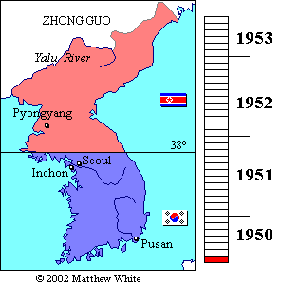
UN forces led by Macarthur prevented communist takeover
Three years of Back & forth fighting (Ping Pong)
Armistice signed in 1953
Border is reset @ 38th Parallel

Slide 46
Vietnam
Objectives:
US- Prevent DOMINO THEORY: Idea that communism will spread to all countries.
SU – Spread Communism throughout Asia, oppose US influence in Asia
EVENTS:
1) French Colonized SE Asia (French Indochina)
2) Ho Chi Minh Led Communist Revolution against French (1945)
3) Geneva Peace Conference (1954)
Vietnam divided at 17th Parallel
Ho Chi Minh rules NORTH
US/France – Anti Communist Government in SOUTH
4) Gulf of Tonkin(1964)
Leads to US Involvement in Vietnam – Americanization
4) US Withdrawal – Vietnamization (1969-1973)
Results:
COMMUNISM PREVAILS - North Overruns South - 1975
Thousands forced to “Reeducation Camps”
Totalitarian Communist State Created
Southeast Asia (Cambodia) become communist

Slide 47
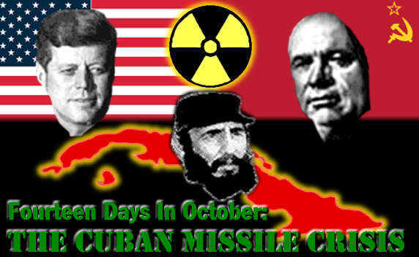
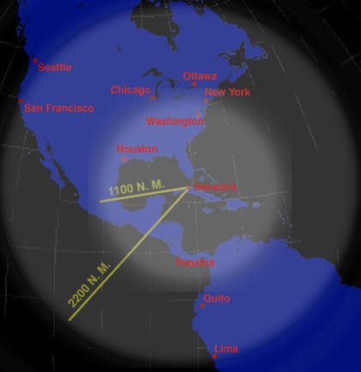

Slide 48
Cuban Missile Crisis
Objectives:
US-Prevent the Soviet Union from building Nuclear Missile Sites in Cuba.
SU – Establish strategic bases, build communist alliances
EVENTS:
1) Cuban Revolution – Castro in Power=COMMUNISM (1959)
2) Bay of Pigs Invasion – Failed US attempt to overthrow Castro (1961)
3) Soviet Missile Sites Detected in Cuba (1962)
4) Missile Crisis (October 14 – October 28 1962)
US Blockades Cuba to prevent Soviet Ships
US President=JFK, SU Prime Minister=Nikita Kruschev
Kennedy promises not to invade Cuba→ Kruschev removes missiles
Results:
Soviet Alliance with Cuba
Brinkmanship Heightened
Diplomacy Prevails over Violence

Slide 49
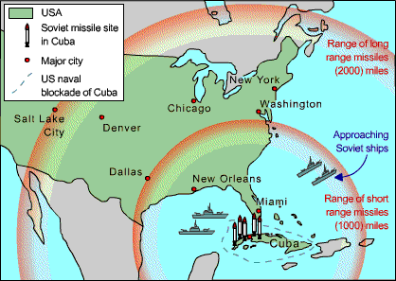
Crisis is avoided after 13 days
USSR dismantles nuclear missiles

Slide 50
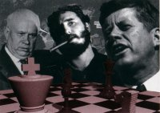
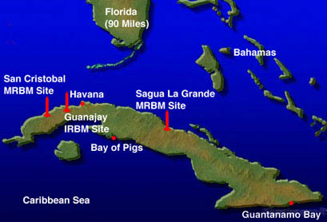
The Cuban Missile Crisis
USSR installs missile bases in Cuba
Threat to US security
US blockades Cuba
US & USSR brought to the brink of war (Brinkmanship)

Slide 51
Crisis Avoided
After 13 Days the Crisis is Avoided
USSR Dismantles Nuclear Missiles

Slide 52
Repression in Eastern Europe
Objectives:
US - check Soviet power and allow SELF DETERMINATION
SU-maintain power and Influence in Eastern Europe (CHERS BP)
EVENTS:
1) East Germany and Poland Revolt (1950s)
2) Hungary Revolts (1957)
3) Czechoslovakia Revolts (1969)
Results:
All revolutions are put down with EXTREME FORCE
Soviets maintain buffer zone in E. Europe
US Role non-existent

Slide 53
Cold War in Afghanistan
Objectives:
US to prevent the spread of Communism
S.U. dominance of Afghans for access to Indian Ocean.
EVENTS:
1) April 27th 1978 – Soviet supported communist government takes over
2) 1979 Soviets invade and put in a friendly leader
3) Rebels (Mujahedeen) resists communist gov’t for interfering with Islamic values. US supported Mujahedeen.
Results:
Soviets embarrassed
UN condemns war, US boycotts Moscow Olympics + ends SALT talks

Slide 54
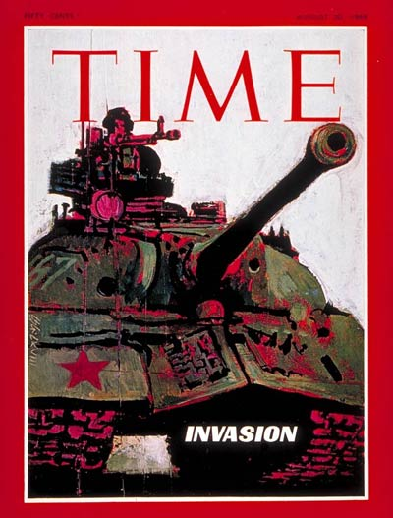
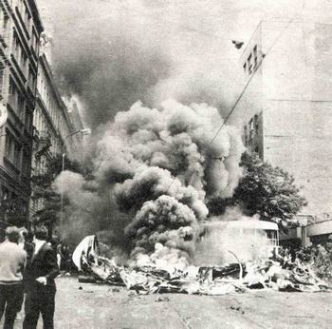

Slide 55
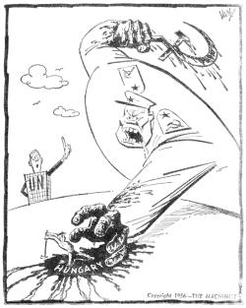

Slide 56
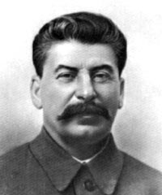
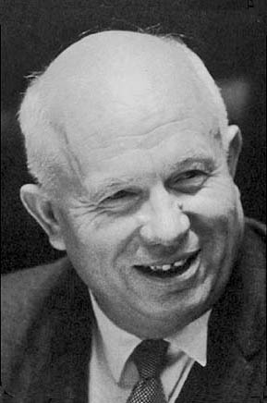
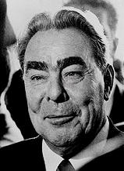
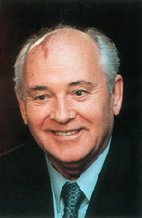
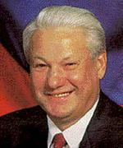
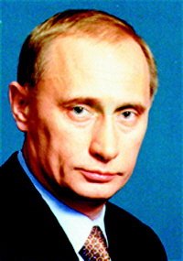
USSR Leaders
The Old
The New
Gorbachev

Slide 57
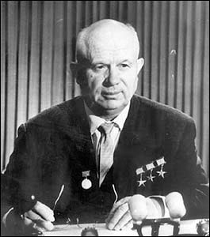
Nikita Khrushchev
Soviet leader following Stalin 1953-1964
Destalinization:
Erase the memory of Stalin in the USSR
Desired “peaceful competition” with Capitalist states (WEST)
Maintained strict control over satellites

Slide 58
Leonid Brezhnev
1964-1982
A return to TOTALITARIANISM
Repressive measures at home and in satellites
Initiated Détente with the US
Détente: A cooling down of tensions between East & West
SALTI & II- 1972,1979 Strategic Arms Limitation Treaties
Limited # of ICBM’s

Slide 59
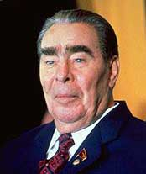
Leonid Brezhnev
1964-1982
Brezhnev Doctrine
Right to prevent Satellite nations from rejecting Communism, using FORCE

Slide 60
Mikhail Gorbachev
1985-91
Drastically reformed the Soviet government & failing economy
Withdrew Soviet Troops from Afghanistan
Encouraged Glasnost
(openness)Ended censorship & encouraged free flow of ideas
Allowed open criticism of the government

Slide 61
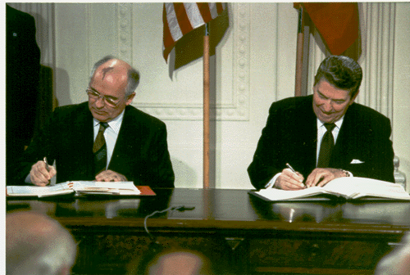
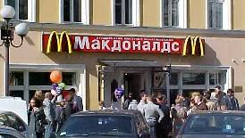
Perestroika
Movement towards a free market economy (Capitalism)
Similar to NEP
Democratization
Movement towards Democratic ideas
Voters could choose candidates for office

Slide 62
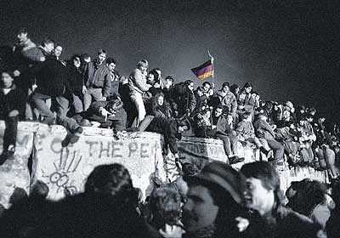
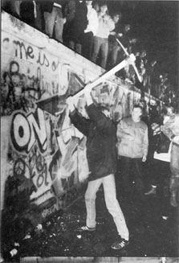
Allowed pro-democracy movements in the Satellites
Repealed Breshnev Doctrine
Without threat of Soviet force, communism crumbles in E. Europe
EX. The Berlin Wall 1989

Slide 63
Boris Yeltsin
Succeeds Gorbachev after failed coup
1st popularly elected President of Russia
Adopted policy of Shock Therapy
Abrubt shift to a free market economy
Living standards declined/ economy faltered/ corruption rampant
Resigned 1999 due to poor health

Slide 64
Vladimir Putin
Current President of Russia
Continues market reforms
Former KGB administrator
Problems still exist today with rebel Province of Chechnya
Improved relations w/ U.S., E.U., NATO & China

Slide 65
Aim: How did the Cold War come to an End?

Slide 66
Détente – Cooling of tensions between East and West
Glasnost – Openness or Transparency in the government, no censorship and allows criticism of the government.
Perestroika – Soviet policy which allowed the gradual introduction of Free Market principles into an otherwise communist economy.
Repression – To hold back, to control harshly

Slide 67
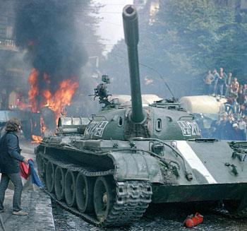
The Soviet Union in Eastern Europe
Throughout the Cold War the Soviets repressed the States of E. Europe using Extreme Force.
Revolts in: East Germany, Poland, Hungary (‘56), Czechoslovakia (‘69)

Slide 68
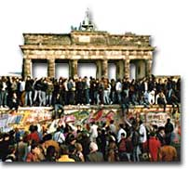
RE-Unification of Germany
1989: Berlin Wall comes down
1990: Germany is reunited
Financial strain on West Germany
Unemployment rises in East

Slide 69
US President Ronald Reagan speaking at the Brandenburg Gate in West Berlin, Germany on June 12, 1987

Slide 70
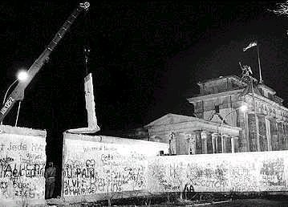

Slide 71
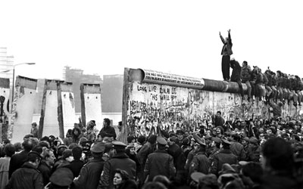

Slide 72
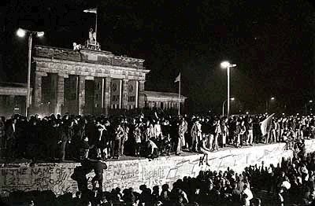

Slide 73
1991 Baltic States declare independence: Estonia, Latvia, & Lithuania
Czechoslovakia breaks apart: Czech Republic & Slovakia
Yugoslavia breaks apart: Croatia, Slovenia, Bosnia- Herzegovina, Macedonia
Bosnia becomes crisis point in 1990’s
Genocide of Non- Serbs

Slide 74
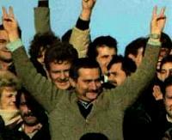
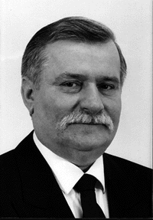
Poland
1980 Solidarity Movement
Lech Walesa calls for a change
Polish government outlaws union & arrested members
1989 Lech Walesa is elected President of Poland

Slide 75
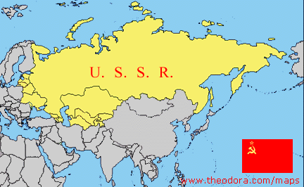
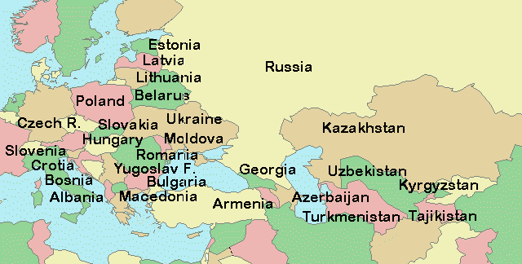
Then & Now

Slide 76
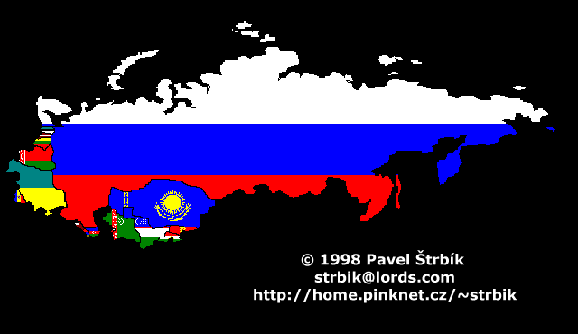
The Collapse of the USSR
1991 Baltic States Estonia, Latvia, & Lithuania declare independence
Shortly after all other 15 Soviet Republics gain independence
1991 The USSR ceases to exist

Slide 77
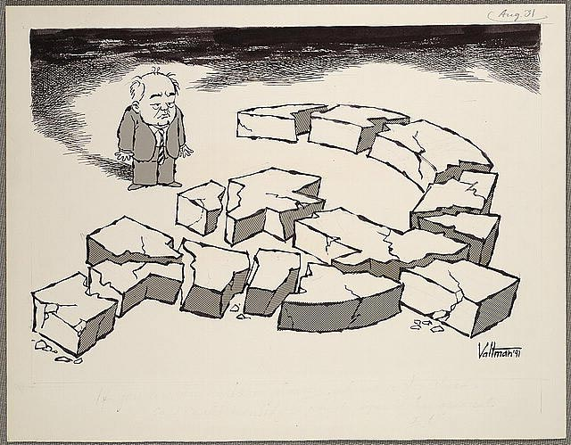
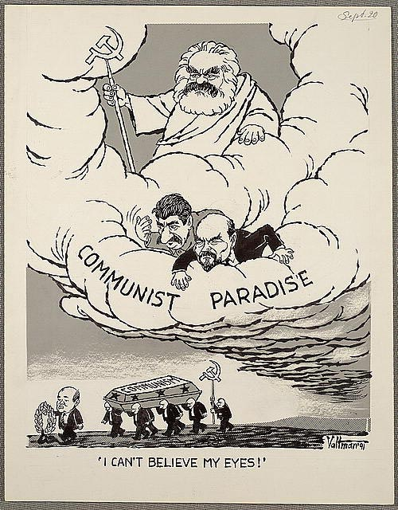

Slide 78
Non-aligned Countries during the Cold War
US & USSR attempted to gain influence over Third World countries
Non-aligned: States that remain neutral of both Super Powers.
Underdeveloped countries of Africa & Latin America
Military, technical, & financial assistance
Backed revolutions (Cuba, Nicaragua, Afghanistan)

Slide 79
Aim: Post Cold War Russia

Slide 80
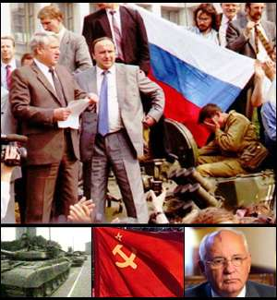
The August Coup
1991- Communist hardliners attempt to overthrow Gorbachev
Attempts failed but Gorbachev resigns

Slide 81
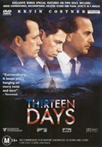
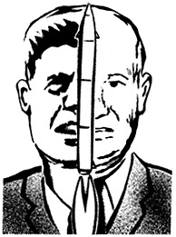
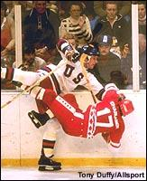
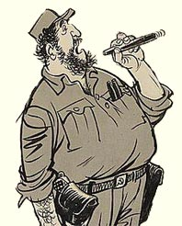

Slide 91
Berlin Airlift
US Goals – Support W. Berlin with food and supplies, prevent SU takeover
Soviet Goals – Gain control of W. Berlin, get allies out
Description: Soviets blockade West Berlin because allies won’t give it up. NATO forces airlift in supplies to W. Berlin and eventually Soviets lift blockade.
Results: Allies win the contest as Soviets eventually lift the blockade. This increases tension because SU is embarrassed. It also proves that conflicts can be resolved without war.

