Slide 1
The Interwar Period Between WWI and WWII

Slide 2
Recall Activity
Causes of WWI: MAIN
Alliances
Lusitania/Zimmerman Telegram
Two-Front War
New Weapons
Trench Warfare

Slide 3
The Paris Peace Conference Treaty of Versailles

Slide 4
The Big Four
Woodrow Wilson – US
Georges Clemenceau – France
David Lloyd George – Great Britain
Vittorio Orlando - Italy

Slide 5
US President Woodrow Wilsons 14 Points
Goal – Achieve a just and lasting peace in Europe
Create a General Association of Nations
Change Borders and Create New Nations
End Secret Treaties
Free Trade
WHY IT DOESN’T WORK →
France and Britain want MORE
(to the VICTOR go the SPOILS)

Slide 6
Major Provisions -Treaty of Versailles (Signed June 28, 1919)
1. Punished Germany
Article 231 – “War Guilt Clause” (Sole responsibility)
Forced to REPARATIONS (Payments for damage in war)
Military Restrictions
Germany Loses Territory
Alsace Lorraine and Saar Basin to France
Poland Created
2. Creates a League of Nations
3. Map of Europe is Redrawn
New Nations better reflect ethnic groups
Based on the principle of SELF DETERMINATION (right to rule your own nation)

Slide 7
New Map of Europe

Slide 8
New Nations are Created
Austria
Hungary
Czechoslovakia
Yugoslavia
Turkey
Romania
Poland
Territories in the Middle East go back to Britain and France

Slide 9
Problems with the Treaty
US Rejected Treaty
US is not in the League of Nations
Mandated (Colonial) Territories wanted Independence
Germany – Angry for taking FULL blame
Japan/Italy – Feel slighted because they didn’t get anything.

Slide 10
Let’s start with WHY?
Who is to blame for WWI?

Slide 12
German Territorial Losses
1. Alsace-Lorraine was returned to France.
2. The Polish Corridor. Poland was restored as an independent nation. Germany was DIVIDED.
3. Mandates. Germany surrendered all of its colonies, which were distributed among the Allies as “mandates.”
4. “Anschluss”, or the unification between Austria and Germany, was forbidden.
5. The Saar Basin area of Germany (coal producing region in Germany) was given to the League of Nations for 15 years, with the goal of producing coal for France.
6. Danzig was a city in the Polish Corridor. It too was to be administered by the League of Nations, and would act as a “free” city; meaning any nation could unload goods there into the European market.

Slide 13
Military Clauses
1. The Rhineland was demilitarized. The area on the French border was to be a permanently demilitarized zone (no Germany army). Allied armies were to occupy the west bank of the Rhine for a period of 15 years. This was set up to act as a between France and Germany.
2. Military Restrictions. Conscription was forbidden in Germany and the German army was limited to 100,000 men who had to serve for 12 years (this way, no one would volunteer!). Its navy and air force were also severely restricted in size. The production of submarines, planes and tanks was forbidden.
3. The German Fleet. Surrendered to Great Britain.
4. Merchant shipping. Germany gave up all of its merchant ships to the Allies in compensation for allied shipping losses during the war.

Slide 14
REPARATIONS
i. Article 231: The War-Guilt Clause. This clause stated that Germany alone must accept responsibility for the start of the war. The Germans were furious over this article.
ii. Reparations. Because the Germans were responsible for the war (Article 231), it meant that they would be forced to pay the allies huge sums of money to pay for the damage caused by the war. Germany must pay the allies 6.6 Billion Pounds in gold, or 33 billion American dollars (ouch!). Also, all coal in the Saar would go to France for five years.

Slide 15
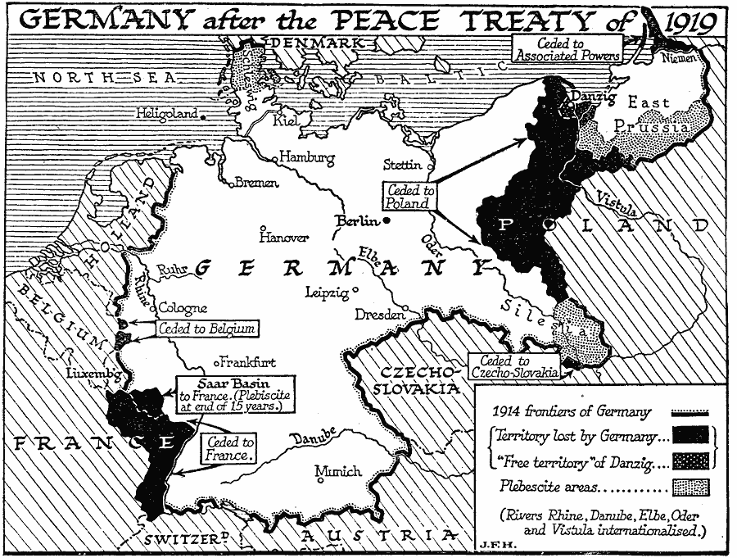

Slide 16
Document A: May 7, 1919 - Leader of German Delegation at Versailles Peace Conference
It is demanded of us that we shall confess ourselves to be alone guilty of the war. Such a confession from my lips would be a lie. We are far from declining all responsibility for the fact that this great World War took place or that it was fought in the way that it was…But we energetically deny that Germany and its people, who were convinced that they fought a war of defense, were alone guilty. No one would want to assert that the disaster began only at that disastrous moment when the successor of Austria-Hungary fell victim to murderous hands. …In the last 50 years the imperialism of all European states has chronically poisoned international relations. Policies of retaliation, policies of expansion, and disregard for the right of peoples to determine their own destiny have contributed to the European malady which came to a crisis in the World War.”

Slide 18
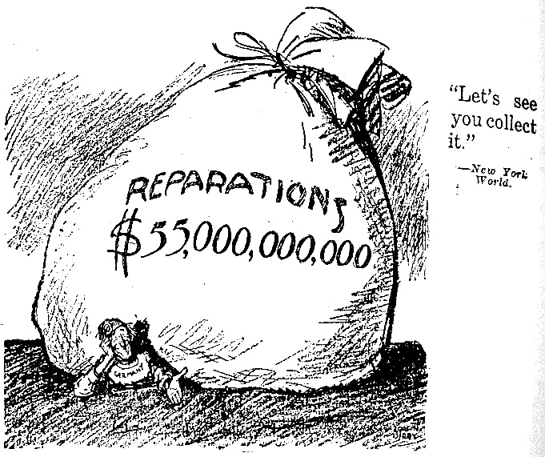

Slide 19
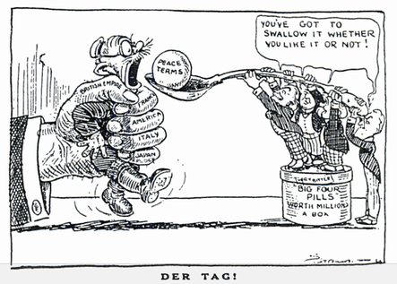

Slide 22
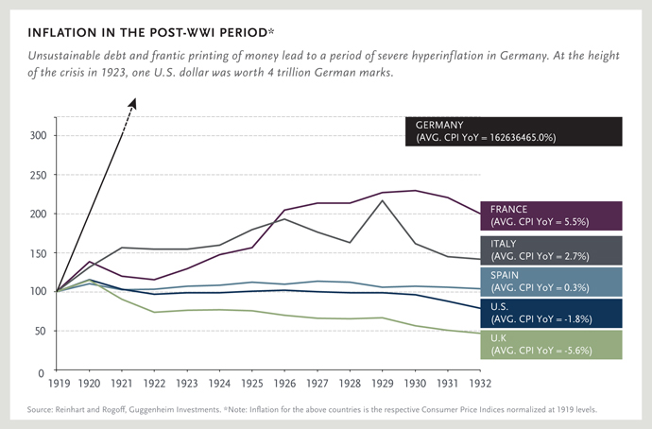

Slide 23
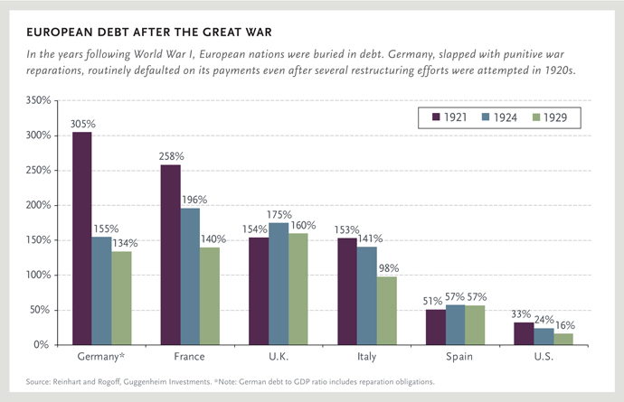

Slide 25
INTERWAR THEMES
WWI, Treaty of Versailles, DEPRESSION caused many problems in EUROPE
POLITICAL, ECONOMIC and SOCIAL PROBLEMS create TURMOIL in RUSSIA, ITALY, GERMANY
PEOPLE SEEK SIMPLE SOLUTIONS TO COMPLEX PROBLEMS → RISE OF DICTATORS
TOTALITARIAN STATES ARISE OUT OF CRISES – PEOPLE EXCHANGE FREEDOM FOR ORDER

Slide 26
INTERWAR PERIOD
The Treaty of Versailles
“A Peace Built on Quicksand”
Problem #1: The US does not agree to treaty
Problem #2: Germany is angry for taking full blame
Problem #3: Japan/Italy feel slighted
Problem #4: Europe remains in a state of crisis (no balance of power)

Slide 27
The Great Depression (1929 – 1940s)
The Great Depression begins in the U.S. but spreads all over the world. The destruction of WWI and the failures of the Treaty of Versailles to restore stability are Major Causes of the Great Depression.
Depression causes many COMPLEX problems:
→ PEOPLE SEEK SIMPLE SOLUTIONS TO COMPLEX PROBLEMS → Communism, Fascism

Slide 28
Aim: What was life like in Europe between WWI and WWII?
Interwar Period in Germany

Slide 31
Major Problems in Germany
WEAK GOVERNMENT (Weimar Republic)
Rising Debt (Reparations)
Inflation
GREAT DEPRESSION SPREADS TO GERMANY
SIMPLE SOLUTIONS TO COMPLEX PROBLEMS

Slide 32
Major Problems in Germany
PEOPLE IN GERMANY LOOK FOR A SCAPEGOAT (someone to blame for their problems)
The people and Hitler blame the Weimar Government – and Jews and both become scapegoats for Germany’s problems.
Adolf Hitler and the Nazi Party rise to power by offering people SIMPLE SOLUTIONS TO COMPLEX PROBLEMS

Slide 33
INFLATION
Impacts
Cost of Living Increases
Decrease in Production
Mark is worthless ➔ hyper-inflation
Causes
Treaty of Versailles - War Reparations
Germany increased money supply ➔ currency loses value
Invasion of Ruhr 1922-1923 ➔ German industry at a standstill

Slide 34
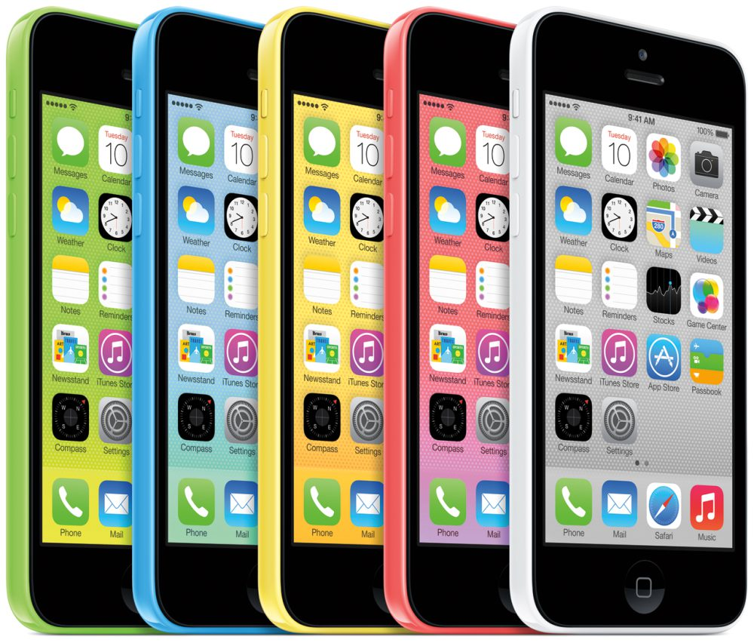
How much would this cost in a Germany experiencing hyper-inflation?

Slide 35
German Marks needed to buy a $170.00 iPhone
Jan 1919 170.00
Jan 1921 1,349.00
Jan 1923 372,477.00
Sept 1923 269,439,000.00
Oct 2, 1923 6,631,749,000.00
Oct 30, 1923 1,347,070,000,000.00
Nov 5, 1923 8,700,000,000,000.00
Nov 30, 1923 87,000,000,000,000.00

Slide 36
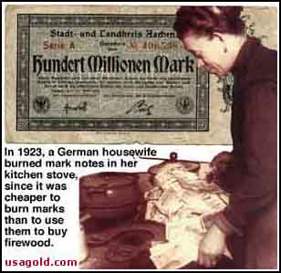

Slide 37
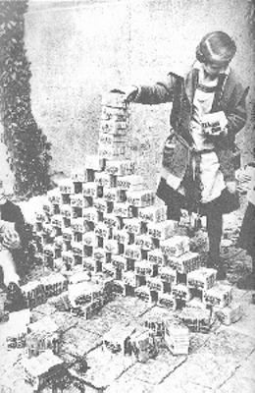
When ALL children were millionaires…

Slide 40
Aim: What Were the Conditions in Italy after WWI?

Slide 41
Major Problems in Italy After WWI
Increasing Inflation
Increasing Taxes (no Benefits from WWI)
Increasing Unemployment-Soldiers Return to NO JOBS!
Class Tension

Slide 42
Major Problems in Italy After WWI
WWI – Soldiers came home to NO JOBS with NO BENEFITS from the war for Italy.
Benito Mussolini pledged to rescue the people (meet their needs) by: SIMPLE SOLUTIONS…
1) Restore Economy
2) Rebuild Army
BLAMED Government for the Poor Conditions

Slide 43
Aim: What is Totalitarianism? How Did Hitler Rise to Power?

Slide 44
The Rise of Hitler
Member of the Nazi Party (Right Wing)
NAZI – National Socialist German Workers Party
Chosen Der Fuhrer – Leader of the Nazis
Nazism: Fascist policies of the Nazi party base on totalitarianism

Slide 45
The Nazi Party Goals
1. Lebensraum – More Living Space for Germany (reclaim lost land)
2. 3rd Reich – Powerful German Empire (Restore the greatness of the German Empire)
3. Single Unified German Race (No Jews)

Slide 46
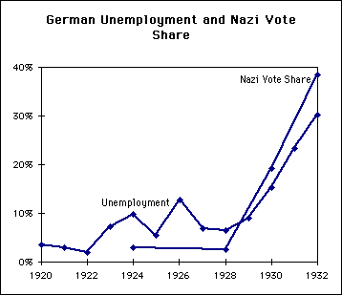
Misery loves company…

Slide 47
Aim: How Did Mussolini Rise to Power?

Slide 48
Mussolini Gains Control
Founded Fascist Party in 1919
Organized supporters into “Combat Squads”
March on Rome
Mussolini named PRIME MINISTER
Notes:
Black Shirts → Party Militants

Slide 49
Mussolini and the Fascist Party
The Fascist Party
Motto: “Believe, Obey, Fight”
Mussolini consolidates power and organizes supporters into “Combat Squads”
Notes:
Black Shirts → Party Militants

Slide 50
What is Fascism?
Totalitarian State
One-party dictatorship with TOTAL control
Non-Communist
Policies Glorify the State over Individual
Extreme Nationalism/Blind Devotion
Action, Violence and Discipline
Foreign Expansion – “Survival of the Fittest”
Use Terror/Fear to maintain control
Propaganda/Indoctrination

Slide 51
Totalitarianism
A government that has TOTAL control over its people
FASCISM: A political movement that promotes an extreme form of nationalism, a denial of individual rights, and a one party dictatorship.

Slide 52
Hitler Becomes Dictator
Turns Germany into a TOTALITARIAN state
Banned Strikes, Dissolved Unions
Massive Public Works (Reduce Unemployed)
Censorship/Book burning (Gestapo=Secret Police)
EXTREME PROPAGANDA
Indoctrination: Youth had to join HITLER YOUTH

Slide 56
Mein Kampf – Hitler’s Book
1) Germans (Aryans) were master race
2) Non-Aryans (Jews and Gypsies) were inferior
3) Germany was over overcrowded – Needed Lebensraum (Living Space)

Slide 57
Anti-Semitism: Hatred of Jews
Scapegoats for Germany’s trouble (1% of Pop)
Nuremberg Laws – Deprived Jews of Rights
Kristallnacht – Night of Broken Glass
“Final Solution” – Extermination of all Jews

Slide 59
“Healthy Parents have Healthy Children”

Slide 61
Tariff – Tax on Imports
Inflation – Substantial rise in the price of goods and services, leading to devalued currency.
Fascism – Totalitarian government based on aggressive nationalism
Oppression – Excessive use of power which places great strain on the population

Slide 62
Mussolini – “Il Duce”
Dictatorship Built on Terror
CENSORSHIP
Rigged Elections
Secret Police
Propaganda
State Control of the Economy
Increase Economic Growth
Production Increased
Workers Became Oppressed

Slide 67
How Were People Treated Under Mussolini?
Total Loyalty to the State
Slogans Glorified the State
“Believe, Obey, Fight”
Men
Ruthless, Selfless Warriors
Women
Pushed out of paying jobs
“Win the Battle of Motherhood”

Slide 69
“Il Duce”

Slide 70
What was the Appeal of Fascism?
Strong Stable Government
Nationalism = Pride
Democracy Wasn’t Working in Italy

Slide 71
Fascism vs. Communism
Communism
International Change
Classless Society
Fascism
National Change
Classes
Both
Blind devotion to the state
Terror used to maintain power
Rise in time of trouble

Slide 72
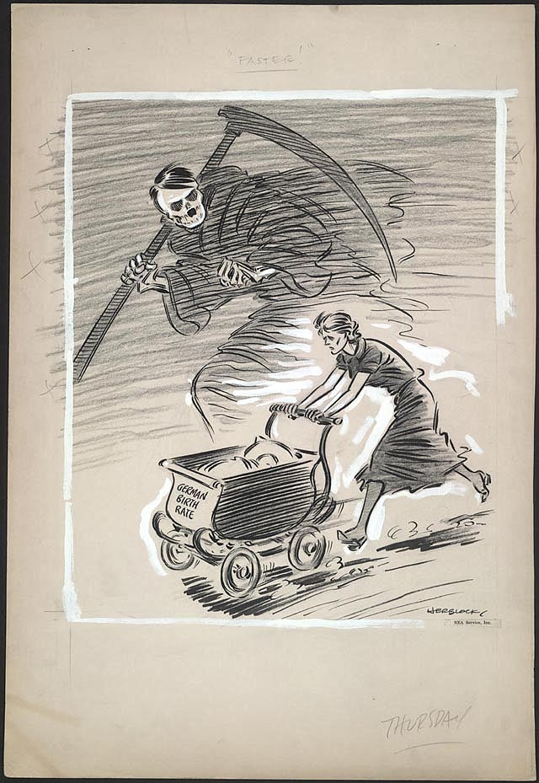

Slide 73
Inflation – Substantial rise in the price of goods and services, leading to devalued currency.
Destined – Developed as according to plan
Opposition– Resistance or dissent expressed in action
Vast– A very great extent or quantity
Condemned – Express complete disapproval of
Rearmament – Provide with a new supply of weapons.

Slide 74
Russian Revolution
Czarist Russia/Bloody Sunday: Czar fails to meet the needs of the people, kills peasants on bloody Sunday to spark revolution.
Bolshevik Revolution: Lenin leads communists to overthrow the Czarist system and establish a communist state (1917). “Peace, Land, Bread”
Communism in the Soviet Union: Lenin’s NEP (allows some capitalism), Stalin’s 5 Year plans (Industry, Collectivization, Famine-UKRAINE)
Causes: Bad Leader (Czar), no representation, GFMNP, WWI
Effects: Communism, Forced Famine in Ukraine, gets out of WWI (Brest-Litovsk)

Slide 75
The Great Depression
Stock Market Crash of 1929: Begins the great depression in US and spreads globally.
Germany currency printed: Used to pay REPARATIONS, leads to HYPERINFLATION
Overproduction: Causes prices to decline, furthers economic instability
Decline in World Trade: Depression combined with internal economic problems causes global instability.
Worldwide Economic Problems: Great depression, recovery from WW1, Reparations, decline in trade

Slide 76
The Rise of Dictators
Reasons why dictators come to power: Political, economic and social INSTABILITY
Dictators offered: Simple solutions to complex problems
Totalitarian Governments: Build power in crisis to control ALL aspects of life.
Suppress all Dissenters/Opposition: Totalitarian/Fascist leaders ELIMINATE anyone who threatens their power
Soviet Union’s government/party: Bolsheviks/Communists use a totalitarian dictatorship to rule the soviet union.

Slide 77
The Rise of Fascism/Nazism
Conditions in Germany after WWI: Weak Government (Weimar Republic), Terrible Economy, Resentment for Treaty of Versailles
Fascism: Extreme nationalist ideology that glorifies the state over the individual.
Economic Problems after WWI: Great depression, inflation, high unemployment
Fascist Rulers Offer: Simple solutions to complex problems, hope and pride for future.

Slide 78
Characteristics of Fascist Government
“State” or party more important than: Individual rights and freedoms don’t exist
EXTREME Nationalism/Racial Superiority: Unity in ethnicity and race=national power.
Promotes imperialism and extreme: Aggressive expansion
Censorship: Government regulates ALL MEDIA
Propaganda: Government advertising to support a cause
Secret Police: Used to instill fear/terror into people
Youth Groups: Indoctrination to follow fascist ideology
Rule by Terror: Fear used to control and eliminate dissent
Benito Mussolini: Italian Fascist
Fascist opinion of the Treaty of Versailles: Fascists blame treaty of Versailles for problems.

