Slide 1
Juvenile Justice

Slide 2
Juvenile Justice Vocabulary
Juvenile: A young person (as defined by law)
Parens Patriae: The power of the state to act as guardian for those who are unable to care for themselves.
Delinquent Offenders: Participation in illegal behavior by minors (juveniles, i.e. individuals younger than the statutory age of majority).
Status Offenders: A status offense is a noncriminal act that is considered a law violation only because of a youth's status as a minor.
PINS: A person in need of supervision (PINS) is a term frequently used by social services agencies in the United States to describe a juvenile who is not currently in the household of a parent or legal guardian, or is currently not under their control as evidenced by the person's status offense
Intake: The process used for every youth referred to juvenile court. Intake involves screening each youth to determine the appropriateness for release or referral to a diversionary program or agency for nonofficial or nonjudicial handling.

Slide 3
Juvenile Justice Vocabulary
ACOD: An adjournment in contemplation of dismissal allows a court to defer the disposition of a defendant's case, with the potential that the defendant's charge will be dismissed if the defendant does not engage in additional criminal conduct or other acts prohibited by the court as a condition of the ACD.
Adjudicatory Hearing: a hearing in which the purpose is making a judicial ruling. In juvenile criminal cases it is another term for a trial.
Dispositional Hearing: the sentencing stage of the juvenile proceedings, and its purpose is to provide a program of treatment, training, and rehabilitation.
Appeal: apply to a higher court for a reversal of the decision of a lower court.

Slide 4
Who is a Juvenile
Young people age 16 and under
In most states a juvenile charged with a serious felony such as robbery, assault, rape or murder can be tried as an adult
Goal of Juvenile Justice System
Goal is to help juvenile and prevent future misconduct
Less Adversarial than adult = More discretion
Statistics:
More than 2.8 million juveniles are arrested each year (up 35% over the last decade)
Younger juveniles account for a substantial portion of arrests
Female delinquency has grown 75% in the last 10 years
Overcrowding is a serious problem in juvenile facilities

Slide 5
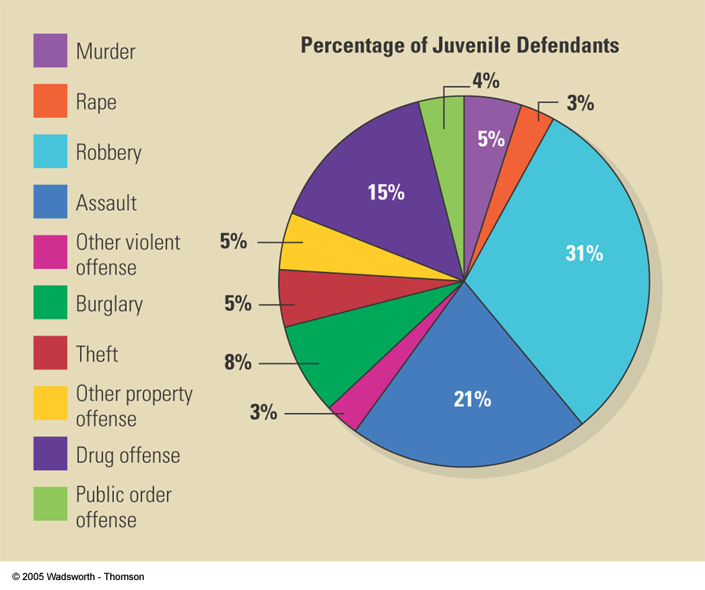
What Offenses are Committed By Juvenile Defendants

Slide 6
Age of Criminal Responsibility
New York and North Carolina are the only states that prosecutes ALL youth as adults when they turn 16 years of age

Slide 7
Scientific research suggests:
The human brain is not fully formed until 25
As the cognitive skills continue to develop through young adulthood, behavior can be impulsive and adolescents lack the ability to focus on the consequences for their behavior
Character, personality traits, and behavior of adolescents are highly receptive to change; therefore they respond well to intervention techniques and strategies to learn to make responsible choices
34% of juveniles in adult facilities get arrested later in life on felony charges, compared to those placed in juvenile facilities
Youth in adult prisons are 2x more likely to be beaten by staff and nearly 50% more likely to be attacked with a weapon than children placed in youth facilities
36x more likely to commit suicide in an adult facility

Slide 8
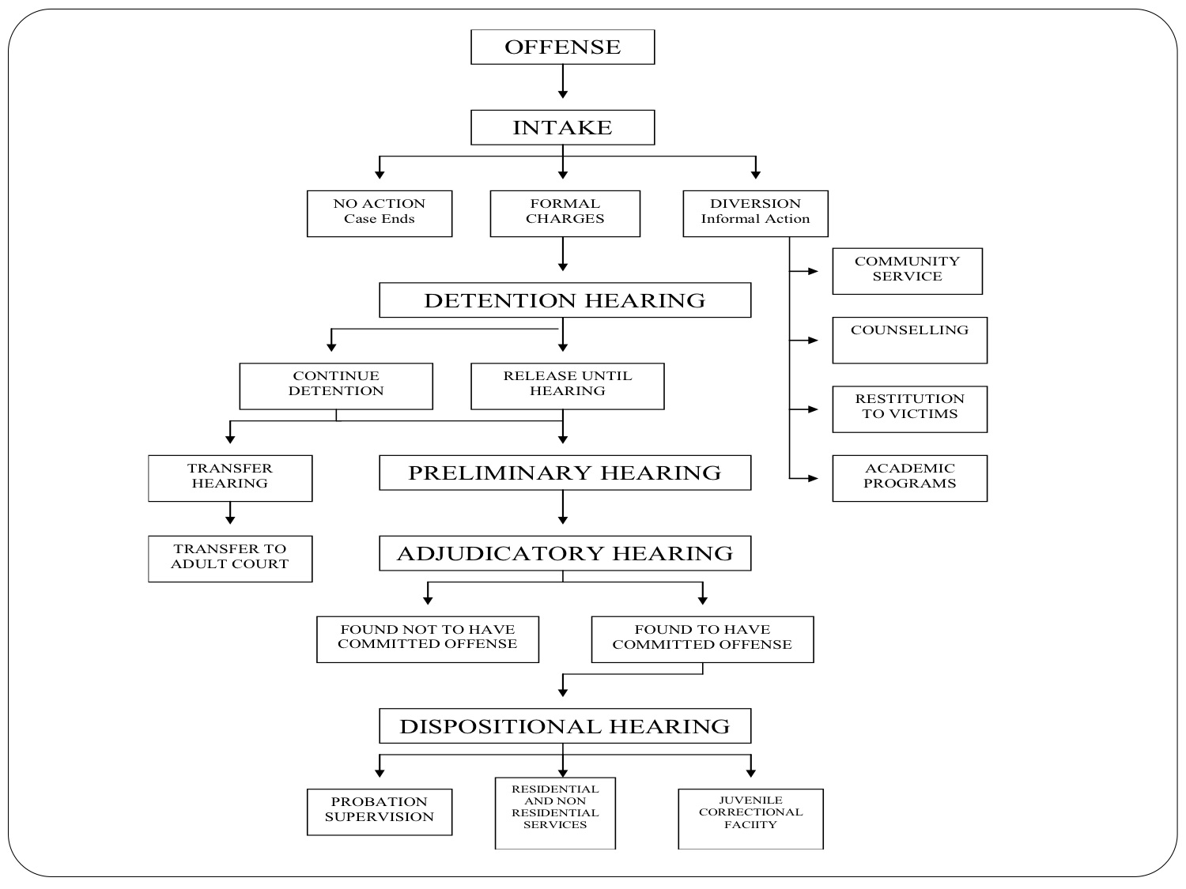

Slide 9
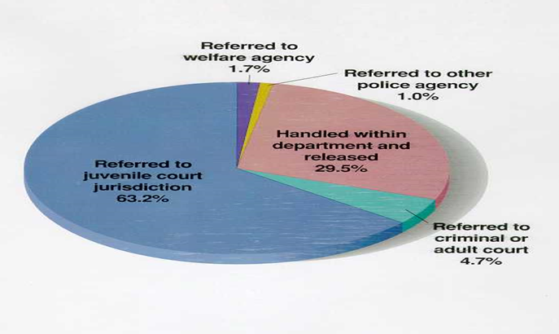

Slide 10
Juvenile Justice
In the US juveniles involved with the law are treated differently from adults
Instead of punishing young people through the adult court system a separate juvenile court was created
Parens patriae: A common law principle that allows the state to assume the role of parent to take custody of a child when he or she becomes delinquent, is abandoned, or is in need of care that the natural parents are unable or unwilling to provide
Gives more power for states to intervene on behalf of child
Allows the court to act as a parent or guardian for the child; overruling the rights of the parents
Court hearings:
closed to the public
juvenile’s identity remains private
uses different terms than those used in adult court

Slide 11
Juvenile Courts
Handle 3 Groups
Delinquent Offenders- youths who commit acts that would be crimes if committed by adults
Status Offenders- youths who commit acts that would not be crimes by adults
Status offenders are considered unruly or beyond the control of their parents or legal guardians; they are Persons or children In Need of Supervision (PINS)
Neglected or Abused Children - are seeking the courts protection from parent or guardian
Neglect case occurs when parents or guardians are charged with failing to provide adequate food, clothing, or shelter

Slide 12
Ways Juveniles Enter the System
Juvenile Service Section of the SCPD
J.D. petition - a youth under 16 who has committed an act which if committed by an adult would be a crime
P.I.N.S. petition - a youth under 16 who is found to be a habitual truant, incorrigible or out of lawful control
Parents, School Officials and Community
Allegations that a youth under the age of 16 is a P.I.N.S. are usually initiated either by the parents in Instances of runaway behavior or keeping late hours, and by school officials in instances of truancy
Voluntary Walk-in (rare)
Some youths will present themselves at Intake on a voluntary basis to ask for assistance
There is individual and group counseling for these youths

Slide 13
Intake
After a juvenile is taken into custody, the police have broad authority to release or detain the juvenile
Minor offenses could be handled with a warning, released to parents, or referred to social service agency
Serious offenders or young persons with priors are most likely detained and referred to juvenile court
Intake: the informal process by which court officials or social workers decide if a complaint against a juvenile should be referred to juvenile court
Factors considered:
Seriousness of offense
Past record of accused
Family situation
Estimate is 1/3 of all complaints are disposed during the intake process by dismissal, diversion( receive educational services and treatment) or transfer to adult criminal justice system

Slide 14
Initial Hearing
Young people who are taken into custody and formally referred to juvenile court are entitled to an initial hearing
State must prove TWO things:
Offense was committed
There is reasonable cause to believe the accused committed it
Three outcomes:
Dismissed: not proven
Detained: Held in juvenile facility
Diverted: (educational programs and community service/restitution)
If the state detains the juvenile, an attorney will be provided if needed (Same for adult criminal justice system)

Slide 15
Adjudicatory Hearing
Juvenile charged with a delinquent act is given a hearing (Adjudicatory Hearing)
Trial
Purpose:
Determine the facts of the case
Unlike an adult trial the hearing is closed off to the public
If the judge finds the juvenile nondelinquent (not guilty) he or she is free to go
Represented by an attorney
Must prove case beyond a reasonable doubt
Cross –examination
Judge to determine if the facts, as outlined in the petition, are true

Slide 16
Dispositional Hearing
At the hearing the judge decides what sentence or disposition the juvenile offender should receive
The judges decision is based on a report prepared by the probation department
4 alternative dispositions for a juvenile who is in need of supervision:
A. Suspended Judgment - all action is suspended and the juvenile is taken out of the system (very rare)
B. Probation - juvenile is assigned to a probation officer (most common)
P.I.N.S. - are placed on probation usually for 1 year
J.D. - are placed on probation usually for 2 years
C. Placement in a Private Residential Treatment Center - family counseling, foster homes, child and alcohol abuse treatment centers, half-way houses
D. Placement in State Training School - only used as a last resort or in most severe cases, formally called a reform school

Slide 17
Juvenile Investigation
The probation dept. investigates:
Legal
Social
Medical history
Arrests
Family history
Education
Psychiatric and psychological reports
Employment and financial records
Primary purpose is to assist the court in determining what should be done for them

Slide 18
Juvenile Trials
Require: Do not require:
Due process
Fair notice of charges
Legal representation
Confrontation of witnesses
Proof beyond a reasonable doubt
Trial by jury is not a constitutional right

Slide 19
Adult vs. Juvenile
Adult Law Terms | Juvenile Law Terms
Crime | Offense
Arrest | Take into Custody
File Charges | Petition
Not Guilty Plea | Denial
Guilty Plea | Admission
Trial | Adjudicatory Hearing
Found Guilty | Found Delinquent
Sentencing | Disposition
Jail | Detention
Parole | Aftercare

Slide 20
In Re Gault (1967)
In re Gault (1967)-The Prank CallCase brought to the Supreme Court under the 14th Amendment-Due Process (right to fair trial)
Supreme Court decided that four of Gerry Gault’s constitutional rights were violated
Right to notification of charges against them-6th
Right to an attorney-6th
Right to confront and cross examine witness-6th
Right to remain silent-privilege against self-incrimination-5th
Four rights were specifically given to youth charged with juvenile delinquent acts:
Right to notification of charges against them
Right to an attorney
Right to confront and cross examine witness
Right to remain silent

Slide 21
New Jersey v. T.L.O. (1985)
NOTES:
School has a duty to provide a safe school environment.
“Reasonable Suspicion” since student was caught smoking
Other items were in “plain view” (exception to 4th amendment)
4th Amendment Case-Illegal search and seizure
(The smoking cigarettes/bag search case)
Court Found With the State of N.J. and School

Slide 22
In re Winship (1970)
NOTES: The Court ruled that the due process clause required that juvenile proceedings provide proof beyond a reasonable doubt in order to classify juveniles as delinquent in juvenile court proceedings
In re Winship, twelve-year-old Samuel Winship was charged with delinquency for allegedly entering a locker and stealing $112 from a woman’s pocketbook, a crime that would constitute larceny if committed by an adult. The family court judge acknowledged that the proof against the boy might not establish guilt beyond a reasonable doubt but, as permitted by state statute, adjudicated him delinquent by a preponderance of the evidence. The court committed Winship to a training school for eighteen months, with annual extensions possible until his eighteenth birthday six years later
The Supreme Court reversed. Winship first held that Fourteenth Amendment due process protects criminal defendants against conviction except on proof beyond a reasonable doubt of every fact necessary to constitute the crime charged. The Court then held that due process also requires application of the standard of proof beyond a reasonable doubt in the adjudicatory stage of delinquency proceedings. ‘‘The same considerations that demand extreme caution in fact finding to protect the innocent adult apply as well to the innocent child.’’

Slide 23
Schall v. Martin (1984)
NOTES: The Court reaffirmed the parens patriae rationale for the juvenile court differences and held that juveniles may be detained before trial if they are deemed a “risk” to the community
In Schall v. Martin, the U.S. Supreme Court upheld a New York statute allowing pretrial detention of juveniles presenting a ‘‘serious risk’’ that they may commit another crime before trial. Martin, a fourteen- year-old boy charged with robbery, assault, and weapons possession, was held pending trial because the court believed he might commit additional offenses in the interim. In essence, the court assumed that Martin was probably guilty
Martin argued the law violated the U.S. Constitution’s due process clause, because it authorized punishment without trial. He also noted that most children subject to preventive detention either had their charges dismissed or were released immediately on being found guilty
The Court rejected Martin’s claims, holding that preventive detention was not punishment. It held that such detentions were an appropriate component of a flexible juvenile justice policy. The Court stressed that states had wide latitude to craft policies protecting such children from themselves
The decision was notable because it was the first time that the Court explicitly authorized ‘‘preventive detention’’—the policy of denying a criminal defendant bail for the purpose of preventing future crime, rather than ensuring his or her presence in court. Although the decision itself was not radical—child detention was widely seen as appropriate in cases of poor parental supervision

Slide 24
Roper vs. Simmons (2005)
NOTES: The Court ruled that standards of decency have evolved so that executing minors is "cruel and unusual punishment" prohibited by the Eighth Amendment.
Decision: 5 votes for Simmons, 4 vote(s) against
Legal provision: Amendment 8: Cruel and Unusual Punishment
In a 5-4 opinion the
Finally the Court pointed to "overwhelming" international opinion against the juvenile death penalty.

Slide 25
Miller v. Alabama (2012)
Notes: Mandatory sentences of life without the possibility of parole are unconstitutional for juvenile offenders
The ruling extended beyond the Graham v. Florida (2010) case, which had ruled juvenile life without parole sentences unconstitutional for crimes excluding murder
The Supreme Court has agreed to hear Montgomery v. Louisiana, which will clarify whether Miller v. Alabama must be applied retroactively. The petitioner, Henry Montgomery, has been in prison since 1963 for a murder he committed at the age of 17

