Slide 1
Arrest To Trial

Slide 2
Steps leading to trial
5 stages or steps of the C.J.S
arrest
arraignment
conference
trial
sentencing

Slide 3
http://www.youtube.com/watch?v=iYqpoylpk-o

Slide 5
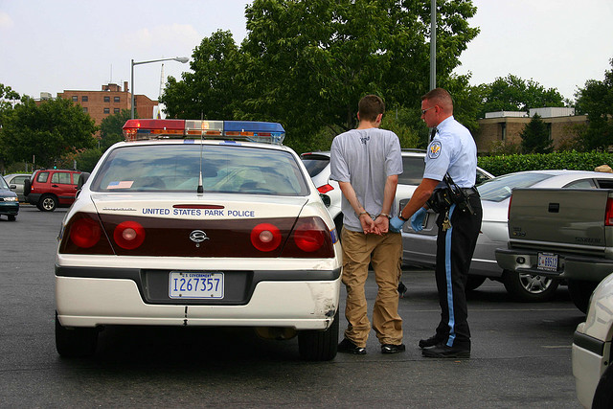
The Arrest
Initiated by Law Enforcement Agent
Probable Cause is necessary to make a legal lawful arrest
Probable cause is more than suspicion but less than certainty
Police may obtain an arrest warrant from a judge.

Slide 6
Arrest
http://www.youtube.com/watch?v=IEoPrCdc4WI&list=PLZ57LlpvGX0bWos7Pop-4hX2eDlZ5N5Rf

Slide 7
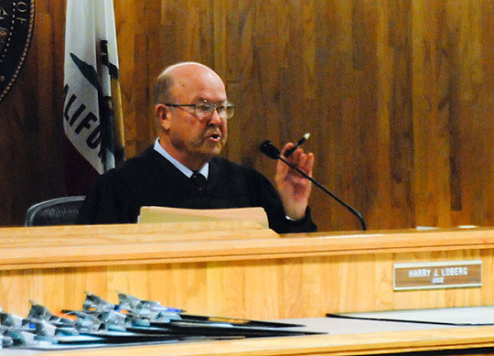
Arraignment appearance of the accused before a judge, at which time the charge(s) are read
Arraignment must take place with reasonable speed (most states within 24-72 hours)
Writ of Habeas Corpus
an order from a judge obtained by the prisoner’s attorney requiring the police to bring the prisoner before that judge, protects against being held unjustly
Plea is entered by the prisoner: GUILTY, NOT GUILTY or NOT GUILTY BY REASON OF INSANITY
guilty - sentencing date is set
pre-sentencing investigation begins
not guilty - bail or R.O.R. is considered
trial date is set
not guilty by reason of insanity
psychiatric testing to determine whether the person is insane

Slide 8
Arraignment
Bail: amount of bail (money) is set by judge and determined by circumstances and type of crime. If the accused can meet bail, he/she will be released pending date of trial. Money is fully returned when accused returns to court on the specified date
https://www.cnn.com/2018/08/28/us/bail-california-bill/index.html
R.O.R. - (Release on Own Recognizance): defendant released prior to the trial on the condition that he return to court whenever required to do so and that he obey any and all instructions of the court
When a defendant is charged with offenses which are not felonies, court must order recognizance or bail. A court may not order recognizance or bail under these circumstances:
defendant convicted of a Class A Felony
defendant is charged with a Class A Felony
it appears defendant has 2 previous felony convictions
Remand: court orders a defendant confined to jail prior to the start of his trial

Slide 9
Arraignment: https://www.youtube.com/watch?v=59GzSxW1eGM&list=PLZ57LlpvGX0bWos7Pop-4hX2eDlZ5N5Rf&index=4
Vera Institute of Justice
(1961) to reform justice system in the area of bail. Not meeting bail and being sent to jail to await trial is unfair and against the 8th amendment
O.R. Program
is an investigative process; accused is asked questions pertaining to his ties to community, family, friends and work

Slide 10
Preliminary Arraignment
http://www.youtube.com/watch?v=iPZ6Hl4m3a8&list=PLZ57LlpvGX0bWos7Pop-4hX2eDlZ5N5Rf&index=2

Slide 11
Preliminary Hearing
Preliminary Hearing
if charges indicate a serious misdemeanor or a felony, the accused may ask for a preliminary hearing
State will have to show that there is sufficient grounds to believe that the accused did in fact commit the crime charged (cannot decide whether or not the accused is guilty)
If no sufficient grounds for a trial, charges are dismissed (defendant is freed and bail is cancelled).
If the charge is a felony, whether or not there has been a preliminary hearing following arraignment, the entire matter is sent to the Grand Jury
Purpose of the Preliminary Hearing
determine if there is sufficient evidence to warrant submitting the case to Grand Jury
Rights of the Accused at Preliminary Hearing
right to counsel
right to confront witnesses
challenge evidence against him
present witnesses and evidence in own behalf

Slide 12
Grand Jury
A Grand Jury is comprised of 12-23 people.
The purpose of a Grand Jury is to decide if there is enough evidence to determine that a felony has been committed, that the accused committed this act and there is grounds for prosecution
If at least 12 jurors believe that there is sufficient evidence for a trial, then a True Bill is returned
If it is determined that the charges are to be totally dropped a No Bill is returned
If evidence needed for a felony charge is inadequate, but sufficient for a misdemeanor, charge will be reduced and sent to criminal court on information as a misdemeanor
Grand Jury witnesses can only refuse to answer questions that violate the 5th amendment. An indictment (support of the prosecution’s case) is not considered a conviction
After hearing and examining evidence a Grand Jury may:
indict a person of an offense
reduce charge to a non-felony
dismiss charges
submit a Grand Jury report

Slide 13
The Conference Stage
Plea Bargaining: reduction of the charge is accepting a guilty plea for a lesser charge and sentence
Rationale for Plea Bargaining
1. It Saves Time - no need for Grand Jury or Supreme Court actions
2. It Saves People Money – Courts and trials can be costly
3. It Saves the State Money - There is a high cost for incarceration
4. It Saves Space – There are a lack of facilities to detain and maintain both the accused and criminals
5. It Saves Weak Cases – The defense or prosecution can seek Plea Bargains if they feel their case is weak due to a lack of evidence or credible witnesses.

Slide 14
The Trial
6th Amendment: In all criminal prosecutions, the accused shall enjoy the right to a speedy and public trial, by an impartial jury of the State and district wherein the crime shall have been committed, which district shall have been previously ascertained by law, and to be informed of the nature and cause of the accusation; to be confronted with the witnesses against him; to have compulsory process for obtaining witnesses in his favor, and to have the Assistance of Counsel for his defense.

Slide 15
The Trial – THE JURY
What are the eligibility requirements for Jury Duty:
A) A Citizen of U.S.
B) At least 18 years old.
C) a resident of county you serve in
D) be able to communicate in English
E) not convicted of a felony
*Sound mind and judgment, good character, approved integrity
How are potential jurors selected?:
A) lists of registered voters
B) Motor Vehicle lists
C) State income tax filers
D) recipients of unemployment insurance or welfare
E) Volunteers
How often are your called for Jury Duty? - every 6 yrs., 8 yrs. if serve for more than 10 days

Slide 16
The Trial – The JURY
Impaneling: The Process by which jurors are selected and sworn in
Voire Dire: The questioning of potential jurors by the attorneys to determine if they should serve.
Lawyers have the right not to impanel a specific juror, there are 2 kinds of challenges that may be used:
1) Challenge for Cause - based on bias or prejudice in which a juror would be unable to reach a fair verdict
2) Peremptory Challenge - rejection by either attorney without having to give a reason; number is fixed at the start of questioning

Slide 17
The Trial – The Jury
Special Circumstances
Sequestered Jury- isolation of jury to prevent tainting or persuasion by media reports (high profile cases)
Change of Venue- location of trial moved to find impartial jury

Slide 18
The Trial – Legal Aid
Legal Aid
society founded in 1876 helping those who were too poor to afford a lawyer or had a language barrier
3 divisions of Legal Aid
Civil Division
Criminal Division
Juvenile Rights
Financial Eligibility for Legal Aid
is based on gross annual income and number of dependents in the household

Slide 19
The Trial – People to Know
Courtroom Participants
Judge- ensures rules and rights are respected
Prosecutor- conduct criminal proceeding for the State
Defense Counsel- defends the accused
Bailiff- officer that keeps order in the court
Stenographer- keeps records of the courtroom proceeding
Court Clerk- organizes records and files of the courtroom proceedings
Lay witness- common person that may have evidence to a crime
Expert witness- professionals that can give opinions in their area of expertise.

Slide 20
Courtroom Procedures
Trial Opening Statements: give the jury an overview of what they are about to hear.

Slide 21
Objections
Objections: During trial, each party may call witnesses to testify on its behalf. Each party, through its attorney, poses questions to the witness, who then answers. During testimony, any attorney may object. An objection is a request that the judge disallows a question, limit the testimony, or instruct a witness to give a complete answer to a question.
An objection—if made correctly—is made immediately after the question is asked and before the witness answers. Occasionally, objections are made to a witness’ testimony as well.
Generally, in the course of trial, the judge rules on the objection by either sustaining or overrule/denying it.
Sustained: Judge agrees with the attorney’s objection and disallows the question.
Overruled: Judge does not recognize the objection and valid and the examination can continue.

Slide 22
Objections
Objections to the FORM of the Question:
Form: Leading, Asked and Answered, Speculation, Argumentative, Badgering, Confusing
Objections to the SUBSTANCE of the Question
Substance: Lacks foundation, Assumes Facts, Irrelevant, Hearsay

Slide 23
Direct Examination- lawyer initially questions own witness
Cross-examination- questioning of witness by opposing lawyer
Re-direct examination-lawyer questions own witness again (damage control)
Re-cross examination-opposing lawyer responds to re-direct exam.
Subpoena- official document summoning a witness to testify.
Deliberations- jury’s discussion of innocence or guilt
Verdict- jury’s final decision
Mistrial or “Hung Jury”- one that can’t agree; mistrial declared!

Slide 25
When in use
Types of cases heard
Number required for decision
Constitutional Amendment that guarantees it
Can defendant waive right to it?
Type of Jury
Grand Jury
Regular Jury (Petit)
Decided if accused is indicted- sent to trial
Decided the verdict- innocence or guilt of accused
Function
Number of people
16-23
12
Before a trial
During a trial
Felonies & Federal crimes
All crimes & civil suits
2/3 majority
unanimous
5th Amendment
6th Amendment
Yes
Yes, bench trial instead; judge decides

