Slide 1
Western Europe in the middle ages

Slide 2
Western Europe Timeline
476 – 800 Dark Age | 800 - 1204 Middle Age | 1204 - 1450 High Middle Age
Fall of Rome De Urbanization Learning Declines Language is Lost Constant Invasion + War Trade Ceases | Feudalism Emerges RCC Source of Unity and Stability Holy Roman Empire - Charlemagne No Trade – Economic Self Sufficiency | “Rebirth of Europe” Crusades increase interaction and diffusion New Learning/Tech Trade Re Emerges Urbanization

Slide 3
Successor States of the Roman Empire
Visigoths – Spain
Franks – France/Germany
  Clovis Converts to Christianity
  Carolingian Dynasty
  Charlemagne – Holy Roman Emperor
    No Bureaucracy
    Missi Dominici – Imperial Officials
  Gradual Centralization
Lombards – Italy
Angles and Saxons - England

Slide 4
Carolingian Decline
Louis the Pious – Lost control of powerful counts/nobles
Invasion
  Muslims
  Maygyars
  Vikings

Slide 5
The Vikings
Norse Expansion begins 800 CE
Motivated by population pressure and resistance to Christianity
Great Seafarers
Merchant Communities

Slide 6
Feudalism
Political, Social and *Economic Structure
Decentralized System of Government
Rigid Social Class Structure
  Reciprocal Relationships
  Feudal Contracts

Slide 7
KING
Lords
Knights
Peasants
Serfs
(Bound to the land)

Slide 8
The feudal manor
Manorialism
Manors are self-sufficient
Three Field System
Spring Planting
Fallow Field
(Empty)
Fall Planting

Slide 9
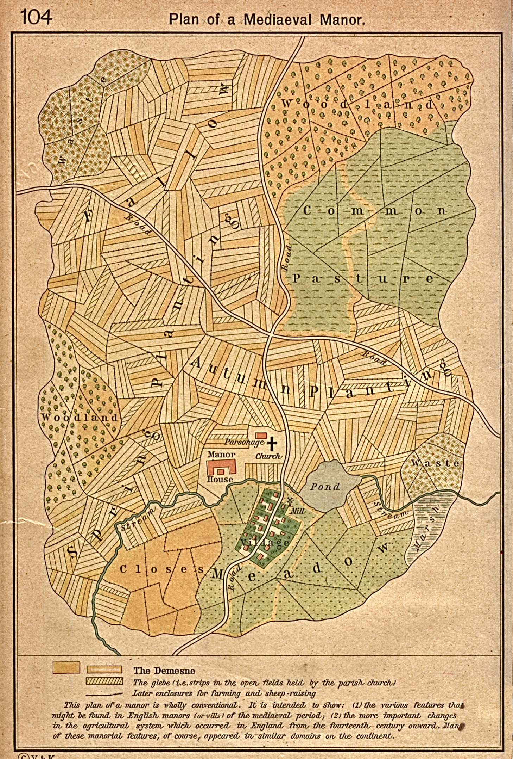

Slide 10
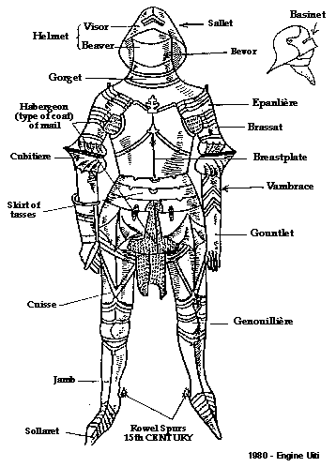

Slide 11
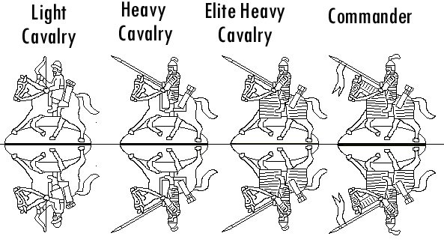

Slide 12
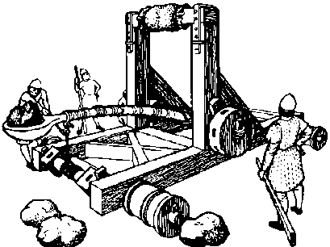

Slide 13
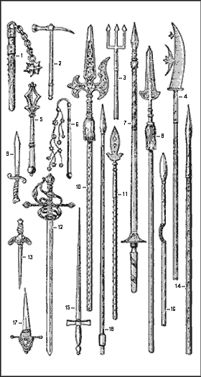

Slide 14
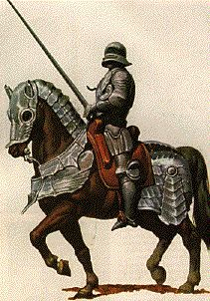

Slide 15
Christianity in Europe
Christianity replaces paganism in much of Europe (Gradual)
Church Unifies People of Europe
  Only Source of Hope (SALVATION)
  Provides Social Services
  Canon Law = Stability and Order
  Enormous Wealth (1/4 of Land) + Tithes
The Papacy
  Strong Leadership – Took over for Roman Emperors
  Pope Gregory I – Papal Primacy

Slide 16


Conflict over Power – Kings vs. pope
  Investiture – Right to appoint church officials.
  The Investiture Contest- Pope Gregory VII ends the practice of Lay Investiture
    Lay Investiture – Imperial Authorities Appoint Church Officials
King Henry IV speaks out against the Pope and is Excommunicated (kicked out of the Church).
King Henry IV is forced to beg for forgiveness – POPE WINS
Compare – ICONOCLASM
→

Slide 17
Christianity in the High middle ages
Monasticism – Monastery Movement
  Egyptian Origins – Asceticism and Reclusion
  St. Benedict – Rules for Monasticism
  Social Institutions
Popular Piety - Religion
  Devotion to Saints (Virgin Mary)
  Pilgrimages
  Relics
Church Reform (limited)
  Dominicans and Franciscans
  Heretics: Waldensians and Cathars

Slide 18
Education
Cathedral Schools → Universities
Liberal Arts Education
Aristotle – Works are translated
St. Thomas Aquinas
  Synthesize Greek Philosophy and Church Theology

Slide 19
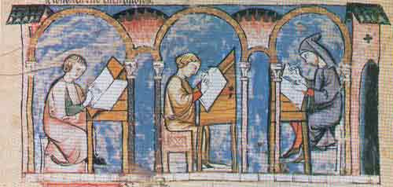

Slide 20
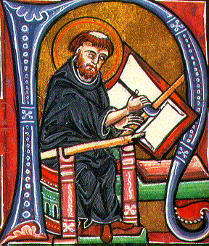

Slide 21
The High Middle Ages in Western Europe

Slide 22
Voltaire
“The Holy Roman Empire was neither Holy, nor Roman, nor an Empire”

Slide 23
Regional Monarchies
Gradual Centralization of Power
Holy Roman Empire
  Otto I – Crowned Emperor by Pope
France
  Carolingians → Capetians
England
  Normans – William the Conqueror
Italy
  Ecclesiastical City-States
Iberia
  Christian Kingdoms

Slide 24
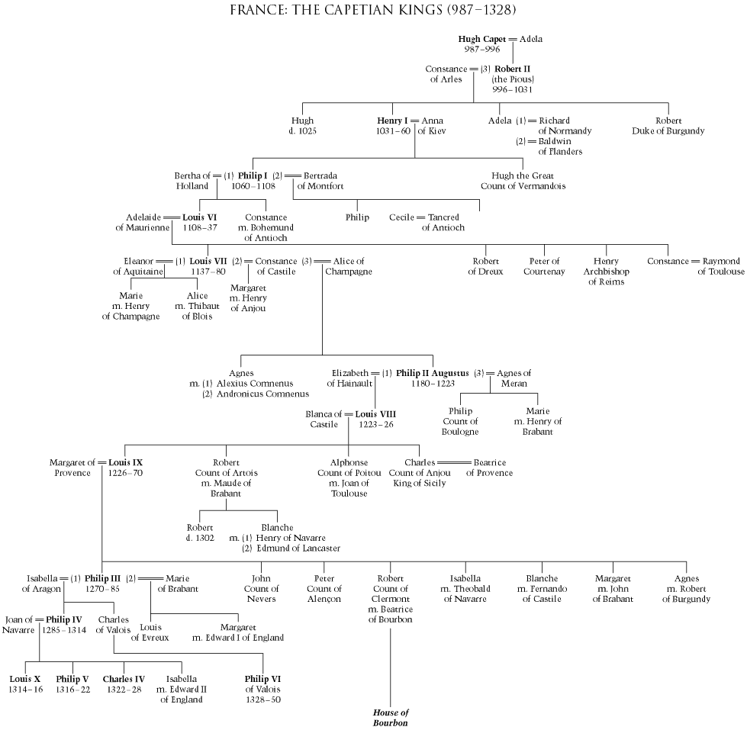

Slide 25
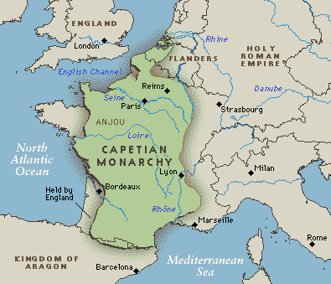

Slide 26
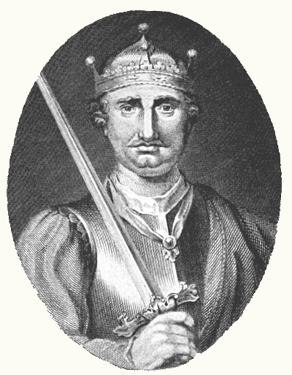
William the conqueror

Slide 27
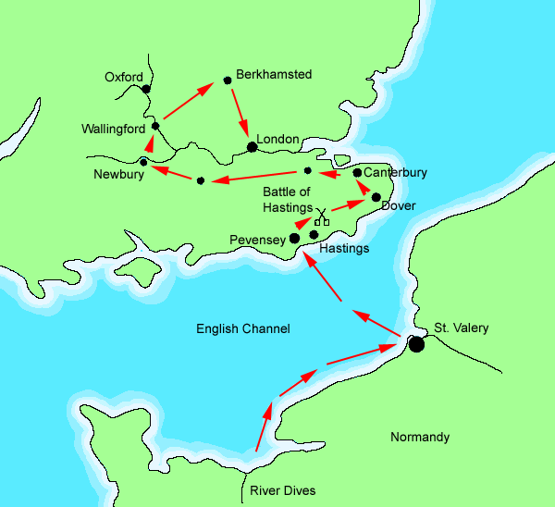

Slide 28
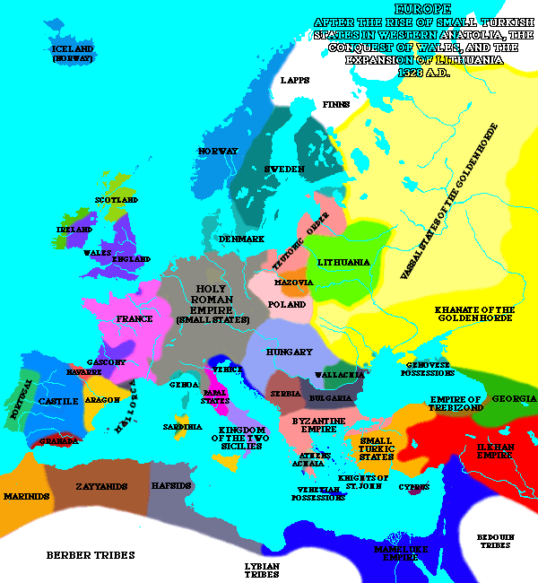

Slide 29
Agricultural Advancements
Expanded Arable Land
Improved Agricultural Techniques
New Tools and Technology
Agricultural Production ↑ - Population ↑

Slide 30
Economic activity
Urbanization
Trade
  Mediterranean
  Hanseatic League
Banking
  Credit
  Joint Stock Companies
Guilds
  Similar to Unions
  Important Socially and Economically

Slide 31
Social Structures
3 Estates
  “Those who pray, those who fight and those who work”
Social Inequality
Chivalry
  Code of Conduct
Gender Roles
  Women worked alongside men

Slide 32
European Expansion
Atlantic/Baltic Colonization
Reconquista of Spain
Crusades

Slide 33
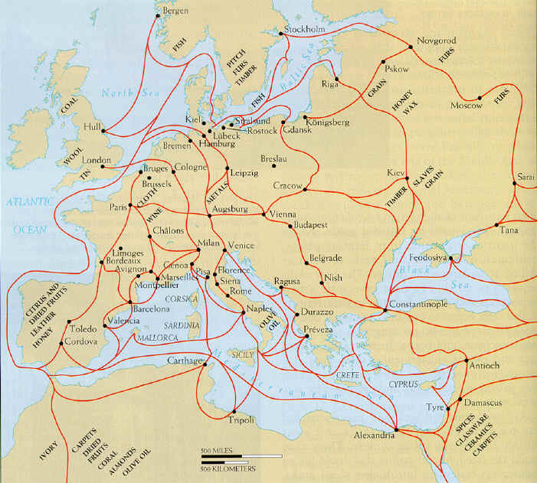

Slide 34
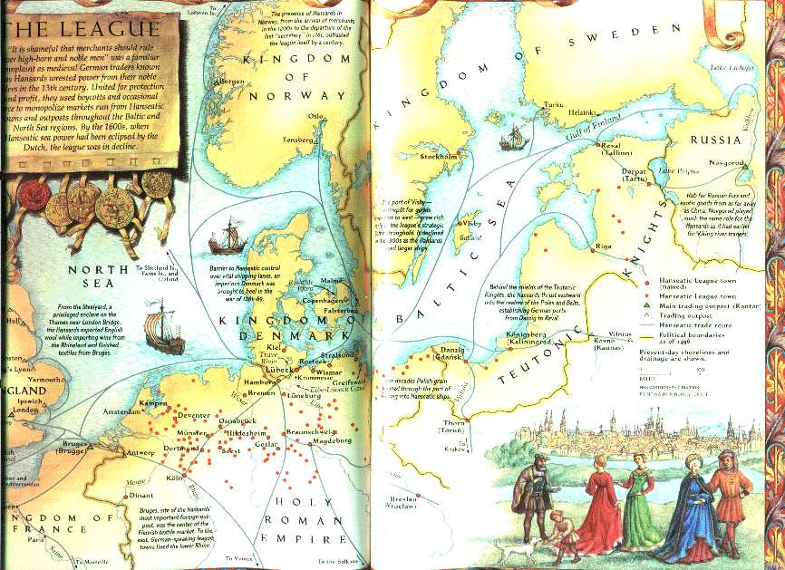

Slide 35
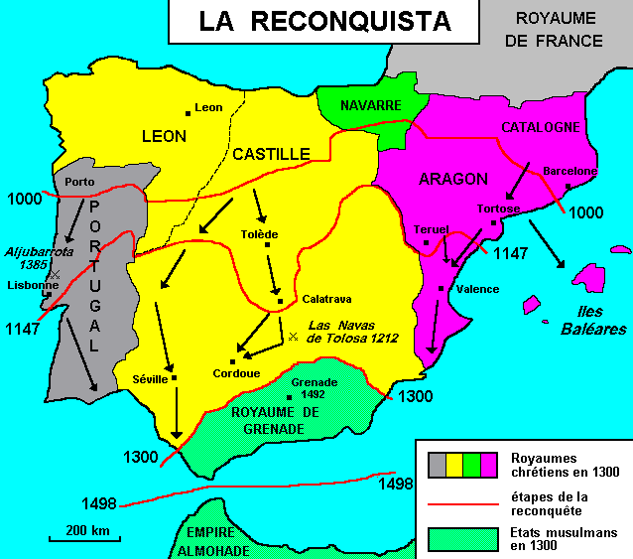

Slide 36
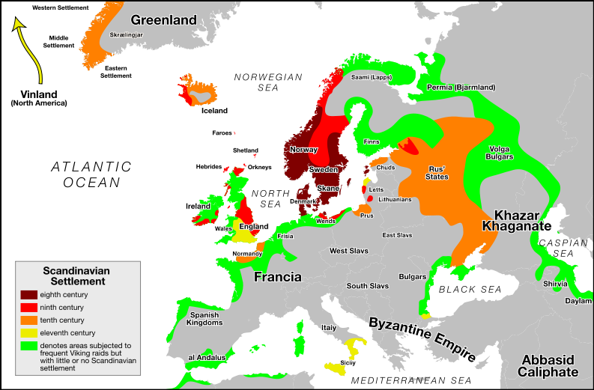

Slide 37
Pope Urban II
"The noble race of Franks must come to the aid their fellow Christians in the East. The infidel Turks are advancing into the heart of Eastern Christendom; Christians are being oppressed and attacked; churches and holy places are being defiled. Jerusalem is groaning under the Saracen yoke. The Holy Sepulchre is in Moslem hands and has been turned into a mosque. Pilgrims are harassed and even prevented from access to the Holy Land. The West must march to the defense of the East. All should go, rich and poor alike. The Franks must stop their internal wars and squabbles. Let them go instead against the infidel and fight a righteous war. God himself will lead them, for they will be doing His work. There will be absolution and remission of sins for all who die in the service of Christ. Here they are poor and miserable sinners; there they will be rich and happy. Let none hesitate; they must march next summer. God wills it!

Slide 38
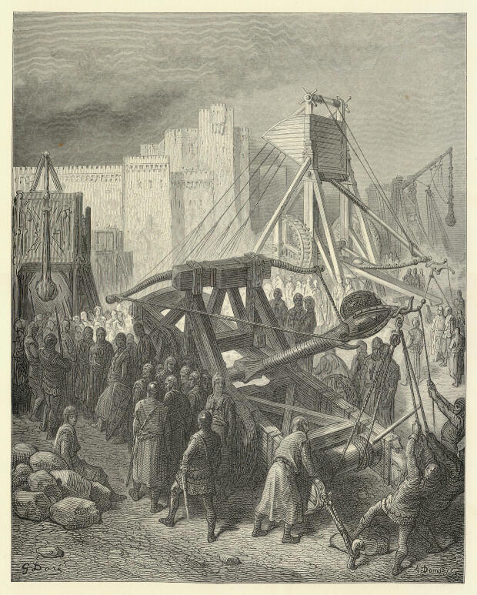

Slide 39
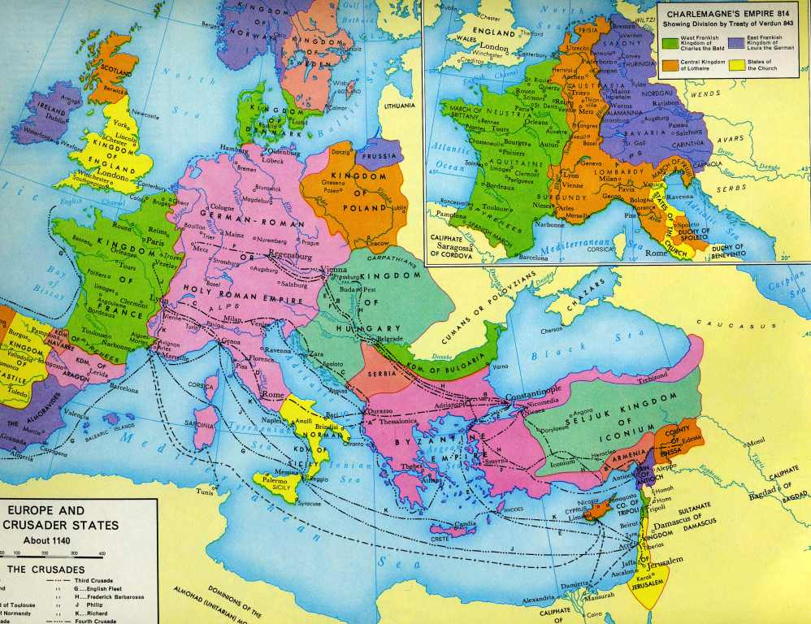

Slide 40
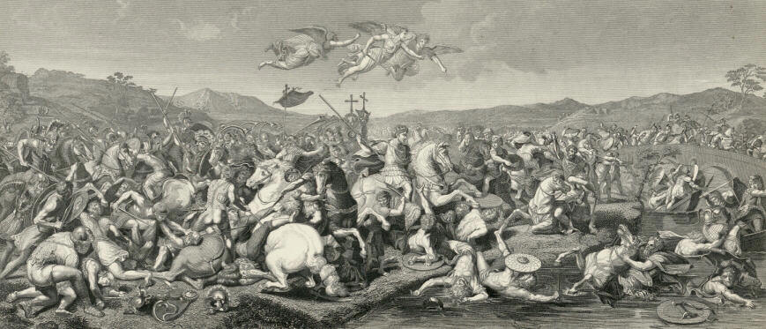

Slide 41
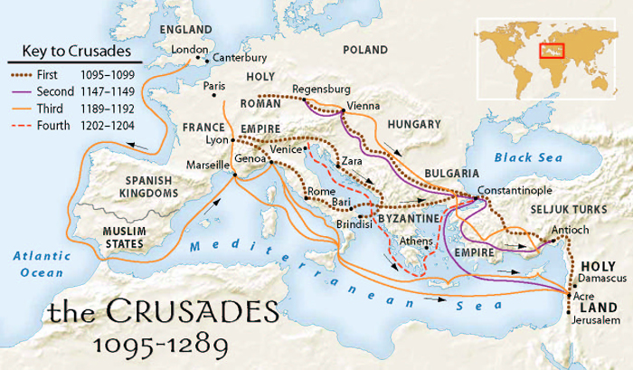

Slide 42
Requite evil with good and he who is your enemy will become your dearest friend. But none will attain this save those who endure with fortitude and are greatly favoured by Allah.
  The Quran
"Blessed be the peacemakers" (Matthew 5:9)

