Slide 1
The Empires of Persia

Slide 2
4 Ruling Dynasties
Achaemenids (558 BCE – 330 BCE)
Seleucids (323 BCE – 83 BCE)
Parthians (247 BCE – 224 CE)
Sasanids (224 CE – 651 CE)

Slide 3
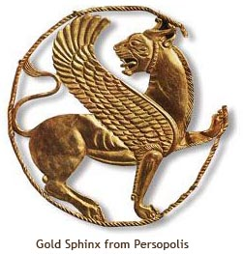
Achaemenid Art

Slide 4
Achaemenids
Cyrus
  Ruled from Pasargadae
  Conquests (Anatolia, Bactria)
Darius
  Conquest to Indus River
  Diverse Empire

Slide 5
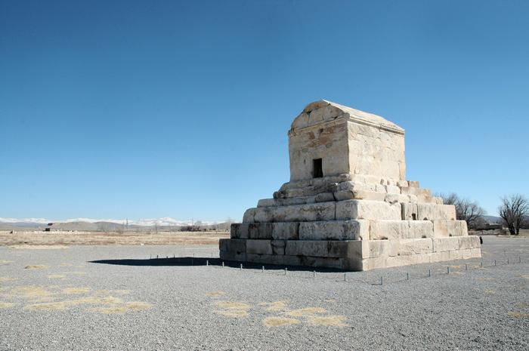
Cyrus’ Tomb

Slide 6
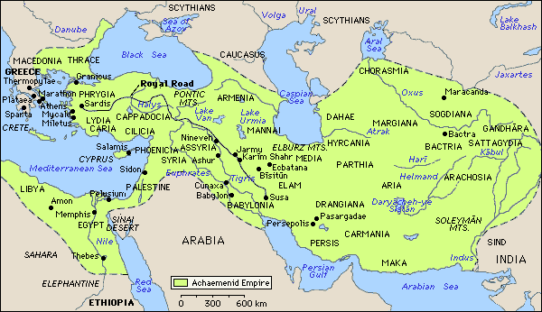
Achaemenid

Slide 7
Darius’ Administration
  Capital at Persepolis
  23 Satrapies
    Administrative/Tax Districts
    Governed by Satraps
  Standardized taxes and laws
  Roads – Persian Royal Road

Slide 8
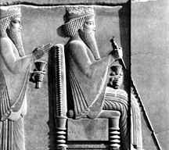
Darius

Slide 9
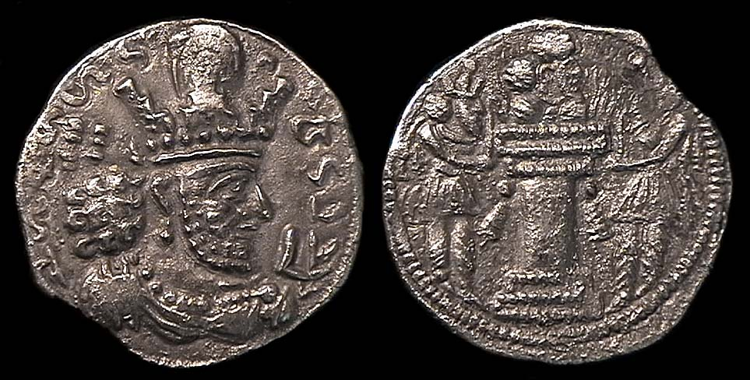
Persian Coins

Slide 10
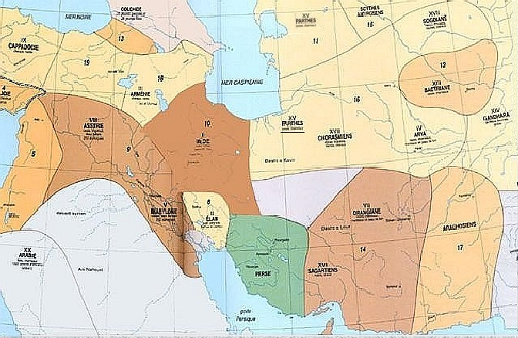
Satrapies

Slide 11
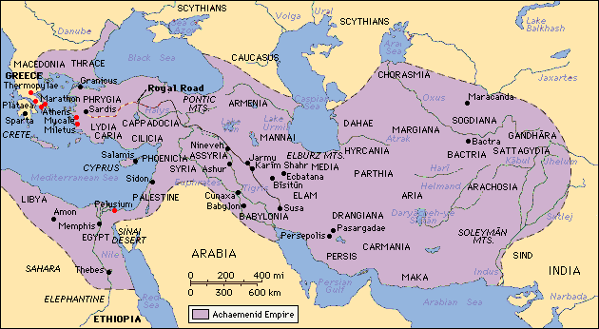
Persian Roads

Slide 12
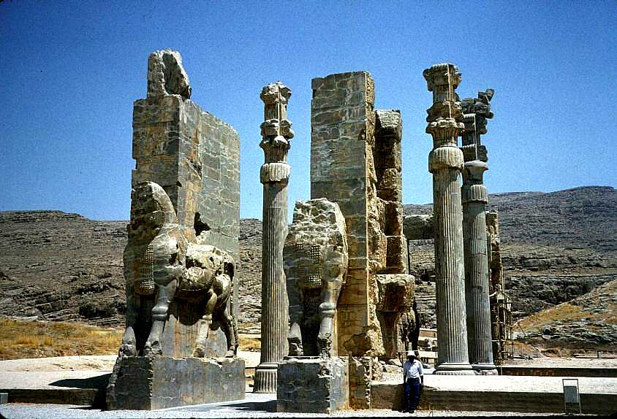
Persepolis

Slide 13
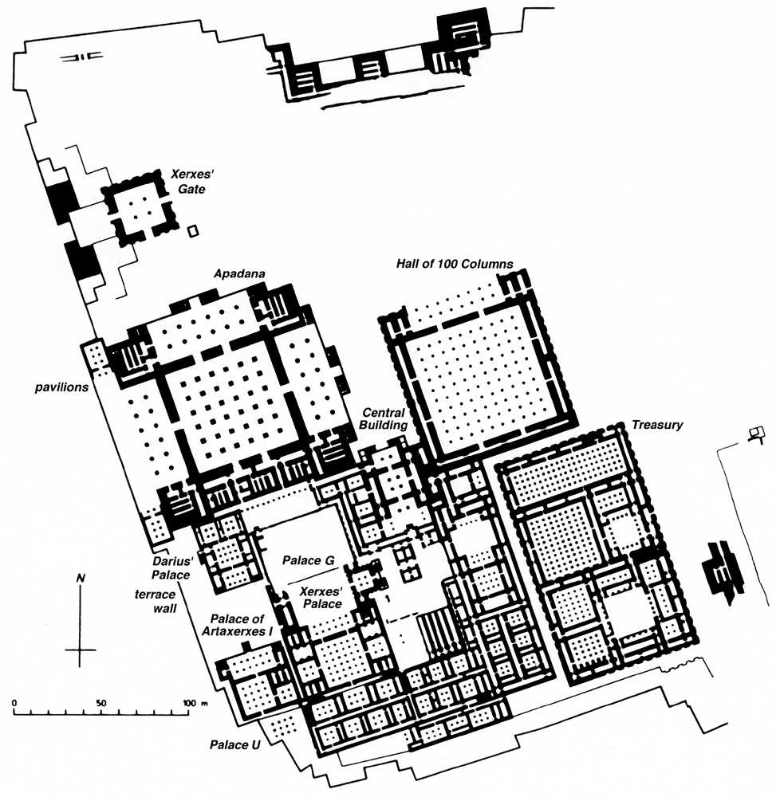
Persepolis

Slide 14
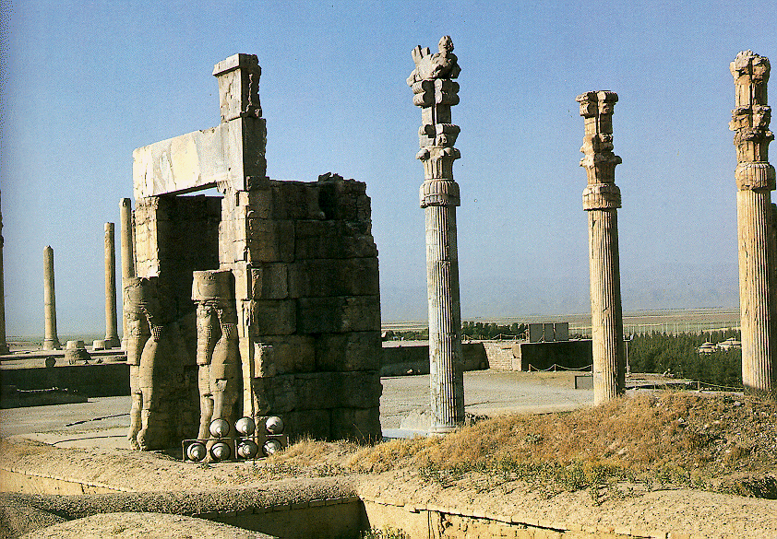
Persepolis

Slide 15
Decline of Achaemenids
Xerxes
  Not tolerant
  Greeks viewed as “tyrants”
  Fought Greeks (Ionia)
  PERSIAN WARS
    Pyrrhic Victory (Causes the fall)
  Alexander the Great!!!

Slide 16
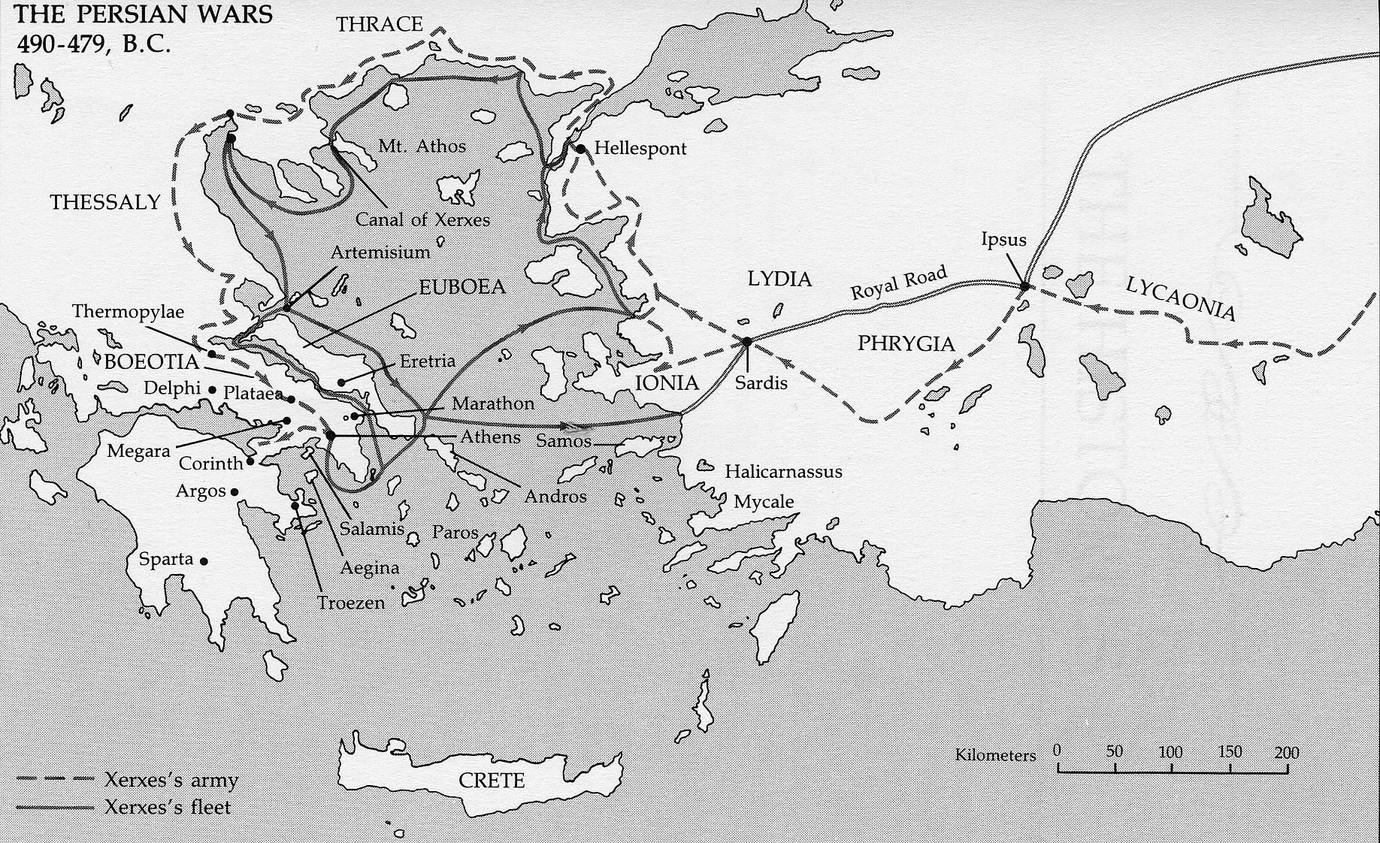
Persian War

Slide 17
Seleucids
Seleucus
  Continued Alexander’s rule
  Built cities → trade
  Satrap rebellions

Slide 18
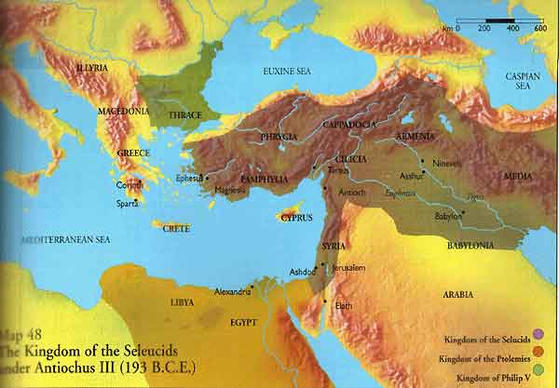
Seleucids

Slide 19
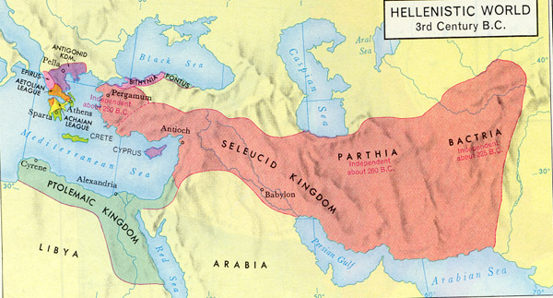
Seleucids

Slide 20
Parthians
Nomadic Traditions
  Lack of centralization
  Heavy Cavalry
Government
  Restored Persian traditions
  Capital at Ctesiphon
  Internal Rebellion

Slide 21
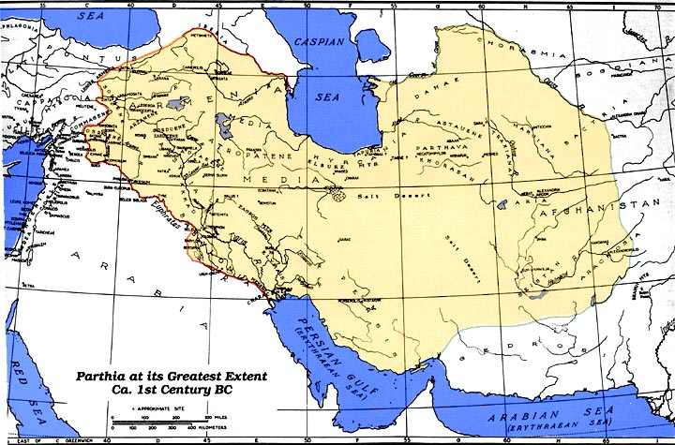
Parthian Empire

Slide 22
Sasanids
Traders
Cultivated new crops
Expanded borders

Slide 23
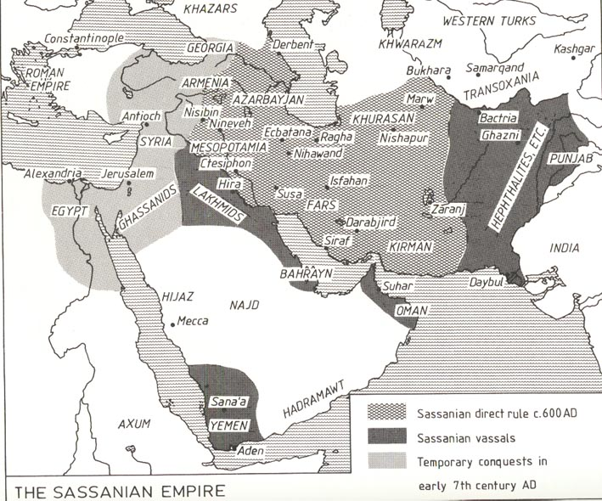
Sassanian Empire

Slide 24
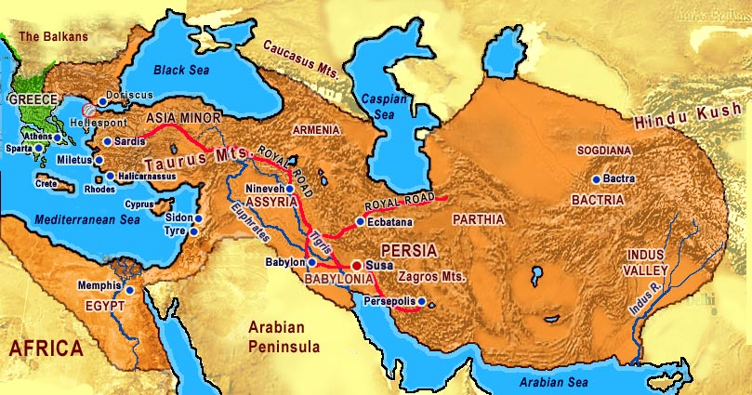
Persia Map

