Slide 1
Europeans and the “new World”
Chapter 25

Slide 2
The Spanish and Portuguese
Desire for Gold
Limited Deposits in Caribbean, Not enough labor
Caribbean focus shifted to PLANTATION AGRICULTURE
Mexico and South America (Peru)
Focus shifted from Caribbean due to large deposits of SILVER in Mexico/S. America
Portuguese in Brazil – Treaty of Tordesilas
Labor Systems
Plantation agriculture and mining required immense labor
Smallpox and harsh conditions limited available native labor
Encomienda and Mita Systems arise to provide native labor
Spanish and Portuguese saw “New World” as a land to administer and exploit, NOT TO SETTLE

Slide 3
The Spanish and Portuguese
Conquest
Spanish come into conflict with large powerful states
Hernan Cortes – Conquest Mesoamerica (Aztecs)
Francisco Pizarro – Conquest of South America (Inca)
After conquest the areas need to be administered
Spanish Administration
Viceroys and Audiencias are put in place to carry out administration
Administration is very ineffective
European Style cities develop throughout the New World
European Society in the New World
Few women travel to new world, great deal of racial mixing
Encomienda System – Rigid structure, based on birth, hierarchical
The Hacienda
HEAVY INFLUENCE OF CHRISTIANITY

Slide 4
The Spanish and Portuguese
The Portuguese in Brazil
Spanish focus was SILVER, Portuguese focus was SUGAR
The Engenho – SUGAR MILL
Requires great amounts of labor
Leads to SLAVE TRADE

Slide 5
The French, English and Dutch in North America
Permanent Colonies
The French, English and Dutch see North America as a land to SETTLE and COLONIZE
Expeditions in North America were privately funded – less royal interference, greater local autonomy
Men and women both came to settle, little racial mixing, rampant racism)
No large states, little significant resistance
North American Economy
Initially ittle interest in plantation agriculture, more Hunting and Gathering, trading
Focus on Fur Trading prior to Cash Crops
Heavy reliance on support from Europe
Plantation agriculture leads to increased demands for labor – INDENTURED LABOR

Slide 6
North american and South America
French, English, Dutch
Land to settle and colonize
Private investors
Segregated Society, little mixing
Less Church influence, protestants
Fur Trading, Cash Crops
Spanish, Portuguese
Land to exploit and administer
Royal backing
Racial Mixing, Encomienda
Heavy Roman Catholic Church influence
Silver Mining, Sugar Plantations

Slide 7
The Global Economy
European conquest and exploration extended to the Pacific Ocean
Full Global Trade
New World silver funds European purchases in Asian Markets (Silk, Tea, Porcelain, Spices)
China has a heavy demand for SILVER

Slide 8
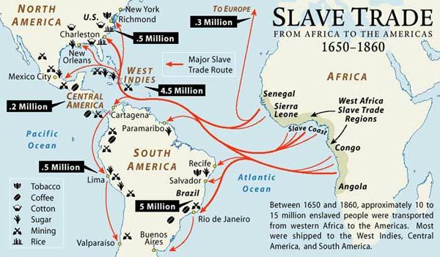

Slide 9
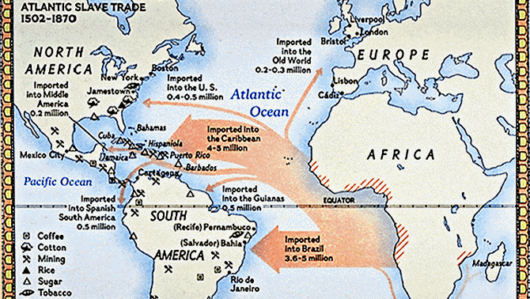

Slide 10
King Afonso I of Kongo wrote some twenty four official letters to his fellow monarchs, the Kings of Portugal. The letters touch on many themes – relations between Portugal and Kongo, Afonso’s devotion to Christianity, and the slave trade. The following exerts come from two letters of 1526, when Portuguese slave trading was causing serious disruption in Kongo, prompting Afonso to request help in controlling the activities of Portuguese merchants.

Slide 11
And we cannot reckon how great the damage [caused by Portuguese merchants] is, since the mentioned merchants are taking every day our natives, sons of the land and the sons of our noblemen and vassals and our relatives, because the thieves and men of bad conscience grab them wishing to have the things and wares of this kingdom which they are ambitious of; they grab them and get them to be sold; and so great, Sir, is the corruption and licentiousness that our country is being completely depopulated, and Your Highness should not agree with this or accept it as in your service. And to avoid it we need from [your] Kingdoms no more than some priests and a few people to teach in schools, and no other goods except wine and flour for the holy sacrament. That is why we beg of Your Highness to help and assist us in this matter, commanding your factors that they should not send here either merchants or wares because it is our will that in these Kingdoms there should not be any trade of slaves nor outlet for them. Concerning what is referred [to] above, again we beg of Your Highness to agree with it since otherwise we cannot remedy such an obvious damage …

Slide 12
Impacts of the Slave Trade

