Slide 1
Aim: What was Japan like before the Meiji Restoration?

Slide 2
I. Japanese Geography
Japan is an archipelago
chain of islands
Isolated (Like China)
Mountainous Terrain
Natural Harbors

Slide 3
Tokugawa Shogunate (1603 – 1868)
Feudalism
Society is divided into rigid classes
Japan was ruled by the Shogun
Shogun – Military leader with absolute control
Emperor had little real power
Japan has a policy of Isolationism

Slide 4
Nobody is Happy: Daimyo – Had wealth (land) but no cash Samurai – Not as wealthy as merchants Merchants – No Status Peasants – Heavy Taxes

Slide 5
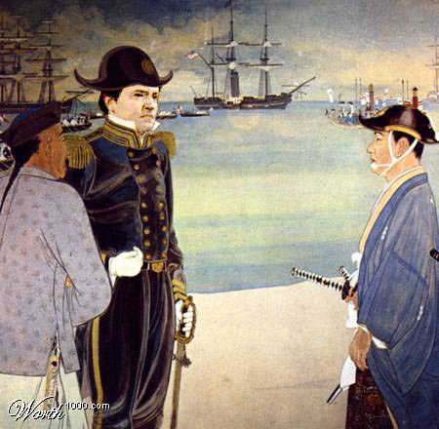
1853 – Commodore Matthew Perry “Opens Up” Japan to Western Trade!

Slide 6
Treaty of Kanagawa
Japan Opens its Doors:
Commodore Matthew Perry (US)
Treaty of Kanagawa
A Treaty between Japan and the USA (Commodore Matthew Perry)
Opened ports for trade with US
Leads to cultural diffusion (Westernization)

Slide 7
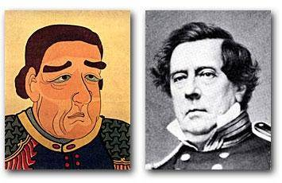
Japan Changes Direction During the Meiji Era: 1868 - 1912
Commodore Matthew Perry

Slide 8
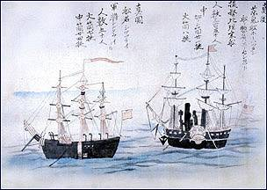
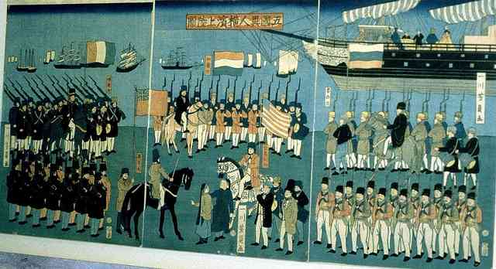
Perry’s “Black Ships”

Slide 9
Japan Learns a Lesson!
In 1862, just before the start of the Meiji period, Tokugawa sent officials and scholars to China to study the situation there. A Japanese recorded in his diary from Shanghai…
“The Chinese have become servants to the foreigners. Sovereignty may belong to China but in fact it's no more than a colony of Great Britain and France.”

Slide 10
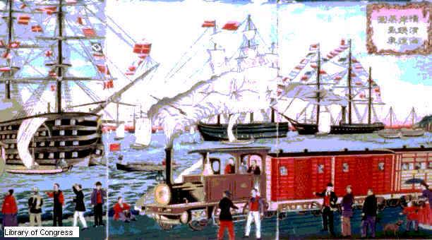
China’s “Unequal Treaties”
After the Opium War of 1839-1842, Japan was forced to Open Up to the West.

Slide 11
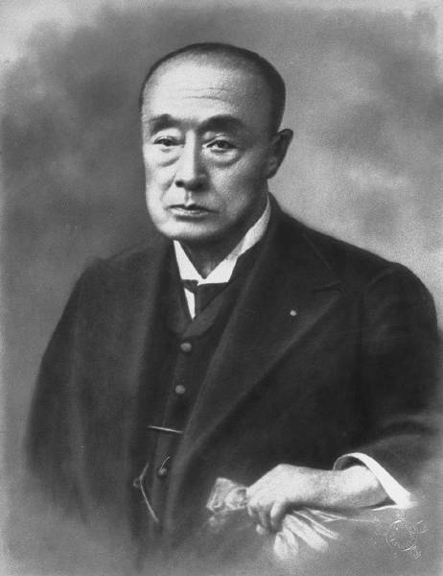
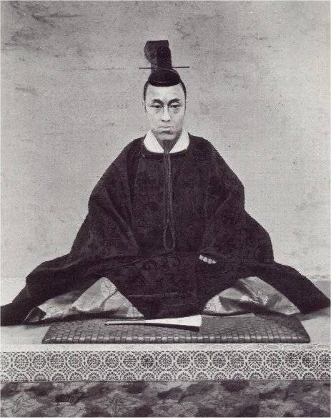
The Shogunate Is Overthrown!
The last Shogun –Tokugawa Yoshinobu.

Slide 12
The Emperor Is “Restored” to Power
MEIJI → “Enlightened Rule”

Slide 13
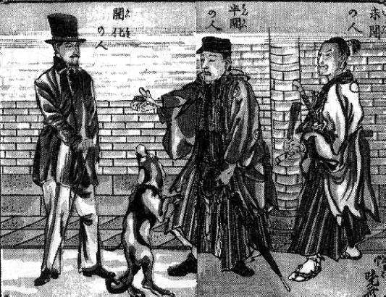
Newspaper Cartoon, 1870s?
Enlightened Half-Enlightened Un-Enlightened

Slide 14
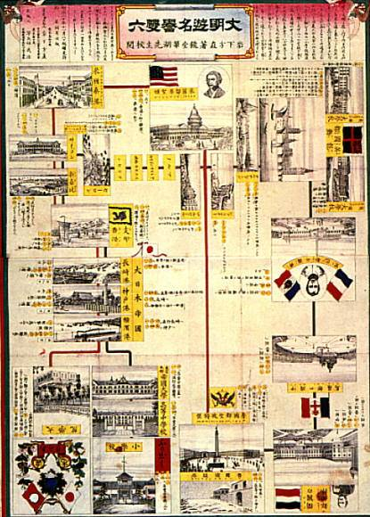
Modernization by “Selective Borrowing”
Popular board game.
Start by leaving Japan & studying in various Western capitals.
End by returning to Japan and becoming a prominent government official.

Slide 15
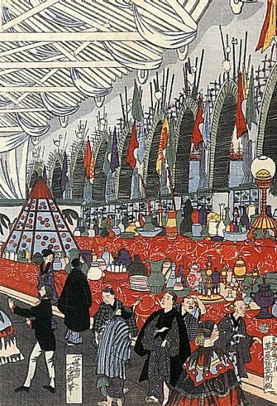
European Goods
Europe began to “loom large” in the thinking of many Japanese.
New slogan: Japanese Spirit; Western Technology!

Slide 16
EMPEROR MEIJI and the MEIJI RESTORATION

Slide 17
Meiji Restoration
“A Rich Country, A Strong Military”
3 Goals:
1) Westernize to keep out the West (Learned from China’s mistake)
2) Build Industrial Economy
3) Replace Feudal System with modern Government

Slide 18
Internal Problems in Japan
Japanese are unhappy with Western Intrusion, want to restore traditional values
Similar to Boxer Rebellion (China), Sepoy Rebellion (India)
Meiji Revolt (1868) – Civil war to overthrow SHOGUN and restore Emperor

Slide 19
Meiji Restoration - Changes in Japan
POLITICAL REFORMS
New Strong Central Government
1889 Meiji Constitution
Western Style Bureaucracy
Emperor is in control
ECONOMIC REFORMS
INDUSTRIALIZATION - Factories
Modern Banking System
Railroads, Ports, Post Office, Telegraph
Population Increase→ Urbanization

Slide 20
Abolition of the feudal system
Land Redistribution
Westernize the School System (Fr. & Ger.)
Modern Banking System
Modernize the Army (Prussian)
Meiji Reforms
Written Constitution (Germans)
Build a Modern Navy (British)
Human Rights & Religious Freedom
Emperor Worship Intensified

Slide 21
A Constitutional Government Copied from the Germans
Satsuma & Choshu Families
The Emperor of Japan
The Diet (Legislative Body)
1889 Constitution of Japan
House of Representatives
House of Peers

Slide 22
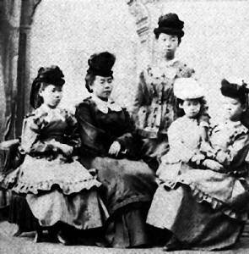
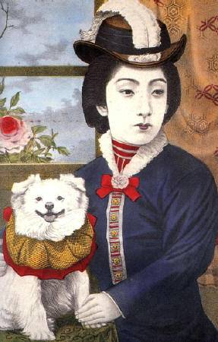
The Japanese Became Obsessed with Western Styles
Civilization and Enlightenment!

Slide 23
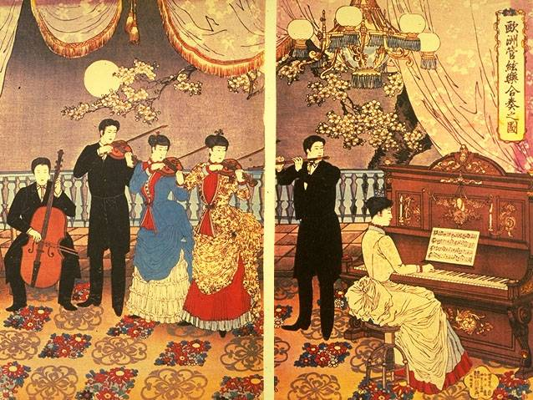
Everything Western Was Fashionable!

Slide 24
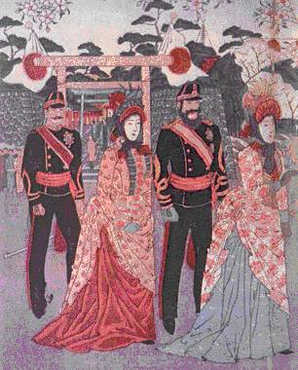
Everything Western Was Fashionable!
Japanese soldiers with their wives.

Slide 25
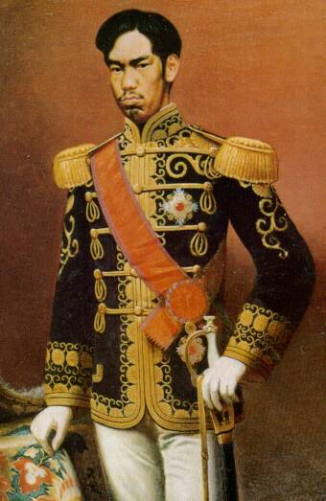
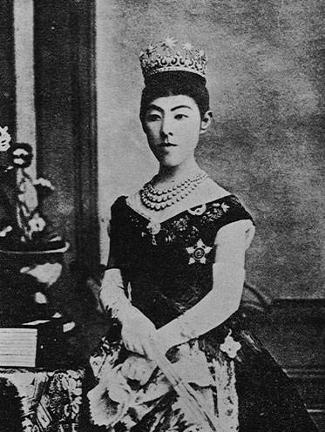
The Rulers Set the Tone with Western Dress
Emperor Meiji Empress Haruko (1868- 1912)

Slide 26
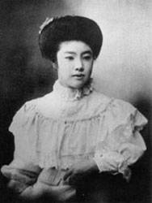
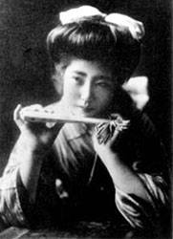
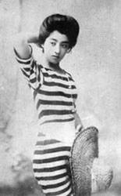
Changing Women’s Fashions
1900 Styles
The First “Miss Japan” (1908)

Slide 27
Aim: Why did the Japanese become imperialistic?

Slide 28
Westernization → Industrialization → IMPERIALISM (Same as Europe)
Industrail Revolution in Japan created a DEMAND FOR:
Foreign Markets
Raw Materials

Slide 29
Positive Impacts of Japanese Imperialism
Increase of Japanese Power and Wealth
Japan becomes a major world power
Cultural Diffusion (Westernization)
Industrialization (Raw Materials)

Slide 30
Negative Impacts of Japanese Imperialism
Japan dominates East Asia
Loss of tradition and culture
Japan exploits resources in the Pacific
War and Conflict
Russia, China, Korea, US

Slide 31
Japanese Imperialism
Japan Adopts Western Military Technology
Korea
China, Russia and Japan compete
1876 – Japan forced Korea to open ports
1894 Sino (CHINA) – Japanese War: Japan wins easily
Japan has influence in China
1904 Russo – Japanese War
Treaty of Portsmouth → Japan get Korea and Manchuria

Slide 32
YEAR | REGION | RESULT
1894 | Sino –Japanese War Sino = CHINA | Japan wins easily, gains influence in China.
1904 | Ruso-Japanese War Ruso=Russia | Japan wins, gains global prominence. Gains Korea and Manchuria
1910 | Korea | Korea is Annexed by Japan

Slide 33
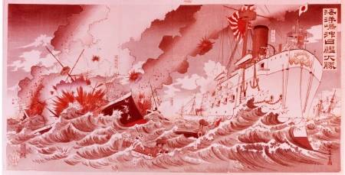
The Russo-Japanese War: 1904-1905
The Battle of Tsushima: The results startled the world!

Slide 34
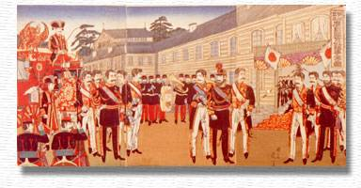
Sino-Japanese War: 1894-1895
The Meiji Emperor was in Hiroshima during the Sino-Japanese War

Slide 35
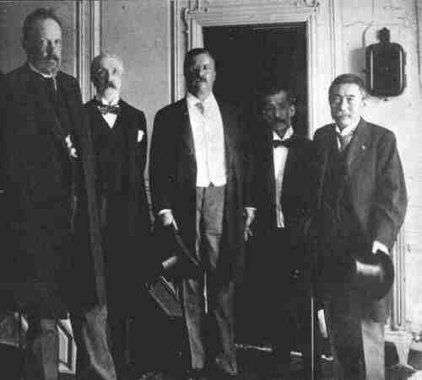
President Teddy Roosevelt Mediates the Peace
The Treaty of Portsmouth, NH ended the Russo-Japanese War.

Slide 36
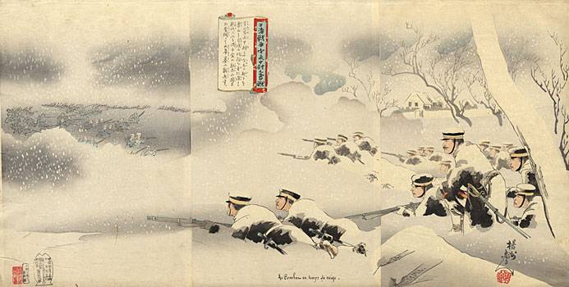
Soldiers on the Battlefield During the Sino-Japanese War
The Treaty of Shimonoseki ended the war.

Slide 37
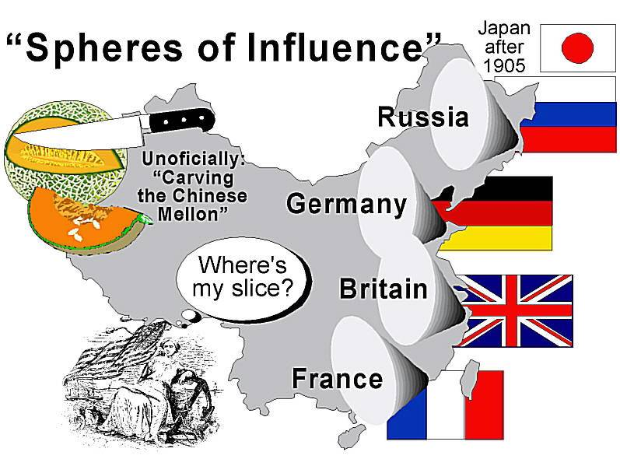
Expansionism & the Rise of Military Power
New players on the block?

Slide 38
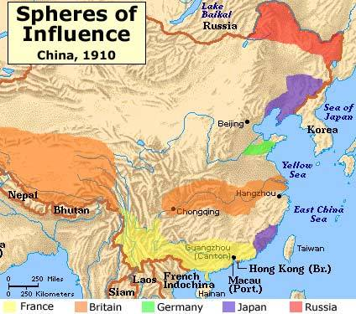
Japan Is a Player in China

Slide 39
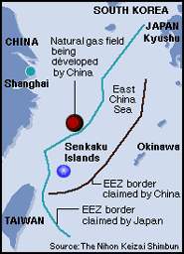
Today—Tensions Between China & Japan
Offshore gas field in the East China Sea reveals recently strained relations between China & Japan.
Tension over disputed gas field on the rise, exacerbating mutual mistrust dating back to the Sino-Japanese War.
EEZ-Exclusive Economic Zone.

Slide 40
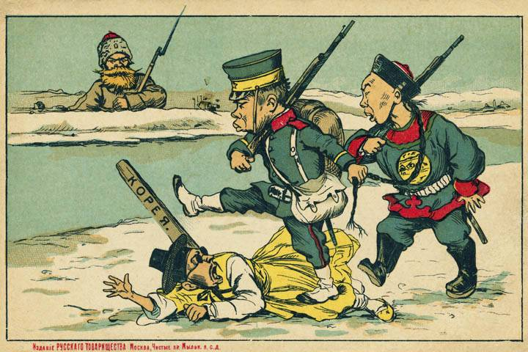
Japan Annexes Korea

Slide 41
Sino-Japanese War: 1894-1895
Japan’s imperialistic war against China to gain control of natural resources and markets for their goods. It ended with the Treaty of Portsmouth which granted Japan Chinese port city trading rights, control of Manchuria, the annexation of the island of Sakhalin, and Korea became its protectorate.
The Russo-Japanese War: 1904-1905
War between Russia and Japan over imperial possessions. Japan emerges victorious
Treaty of Portsmouth (1905)
Japan earned the following:
Chinese port city trading rights;
Control of Manchuria in China;
Korea became its protectorate;
Annexation of the island of Sakhalin

Slide 42
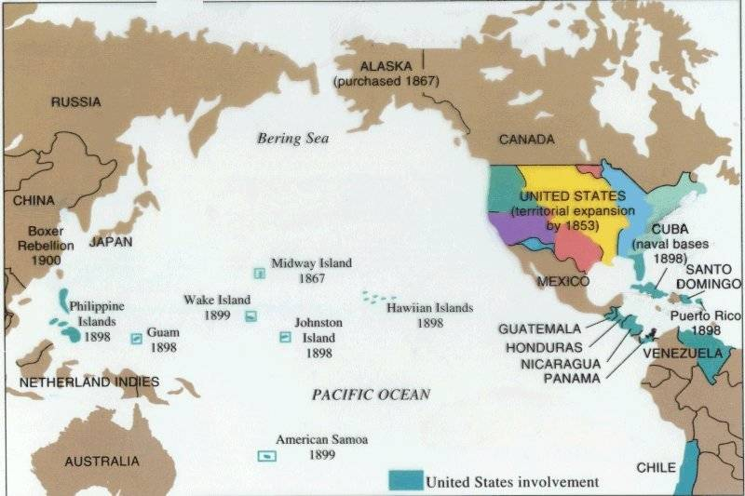
Competition from Another “Pacific” Power Is on the Horizon

Slide 43
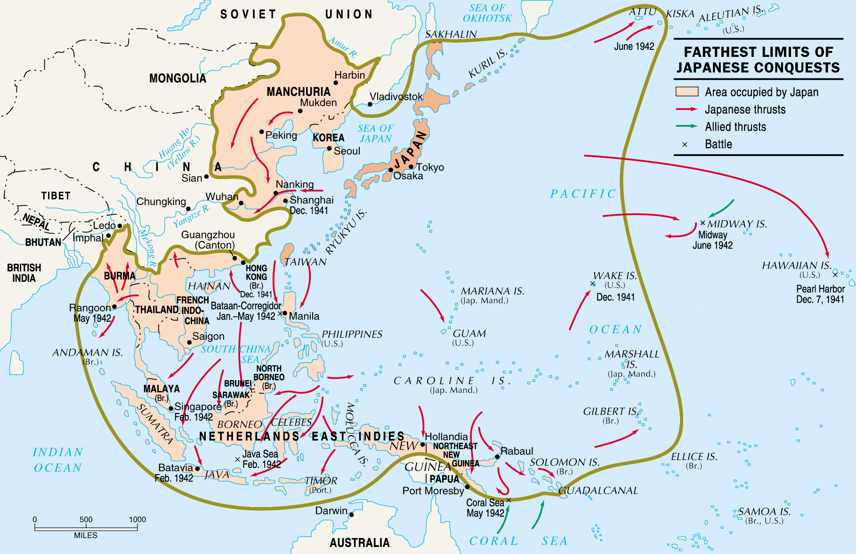
But, Japanese Power Would Grow . . .

Slide 44
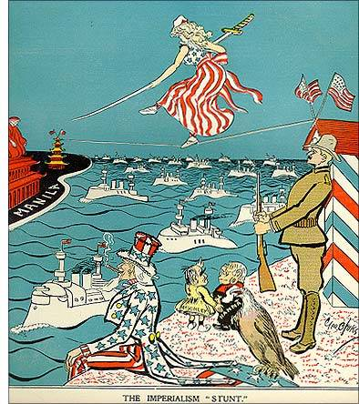
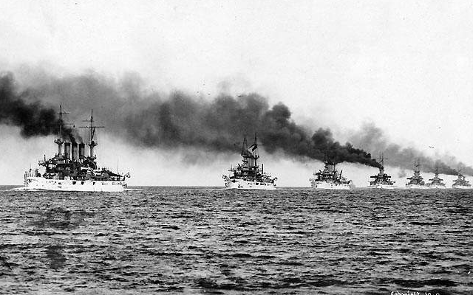
The U. S. “Great White Fleet”

