Slide 1
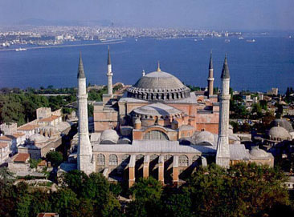
The Byzantine Empire

Slide 2
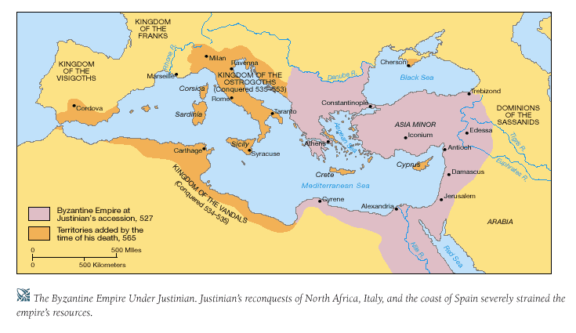
The Byzantine Empire

Slide 3
Byzantine Origins
286 CE Diocletian splits the Roman Empire
330 CE – Constantinople becomes the Capital
Eastern Rome
Blend of Greek, Roman and Christian cultures

Slide 4
Constantinople
CONSTANTINOPLE
Center for trade and Cultural Advancement
Strategic Location on BOSPOROUS STRAIT
Access to sea trade
Protected by water
Strong Roman Influence

Slide 5
Byzantine Political Structure
Autocratic – rulers have unlimited authority
Caesaropapism – Ruler is head of Church and State
Theme System – Land exchanged for military service
Elaborate bureaucracy: Governing organization made up of divisions and departments

Slide 6
The Age of Justinian (527 – 565 CE)
Emperor of Byzantium
Recovered lost territory of Rome
Absolute Ruler (Autocrat)
Strong Central Government
Prosperous economy
Glorified the City of Constantinople
Hippodrome
Hagia Sophia
JUSTINIAN CODE

Slide 7
Byzantine Accomplishments
JUSTINIAN CODE – LAW, ORDER, STABILITY
Foundation for modern legal systems in Europe
Criminal and Civil Law
Arts & Engineering (Hellenistic Culture!)
Churches, palaces, public buildings (domes, arches)
Murals and mosaics
Artists and Monks
Manuscripts, icons, frescoes
Romanesque style spreads throughout Balkans, Eastern Europe, Russia

Slide 8
The Eastern Orthodox Church
The Great Schism
Christianity splits into:
Roman Catholic Church (Western Rome)
Eastern Orthodox Church (Byzantium)
Emperors appoint church officials
Key component of Byzantine Culture
Spread faith into Russia, Persia, Africa

Slide 9
Byzantine Influence
Expanded Hellenistic Culture
Preserved Greco-Roman Culture
Russia (Kiev)
Trade with Russia via Bosporus Strait
Cyrillic alphabet & architectural styles
Spread Eastern Orthodox Religion
Eastern Europe
Contact w/ Vikings
Novogorod& Kiev become great centers of trade; captured by Vikings in late 800s

Slide 10
Byzantine Decline
Gap between rich and poor→ Social Tension
Weakened Military (not enough soldiers)
Invasions
Crusaders
Ottomans

Slide 11
So, what have we learned today?
Preservation of Hellenistic Culture
Justinian’s Code
Spread of Church & Trade
CULTURAL DIFFUSION → GOLDEN AGE!

