Slide 1
West African Kingdoms
GHANA, MALI and SONGHAI

Slide 2
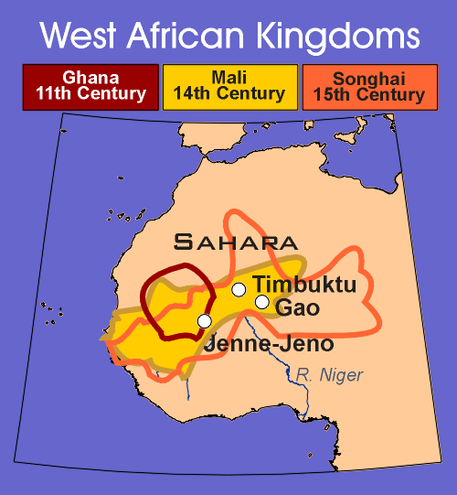
Sub-Saharan Africa:
Africa South of the Sahara
Desert
Ghana: 11th Century
Mali: 14th Century
Songhai: 15th Century
Rivers: Niger, Senegal
Cities: Timbuktu, Jenne,
Gao

Slide 3
The Kingdom of Ghana
Located in Western Africa on the Senegal River
The Rulers of Ghana built a powerful empire by controlling GOLD AND SALT TRADE. (Silent Barter)
Kings taxed ALL TRADE
Kings owned all GOLD
Ghana had valuable resources: GOLD, IVORY, IRON
Strong Rulers led to a Golden Age
Military protected Kingdom and assured safe trade

Slide 4
The Fall of Ghana
Invasion: Disrupted stability and cut off trade routes
Overgrazing: Land was left useless for farming.
Internal rebellion: Civil war led to an overthrow of the Government (MALI)

Slide 5
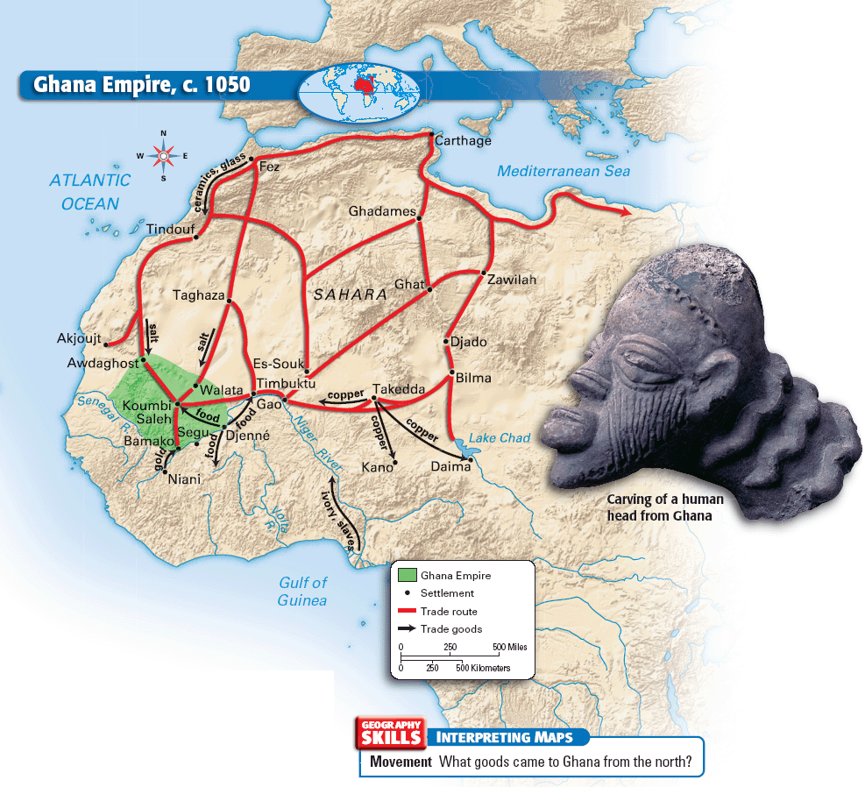

Slide 6
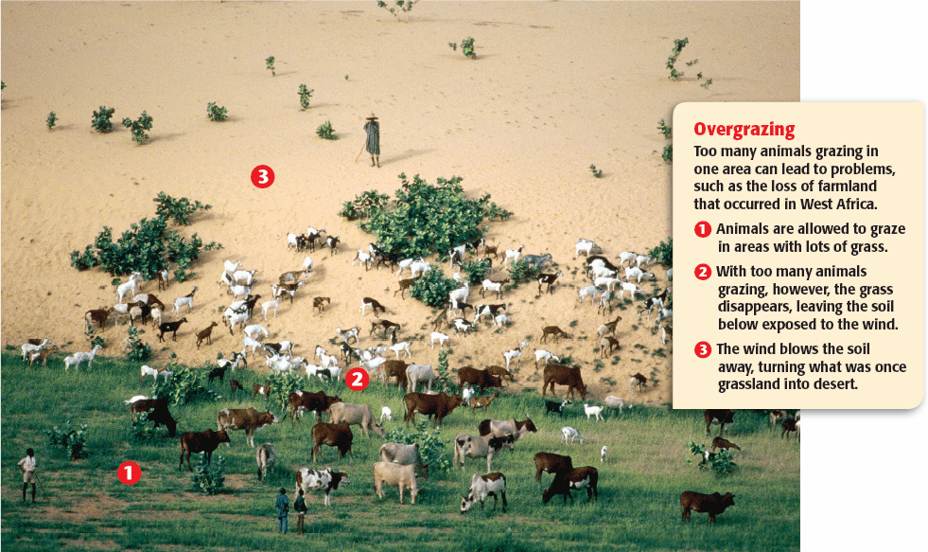

Slide 7
The Kingdom of Mali
The Wealthy and Powerful kingdom of Mali ruled West Africa after Ghana.
Sundiata made Mali into an Empire and MANSA MUSA led a GOLDEN AGE. Mali is one of the richest Kingdoms in World History.
Mansa: Ruler/King, Religious and secular leader
In Mali TIMBUKTU was one of the most advanced cities in the world.

Slide 8
MANSA MUSA
Mansa Musa was a powerful king that doubled the size of Mali.
Strong Central Government:
Divided into provinces
Wealth from TAX: Gold and Salt Trade
Mansa Musa: The Great King of Mali
Pilgrimage to Mecca – Introduced Mali to the world
Spread Islam to West Africa: Built Mosques
Promoted Education and Justice in his empire

Slide 9
TIMBUKTU
TIMBUKTU is one of the richest and most advanced cities in the history of the world.
Great Location for Trade
Bank of the Niger River
TRANS-SAHARAN caravan route to Arab World
Close proximity to Salt Mines
Spiritual and Cultural Center
Mansa Musa built a Great Mosque and Libraries
Scholars from around the world came to Timbuktu
Islamic Courts/Advanced Justice System

Slide 10
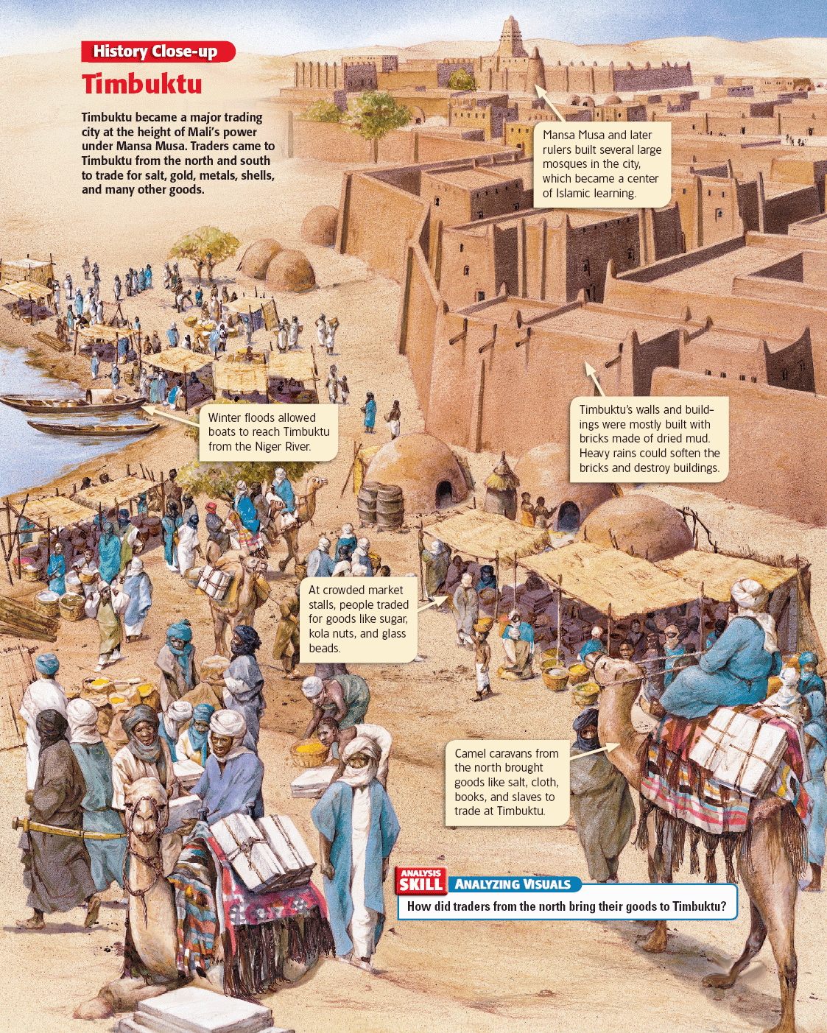

Slide 11
Fall of Mali: Reasons for Decline
Weak Leadership
Too Large to Rule
Invasions
New ocean trade routes reduced wealth

Slide 12
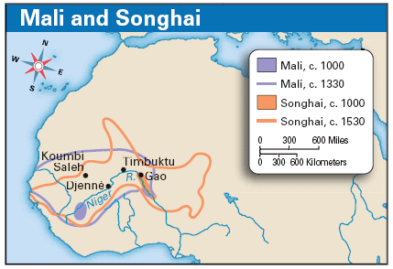

Slide 13
Songhai Empire
Songhai rose up against Mali and gained their freedom as an Islamic Empire.
Strong Leaders:
Sunni Ali
Unified, strengthened and enlarged the empire.
Conquered wealthy cities: Timbuktu, Jenne
Askia the Great
Supported learning and medicine
Standing professional army
Songhai fell to MOROCCAN INVADERS who had guns and cannons.

Slide 14
African Cultural Traditions
Outsiders spread knowledge of Africa to Europe and the Arab World
Foreign Visitors
Ibn Battuta: Arab Traveler/Historian visits West Africa
Leo Africanus: Muslim traveler, lived and wrote in Europe
Oral Histories
Writing was not common in Africa
History was passed on Orally
Artistic Expression
Sculpture, Music, Dancing
Mosque Building

Slide 15
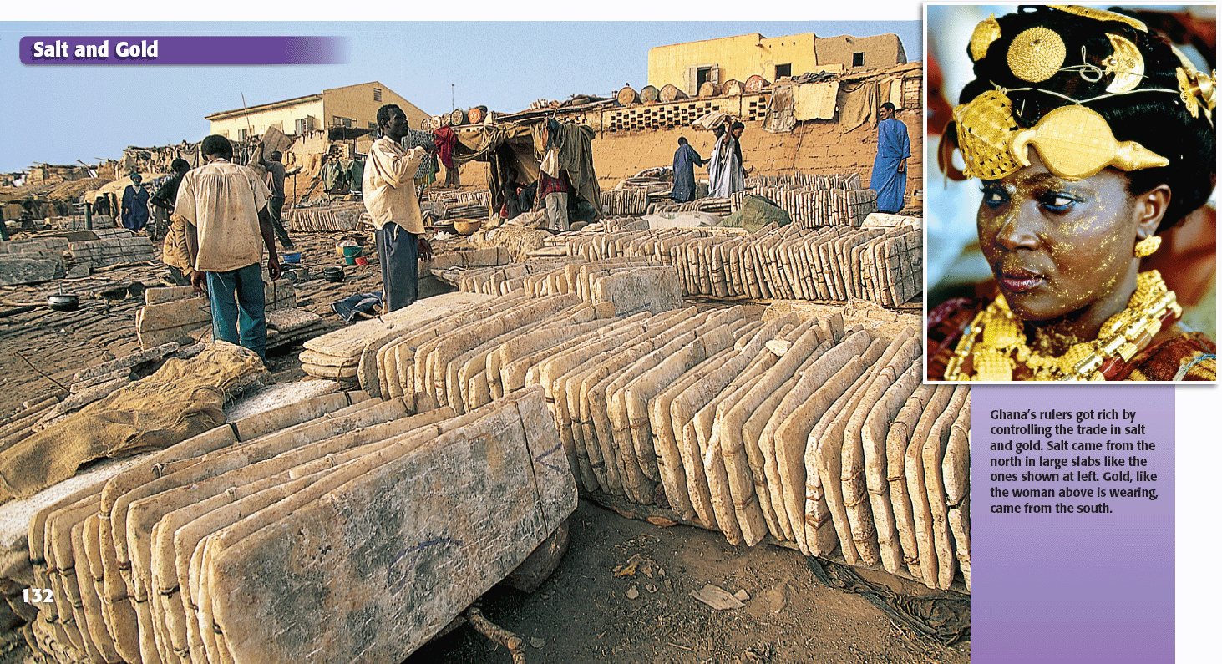

Slide 16
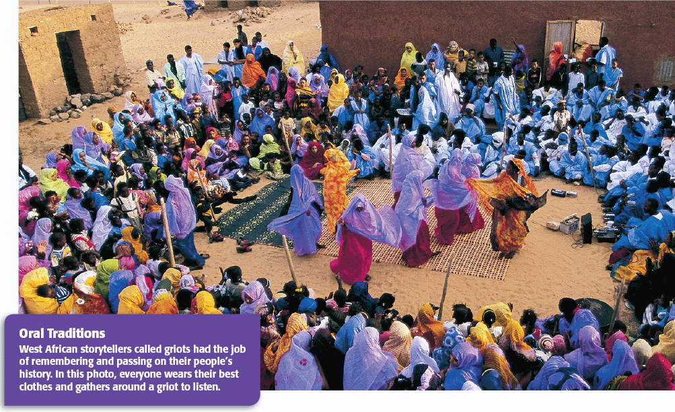

Slide 17
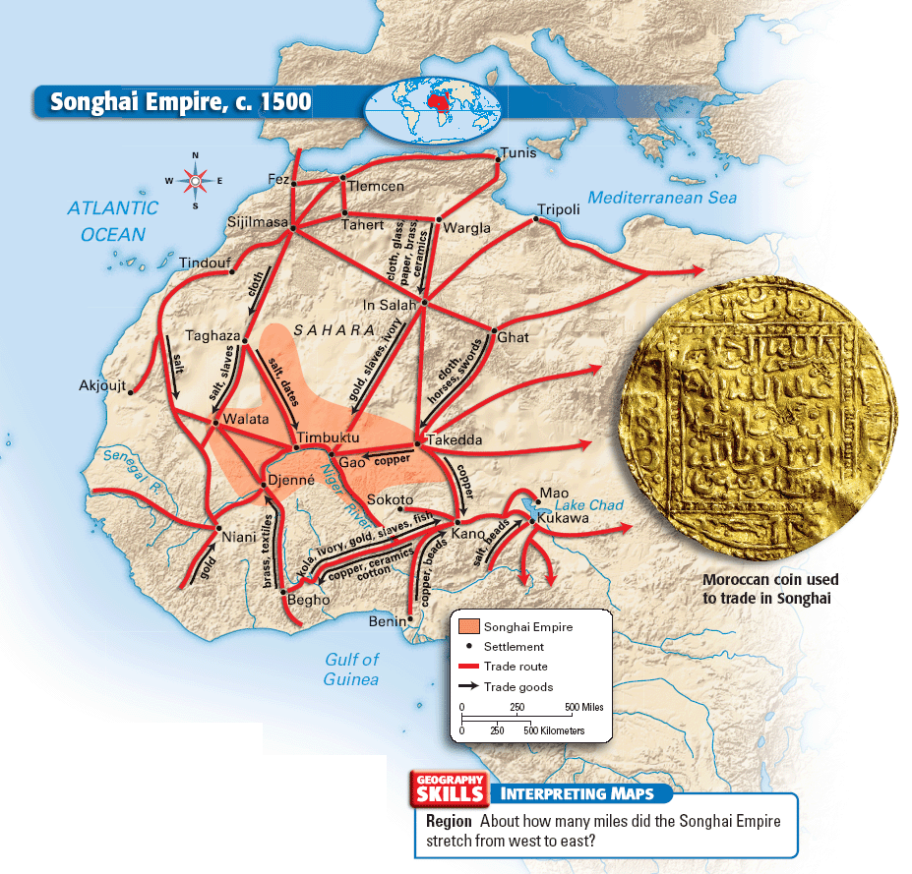

Slide 18
