Slide 1
Aim: What caused the Protestant Reformation?

Slide 2
Protestant Reformation Vocabulary
Purgatory – A condition or place where the dead suffer punishment for their sins in order to purify their souls.
Indulgence – Reduction of the time that will be spent in purgatory.
Relic – Body, body part or personal property of a religious figure (ex. Skull of a Saint)
Reformation – Movement for religious reform

Slide 3
Heretic – A person that goes against the church.
Excommunication – An act that kicks a person out of the church.
Recant – Take back a statement or action
Inquisition – An official church investigation of an individual.
Vernacular – The common spoken language of a region.

Slide 4
Causes of the Reformation
Renaissance Ideas (ie. Questioning Spirit) inspire people to challenge church authority
Kings/Princes resent the Pope’s power
Merchants resented church taxes and were jealous of Church wealth.
Clergy became very corrupt

Slide 5
Who was Martin Luther?
German Monk
Recognized problems in the church
Wrote 95 Theses
Problems that the Church needed to fix
The big problem is the sale of INDULGENCES
Printing Press (Johann Gutenberg) helps to spread ideas quickly

Slide 6
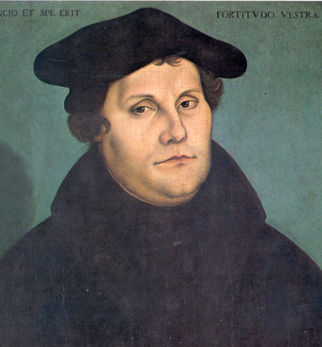
Martin Luther

Slide 7
Luther’s Teachings
Martin Luther | Catholic Church
Salvation achieved by faith alone | Salvation by faith and “GOOD WORKS” (Charity)
All people of faith are equal | Priests and Clergy had to interpret the Bible for people
The bible should be printed in Vernacular (ex. German) | The bible should be printed in Latin

Slide 9
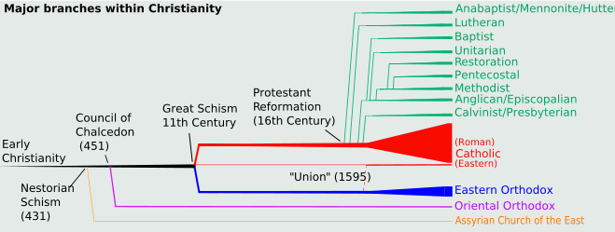

Slide 10
Luther vs. Tetzel
Johann Tetzel is the Church’s best seller of INDULGENCES. He is very POPULAR in the CATHOLIC CHURCH. Luther takes a public stand against Tezel. He believes it is WRONG TO TAKE $ for FORGIVENESS. The church is angry that Luther is costing them money!

Slide 11
The 95 Theses
Written by Martin Luther to REFORM THE CHURCH (Stop the sale of Indulgences)
Spread quickly due to the PRINTING PRESS which was invented by Johann Gutenberg
Causes Martin Luther to be EXCOMMUNICATED

Slide 12
The Catholic Church Responds with a COUNTER Reforamation
Catholic Counter Reformation
1) The Council of Trent (1545 – 1563)
Ended the Sale of Indulgences
Confirmed Pope as supreme leader
II) The Inquisition
Aggressive action to eliminate HERESY
III) Missionaries
Church creates Missionaries to Spread Christianity (The Americas)

Slide 13
OTHER REFORM MOVEMENTS
ANGLICANS: Henry VIII - England
Asked Pope to Annul his marriage – Pope said NO
Henry gets Parliament to declare an ACT OF SUPREMACY
The act makes the King head of the Church in England
CALVINISM: John Calvin – Switzerland
Pre-Destination – God wills if one will achieve SALVATION

Slide 14
IMPACTS
Destroyed Religious Unity
Developed New Religions
Created Religious Tension (Catholics/Protestants)
Church Power Monarch Power
Rise of Nation-States (Countries)
Education Increased

