Slide 1
The Ming Dynasty and Ottoman Empire
Ming Dynasty, 1368-1644
Ottoman Empire, 1299-1923

Slide 2
Ming Dynasty – A return to Chinese rule
After expelling the MONGOLS the MING DYNASTY controlled China.
Capital city moved to BEIJING.
China closes the door to EUROPE and remains ETHNOCENTRIC.

Slide 4
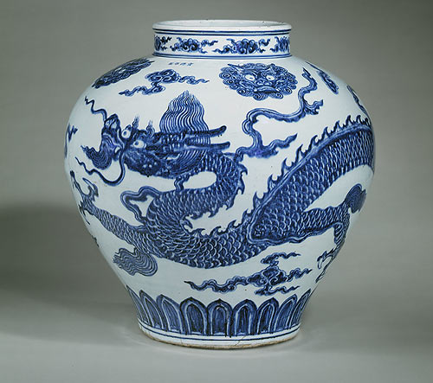
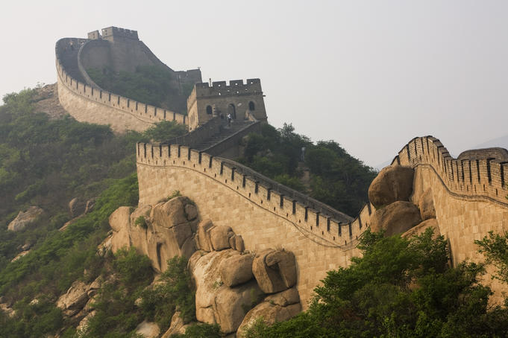
Ming Dynasty
Reduce Trade on Silk Road because they are Ethnocentric

Slide 5
Confucianism is restored in china
1) Civil Service Exams are reinstated:
Merit Based Bureaucracy (Ability)
Government Officials are highly honored
2) Confucian Schools are built.
3) Confucian Values: Education, Family, Lead by Example
4) Neo-Confucianism: Mixture of Daoism, Buddhism and Confucianism

Slide 7
An Age of Exploration for China
Zheng He Explores the Indian Ocean Basin(1405)
Show powers and splendor of China
Establishes a Tribute System
Distributed gifts to show Chinese superiority

Slide 12
A RETURN TO ISOLATION
Europeans Demand Chinese Goods:
Silk
Porcelain
Gunpowder
Chinese end trade and exploration
BUILD THE WALL

Slide 13
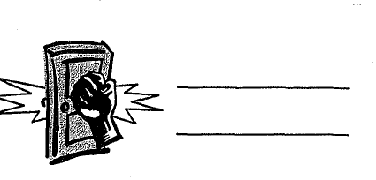
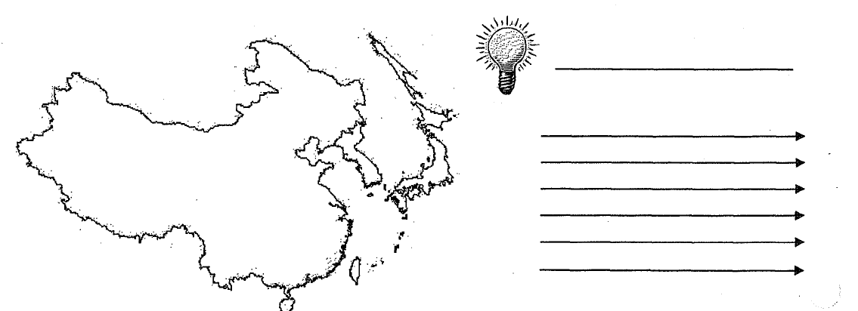
China closes
Door to Europe
Superior to Europeans
Trade w/ Euro
Gun power
Silks
Porcelain
View Euro as barbaric
Bld Great Wall of China
Ming Dynasty
China

Slide 14
Ming Fall
Ineffective rulers : Overspending and Corruption
Famine
Manchu invaders from the north → QING DYNASTY

Slide 15
Rise of the Ottoman Empire- The Ottoman Turks

Slide 16
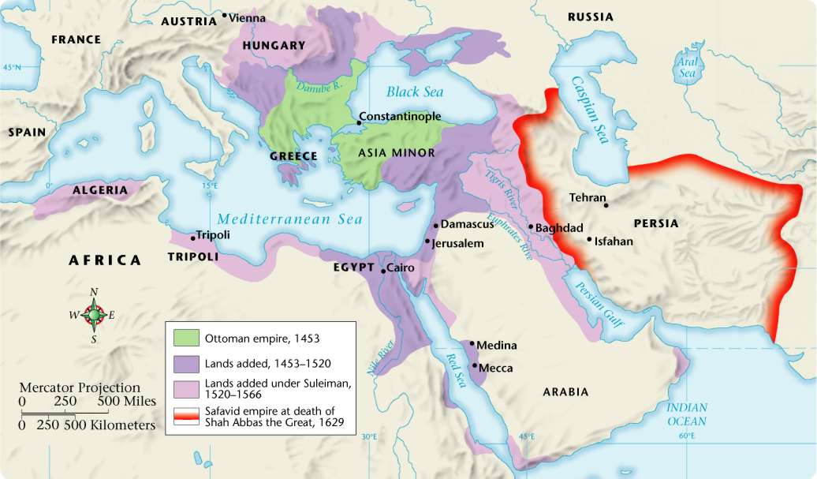
Ottoman and Safavid Empires 1453–1629
5

Slide 17
Ottoman Beginnings
Ottomans took over Byzantine Empire
Renamed conquered capital of Constantinople to Istanbul
Made Christian city the capital of Muslim Empire
**Cut off European trade with Asia**

Slide 18
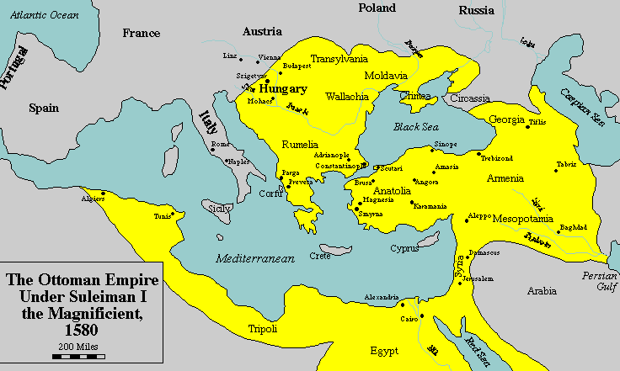
Reasons for Success
Had well-armed soldiers and effective cannons
Advanced Technology (Cannons, Muskets) allowed for CONQUEST
Areas conquered
Mecca (Islamic Holy Land)
Egypt (N. Africa)
Eastern Europe
Part of Russia

Slide 19
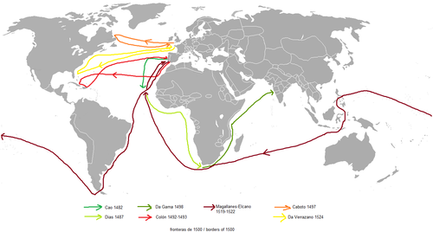
Exploration Routes to get to India/China

Slide 20
Ottoman Achievements and Golden Age
The Ottoman Golden Age was influenced by Rome and the Byzantine Empire. (Why?)
Suleiman the Magnificient (Lawgiver) leads the Golden Age
Strengthened government
Improved system of justice/law -based on Islam
Conquered new territory for Ottoman Empire

Slide 21
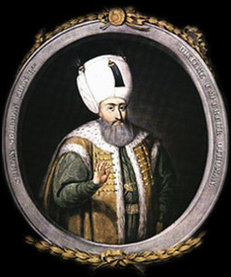
Suleiman
Ottoman Empire’s Golden Age
“Suleiman the Magnificent” to Westerners
“The Lawgiver” to his own people

Slide 22
The Ottoman Empire and Suleiman
Political | Social | Cultural
Suleiman was an ABSOLUTE RULER (Total Power) Complex Bureaucracy Powerful Military Law based on Islam (Sharia Law) | Non-Muslims were treated separately. (Christians, Jews) Government promoted religious conversion Social structure based on RELIGION 4 Classes: Men of the Pen, Men of the Sword, Men of Negotiation, Men of Husbandry | Turkish language Magnificent Mosques and Palaces. Islamic Culture Poetry

Slide 23
Ottoman gov’t/law
SULTAN
Divans
Social / Military Divans
Heads of Individual Religious Millets
Muslims
Jews
Local Administrators & Military
Christians
Landowners / Tax Collectors

Slide 24
Ottoman Empire’s Golden Age Achievements:

Slide 25
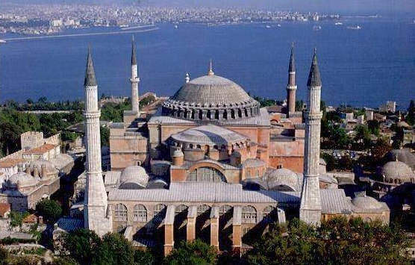
Hagia Sophia- was a Christian Church in the Byzantine Empire- becomes a mosque under Ottomans

Slide 26
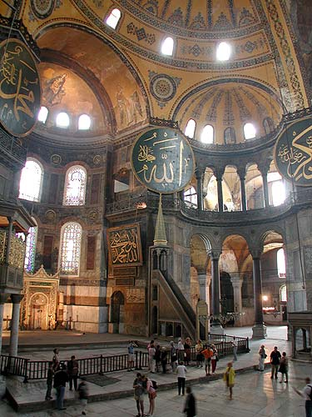
Hagia Sophia - interior

Slide 27
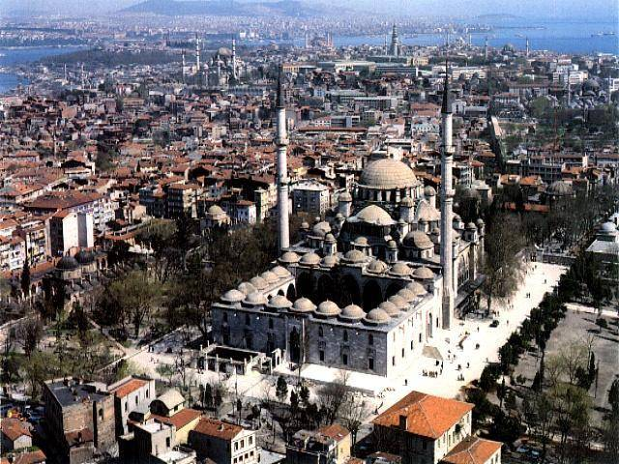
Faith Mosque

Slide 28
Qur’an Page: Arabic Calligraphy

Slide 29
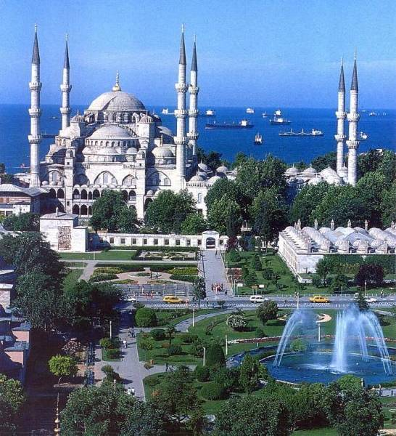
Blue Mosque

Slide 30
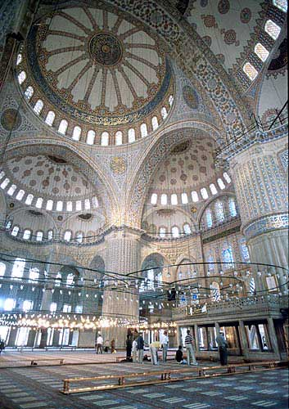
Blue Mosque - interior

Slide 31
Prayer Rug, 16c Ottoman Empire

Slide 32
Illuminated Qur’an Page

Slide 33
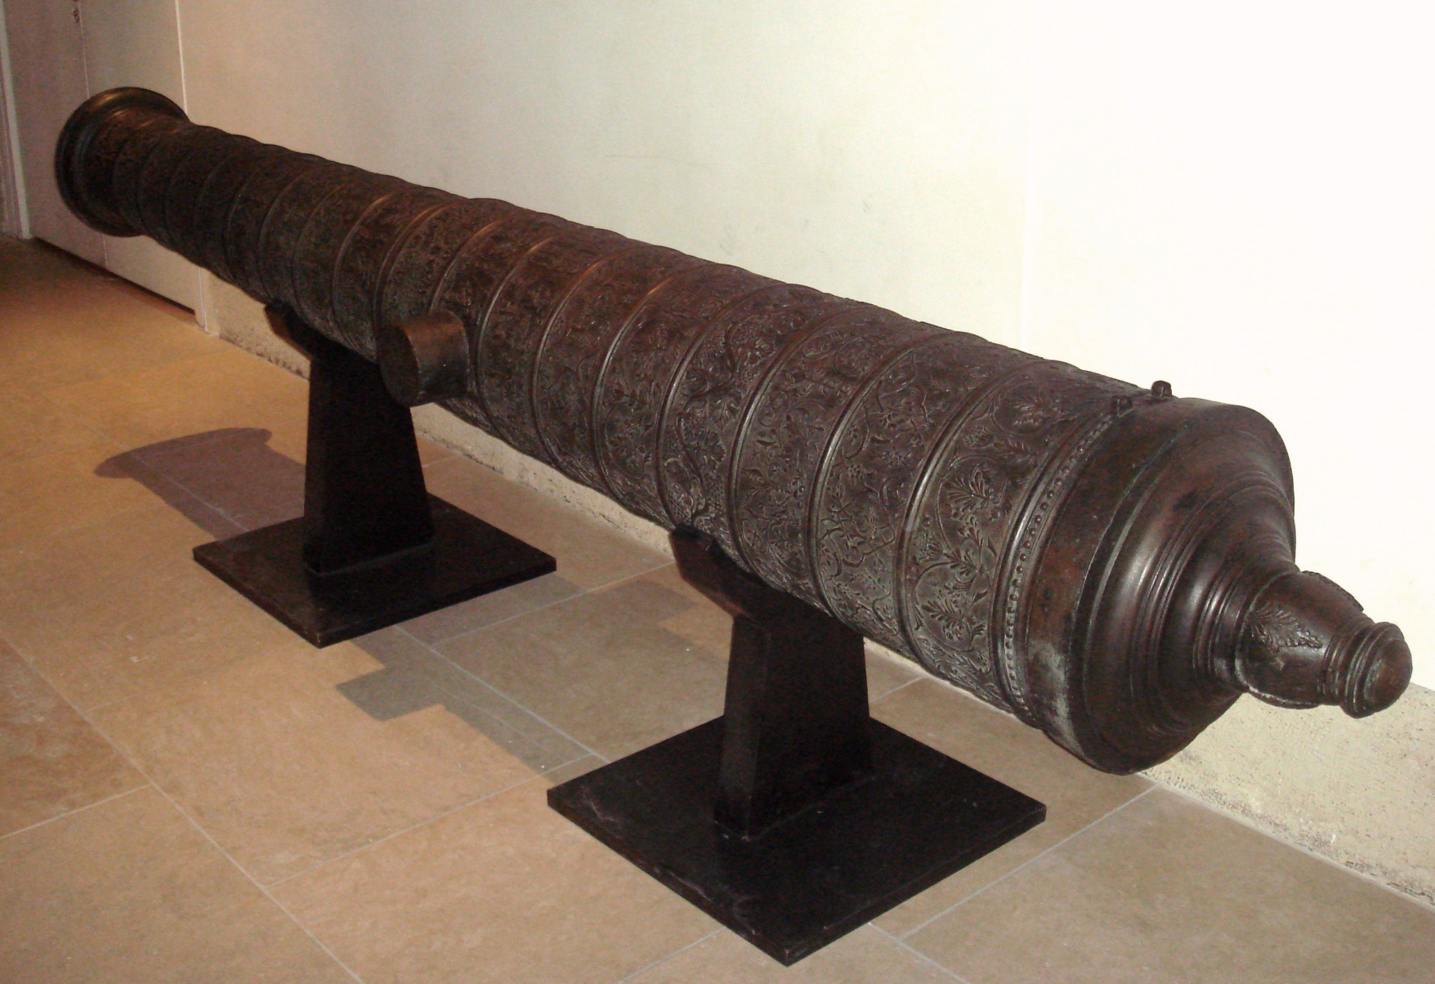
Ottoman Cannon

Slide 34
Major concepts
The Ottoman Empire and Ming Dynasty are both civilizations built upon Religious/Philosophical Traditions.
Ottoman: Islam
Ming: Confuciansim
Trade and Interaction helped both empires to prosper
Ottoman Control of Mediterranean Sea and High demand for Chinese goods combined to lead to the European AGE OF EXPLORATION.
Both Empires are surpassed by Europeans who have better technology and resources

