Slide 1
Western Europe in the middle ages

Slide 2
Western Europe Timeline
476 – 800 Dark Age | 800 - 1204 Middle Age | 1204 - 1450 High Middle Age
Fall of Rome De Urbanization Learning Declines Language is Lost Constant Invasion + War Trade Ceases | Feudalism Emerges RCC Source of Unity and Stability Holy Roman Empire - Charlemagne No Trade – Economic Self Sufficiency | “Rebirth of Europe” Crusades increase interaction and diffusion New Learning/Tech Trade Re Emerges Urbanization

Slide 3
Successor States of the Roman Empire
Visigoths – Spain
Angles and Saxons - England
Franks – France/Germany
  Clovis Converts to Christianity
  Carolingian Dynasty
  Charlemagne – Holy Roman Emperor
    No Bureaucracy
    Missi Dominici – Imperial Officials
  Gradual Centralization

Slide 4
The Vikings – Northern Europe
Norse Expansion begins 800 CE
Motivated by population pressure and resistance to Christianity
Great Seafarers
Merchant Communities

Slide 5
Feudalism: The Political, Social and Economic Structure of the Middle Ages
POLITICAL:
Decentralized System of Government
Regional Kingdoms with limited power
Church is the dominant institution
Land is the source of power
SOCIAL:
Rigid Social Class Structure (No Mobility)
Reciprocal Relationships (Feudal Contracts)
Land is exchanged for loyalty/service/labor

Slide 6
KING
Lords
Knights
Peasants
Serfs
(Bound to the land)

Slide 7
ECONOMIC
Manorialism: Economic system of the Middle Ages based on land (The Manor)
Manors are self-sufficient
  Everything needed for survival is on the manor
  No trade/interaction
Barter System: All goods and services are exchanged for labor and protection.
Fallow Field
(Empty)
Fall Planting
Spring Planting

Slide 8
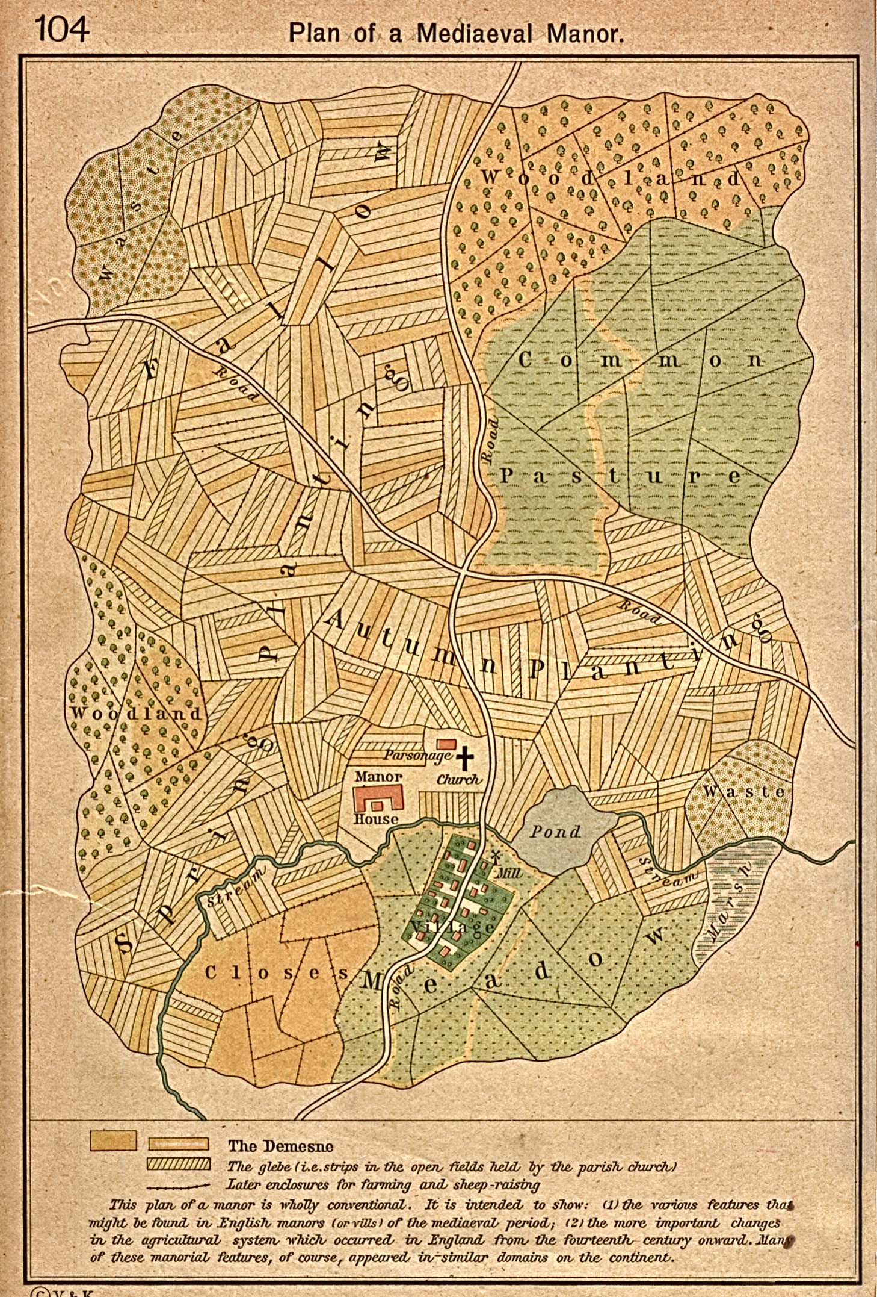

Slide 9
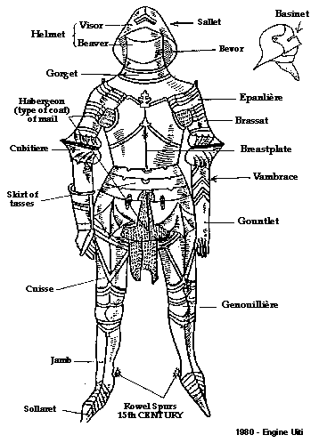

Slide 10
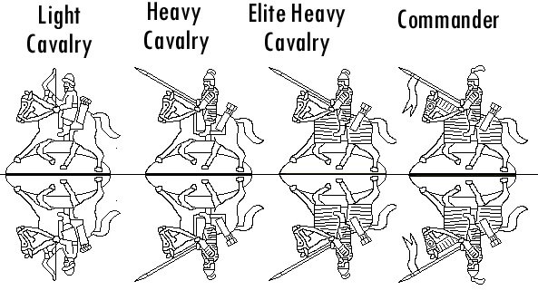

Slide 11
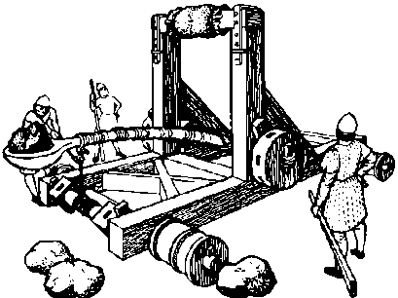

Slide 12
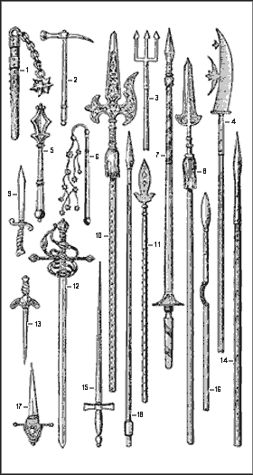

Slide 13
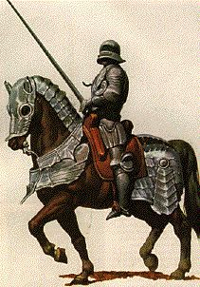

Slide 14
Christianity in Europe
Christianity becomes the major religion in Europe
Church Unifies People of Europe
  Only Source of Hope (SALVATION)
  Provides Social Services (Education, Medicine, Care for Poor)
  Stability and Order (Canon Law)
  Enormous Wealth (1/4 of Land) + Tithes (Tax/Donation)
The Papacy
  Strong Leadership – Took over for Roman Emperors
  Most Powerful leaders in Europe

Slide 15
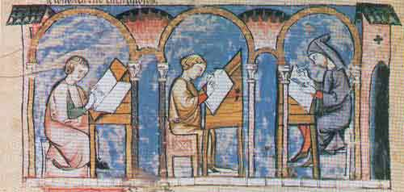

Slide 16
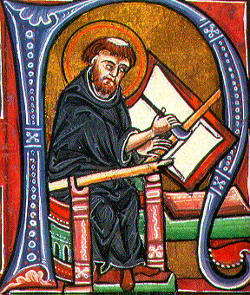

Slide 17
Voltaire
“The Holy Roman Empire was neither Holy, nor Roman, nor an Empire”

Slide 18
Pope Urban II
"The noble race of Franks must come to the aid their fellow Christians in the East. The infidel Turks are advancing into the heart of Eastern Christendom; Christians are being oppressed and attacked; churches and holy places are being defiled. Jerusalem is groaning under the Saracen yoke. The Holy Sepulchre is in Moslem hands and has been turned into a mosque. Pilgrims are harassed and even prevented from access to the Holy Land. The West must march to the defense of the East. All should go, rich and poor alike. The Franks must stop their internal wars and squabbles. Let them go instead against the infidel and fight a righteous war. God himself will lead them, for they will be doing His work. There will be absolution and remission of sins for all who die in the service of Christ. Here they are poor and miserable sinners; there they will be rich and happy. Let none hesitate; they must march next summer. God wills it!

Slide 19
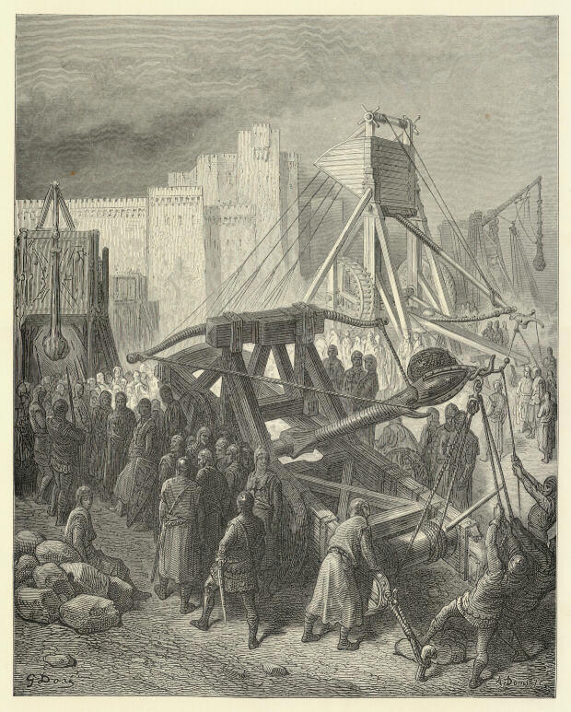

Slide 20
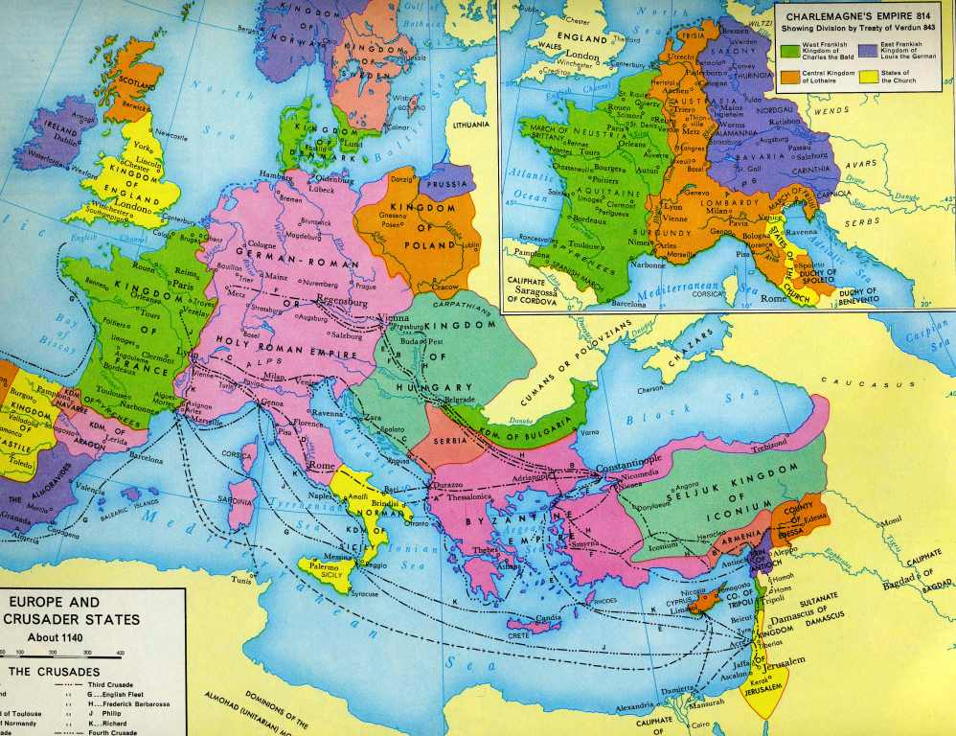

Slide 21
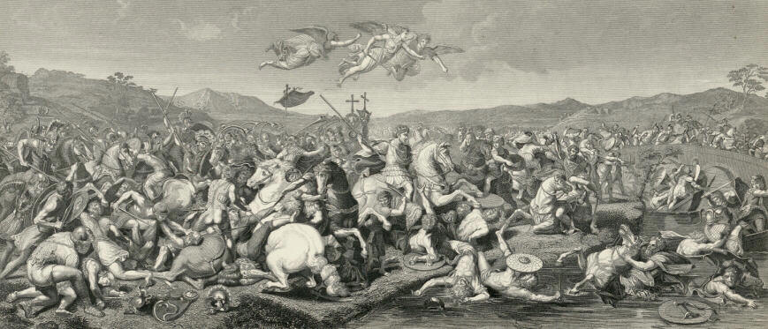

Slide 22
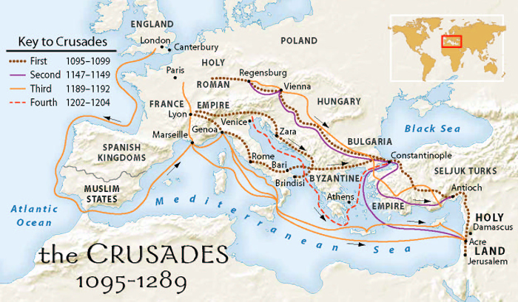

Slide 23
Requite evil with good and he who is your enemy will become your dearest friend. But none will attain this save those who endure with fortitude and are greatly favoured by Allah.
  The Quran
"Blessed be the peacemakers" (Matthew 5:9)

