Slide 1
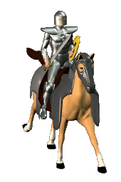
THE CRUSADES
A Quest for the Holy Land

Slide 2
What were the Crusades?
Crusade = HOLY WAR
European Christians fought against Arab Muslims.
The Crusades were a battle for control of the Holy Land – Jerusalem
Pope Urban calls for a Crusade against the “infidels” (Muslims) in 1096 CE

Slide 3
Why did Christian from Western Europe go and fight in the Crusades:
Wealth: The desire for the riches of the Islamic world
Adventure: Knights could travel the world and fight in exotic places
Religion: Crusaders believed the future of Christianity depended on them.
Salvation: (Heaven) Knights who fought and died in a crusade were garaunteed to go to heaven!

Slide 4
Who? When? What?
Richard the Lion Heart (England)
Saladin (Islam)
Barbarossa (Holy Roman Empire)
1099 CE – Christians capture Jerusalem
1187 – Saladin re-captures Jerusalem
1192 - Truce

Slide 5
What was the impact of the Crusades
ECONOMIC
Increased Cities and Trade
Increased Wealth and Banking
End of Manorialism
POLITICAL
Power of kings increased (Taxes)
End of Feudalism – Growth of the Nation
RELIGIOUS
Power of Christian Church Grows
Tensions between Christians and Muslims
LONG TERM
Opened Europe up to the rest of the world
Increased Cultural Diffusion and Global Interactions

Slide 6
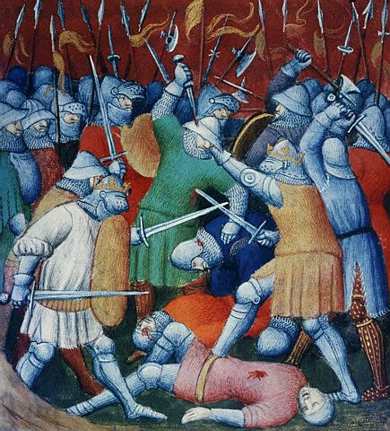
The First Crusade (1096-1099)
Peasant army
Untrained
Lacked military equipment
Many killed by Muslim Turks
Knights
Succeeded in capturing Jerusalem

Slide 7
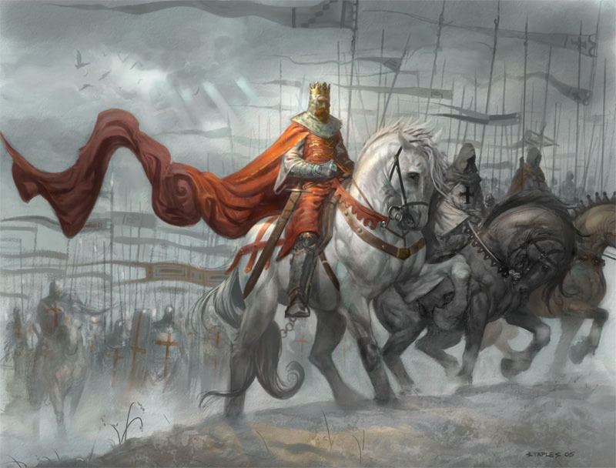
Second Crusade (1147-1149)
After victory many Christians went back home.
The Turks eventually took back much of the territory.
King of France and Emperor of Germany sent troops to stop the Turks.

Slide 8
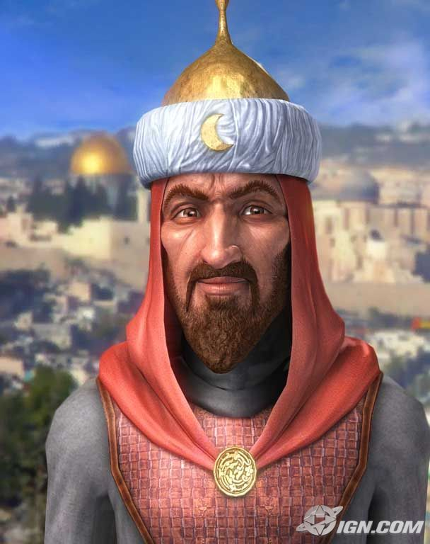
Second Crusade (1147-1149)
Saladin leads the Muslim Turks to victory, defeating the Christians
* He was considered a very wise ruler. He was known for his sometimes kind treatment of fallen enemies. Many Christians saw him as a model of knightly chivalry.

Slide 9
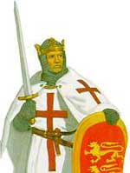
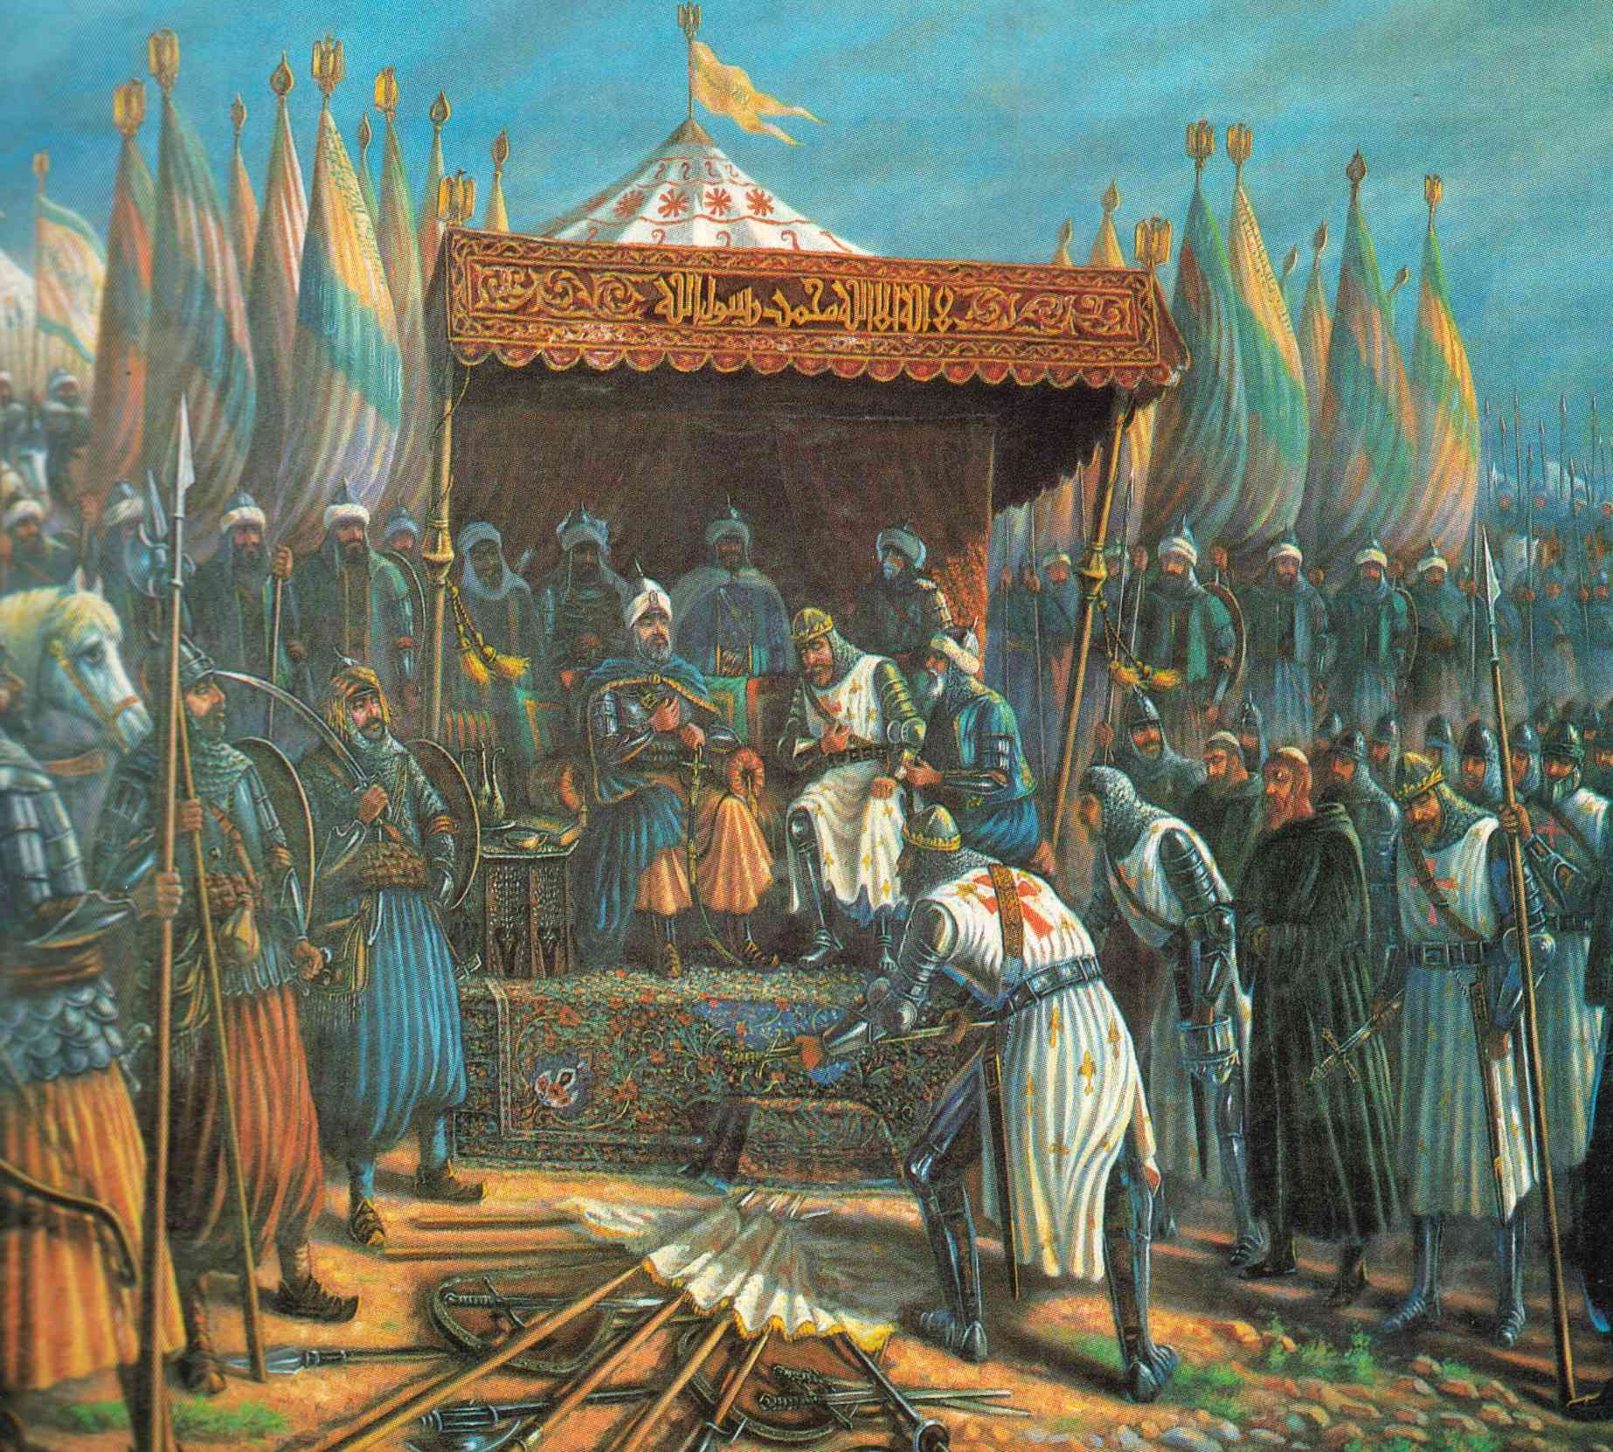
Third Crusade (1189-1192)
King Richard of England convinces the Turks to allow Christians to visit the Holy Land

Slide 10
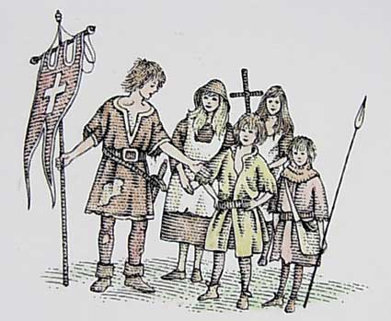
Crusades Continue Through 1200’s
Several more crusades attempted with no victories for the Christians
Children’s crusade, - 30,000 soldiers - many of them under 12 years old – Never made it to the Holy Land

Slide 11
What happens in Europe after the Crusades?
Feudalism Ends: New wealth caused the manor system to break down and people paid taxes instead of pledging loyalty and service.
Towns and Cities: As people left the manors they moved to towns and cities to find work.
Nations Arise: Kings amassed power by collecting taxes and raising armies to provide protection.
Cultural Diffusion: New ideas, disease and technology changed the political, social and economic structures of Europe.

Slide 12
The Hundred Years War
A war between ENGLAND and FRANCE over LAND and POWER. The LONGBOW was used in warfare for the 1st time.
RESULTS:
1) Major buildup of National Armies and Trained Military
2) Joan of Arc emerges as a Nationalist leader in France
3) France solidified as the dominant power in Western Europe
4) Rise of Nationalism in England and France
Nationalism: Intense pride in one’s country

Slide 13
The Black Death: The Bubonic Plague Ravishes Europe
Causes:
Increased trade and interaction spreads the disease quickly
Poor sanitation and hygiene
Lack of medical knowledge
PANIC
Results:
Almost 1/3 of Europe’s population dies (Over 25 million)
Massive Labor Shortages → Economic Depression
Decreases faith in the Church
Anti-Semitism – Many people blamed Jews

Slide 14
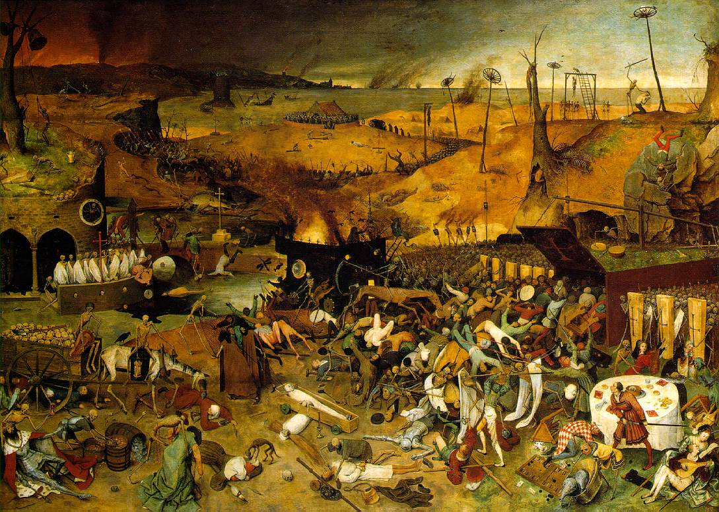
Triumph of Death
Notes:
painted c. 1562 by Pieter Bruegel the Elder. It currently hangs in the Museo del Prado, Madrid.

Slide 15
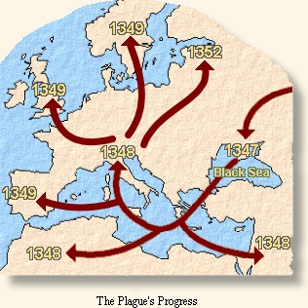
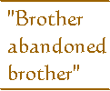
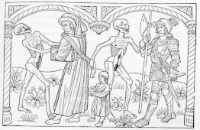
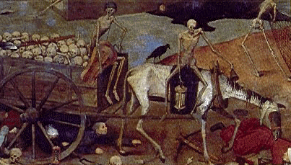
The Black Death,
1348

Slide 16
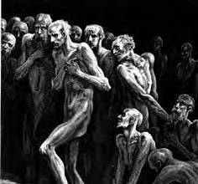
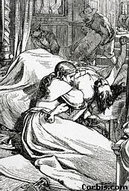
D e a t h
The Plague occurred in 3 Forms
PNEUMONIC PHASE
Attacked the Lungs
Caused fierce coughing & sneezing fits
Chest pain, Bloody sputum
SEPTICEMIC PHASE
Rarest and Deadliest
Traveled thru bloodstream
Black spots beneath skin
Victims choked on own blood, Excruciating Pain!
BUBONIC PHASE
Most Common
Egg-sized swellings (buboes)
Neck, armpits, groin (dark blisters)
Headaches, Weakness, Nausea/Vomiting
Severe Fever and Delirium
The Whirligig was not that bad of a torture. It just spun the victim around in circles until he puked, mostly all over himself.

Slide 17
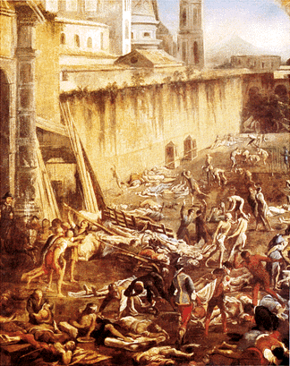
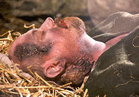
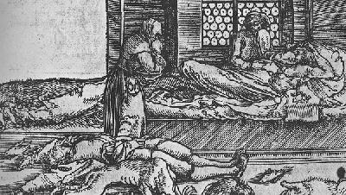
Myth or Fact? (Song)
Ring around the rosie, A pocket full of posies, Ashes! Ashes! We all fall down!

Slide 18
WHY?
Ignorance Surrounded Cause and Cure
Europeans were Frantic
Blames
Alignment of Planets
Infected Clothing, Humans
God’s Wrath aimed at Sin
Jews
Cures/Remedies
Pomanders
Mixture of Molasses & Chopped Snake
Repentance
Flagellants

Slide 19
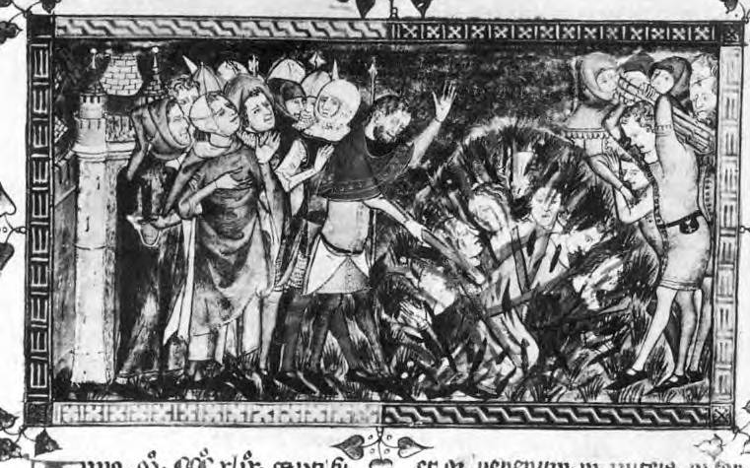
The burning of Jews in 1349 (from a European chronicle written on the Black Death between 1349 and 1352)

Slide 20
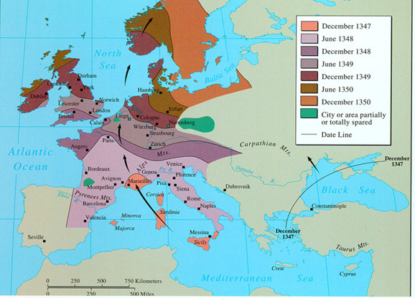

Slide 21
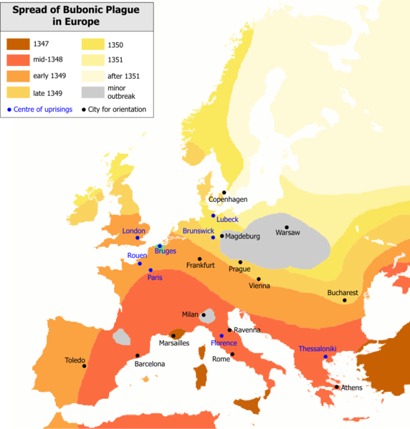

Slide 22
Absurd attempted cures for the plague
Live in a sewer
Bath in Urine
Rub your wounds with a live Chicken
Leaching
Smear yourself with Poop (yes, poop)
Whip yourself to atone for your sins

Slide 23
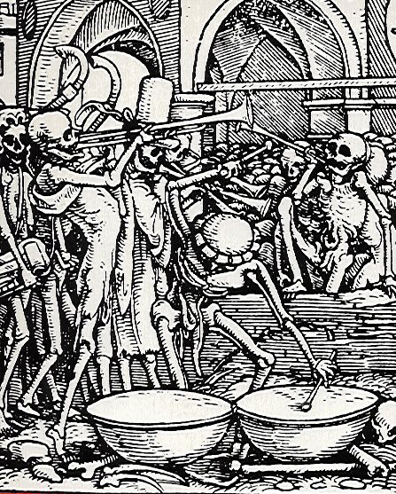
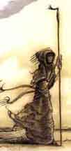
DISASTER STRIKES
Estimated population of Europe from 1000 to 1352.
1000 38 million
1100 48 million
1200 59 million
1300 70 million
1347 75 million
1352 50 million
25 million people died in just under five years between 1347 and 1352.

Slide 24
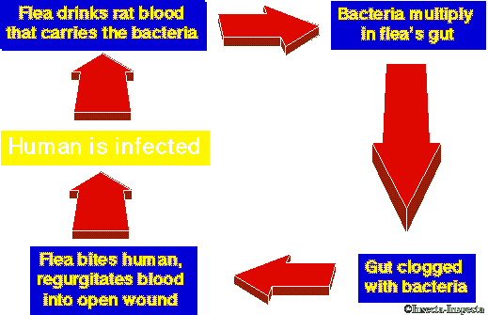
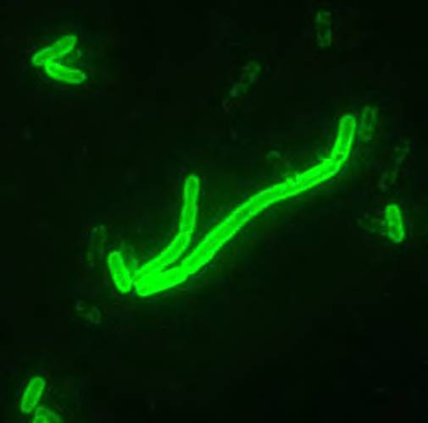
How it was Transmitted
Yersinia pestis seen at 2000x magnification. This bacterium, carried and spread by fleas, is the cause of the various forms of the disease plague

Slide 25
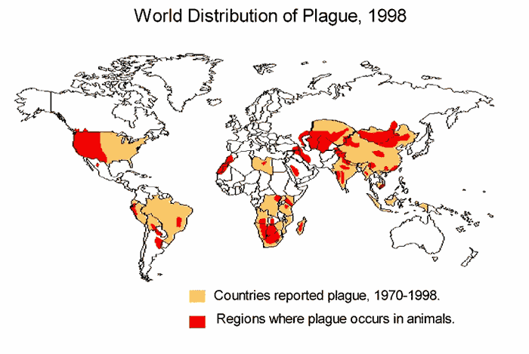

Slide 26
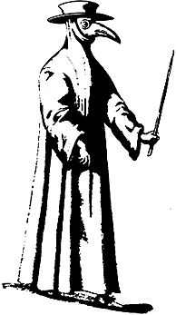
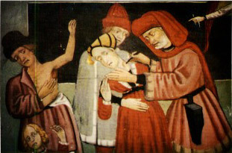
Attempts to Stop the Plague
“Leeching”
A Doctor’s Robe

