Slide 1
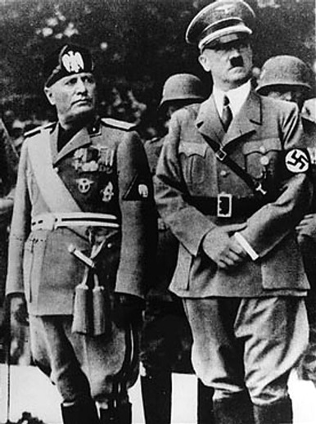
Why did the policy of appeasement fail to stop the aggression of Adolf Hitler and Benito Mussolini??

Slide 2
What is appeasement?
Giving in to an aggressor to keep peace.
What nations became aggressive?
  GERMANY
  Japan
  Spain
  Italy
Why did The League of Nations and European powers chose the policy of appeasement?
  PACIFISM
  NOBODY WANTED TO GO BACK TO WAR (STILL SUFFERING FROM WWI)

Slide 3
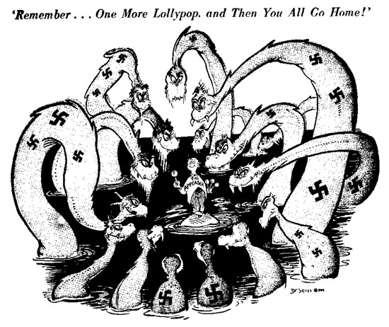

Slide 4
Italian Aggression
What was Benito Mussolini’s goal?
  Create a COLONIAL EMPIRE
Italy attacked Ethiopia because it was weak and had resources. It was easily defeated due to Italy’s superior technology
The League of Nations did nothing to help
  Britain and France APPEASED Italy and ALLOWED it to have Ethiopia

Slide 5
Haile Selassie on Appeasement
After Italy attacked Ethiopia, Haile Selassie, emperor of Ethiopia, asked the League of Nations for help in stopping the invasion. He asked for military sanctions but the League of Nations’ response was ineffective. Haile Selassie used these words to the League of Nations: “God and history will remember your judgment. . . . It is us today. It will be you tomorrow.”
WHAT IS HE IMPLYING ABOUT APPEASEMENT?

Slide 6
Source: Adolf Hitler, Speech on the Treaty of Versailles (1923).
So long as this Treaty stands there can be no resurrection of the German people; no social reform of any kind is possible! The Treaty was made in order to bring 20 million Germans to their deaths and to ruin the German nation. But those who made the Treaty cannot set it aside. As its foundation our Movement formulated three demands: 1. Setting aside of the Peace Treaty. 2. Unification of all Germans. 3. Land and soil [Grund und Boden] to feed our nation. Our movement could formulate these demands, since it was not our Movement which caused the War, it has not made the Republic, it did not sign the Peace Treaty .

Slide 7
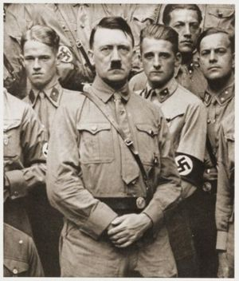
German Aggression
Hitler DEFIED (went against) the Treaty of Versailles
  Hitler began to re-arm Germany (militarization)
  Hitler moved troops into the RHINELAND (Demilitarized Zone)
  Invaded Chechoslovakia
  Anschluss – Union of Germany and Austria
Still, the League Did NOTHING

Slide 8
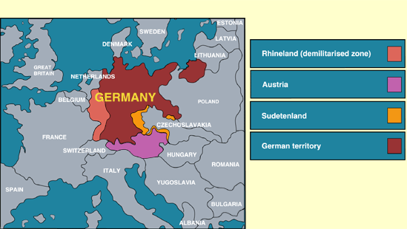
GERMAN EXPANSION

Slide 9
The Rhineland
GERMANY INVADED THE RHINELAND IN 1936
What was the Rhineland and how did the League of Nations respond?
The Rhineland was a strong industrial area
Again…the League of Nations did NOTHING (appeased)
Why did Germany want to control the Rhineland?
Germany wants to use the resources and industry there
Why did France appease Germany?
France didn’t want WAR and APPEASED Germany - gave in to German aggression
The German re-occupation of the Rhineland was a TURNING POINT:
  Strengthened Hitler’s (Germany’s) power
  SHIFTED the balance of power in Europe
  The weak response of France and Britain encouraged Hitler
  Belgium and France were now open to attack

Slide 10
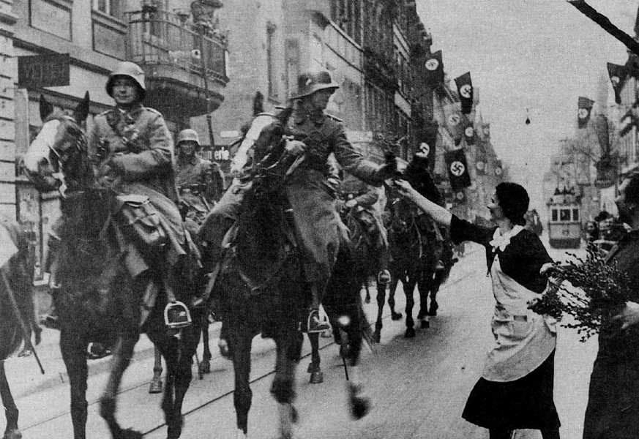

Slide 11
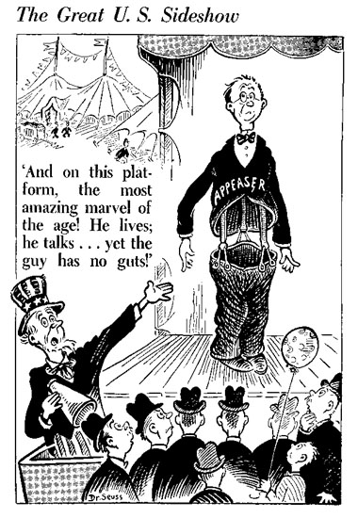
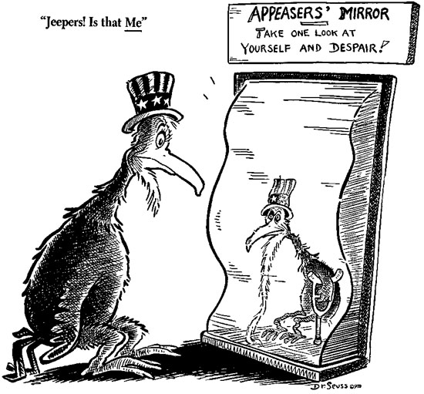

Slide 12

Democratic Nations Try To Preserve Peace
The United States were isolationists, meaning that they avoided ties to other countries.
American’s favored Isolation because they wanted to avoid another war that was a “European Problem” and they were having severe domestic problems (The Great Depression)

Slide 13
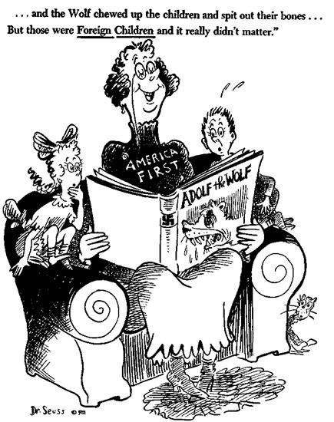

Slide 14
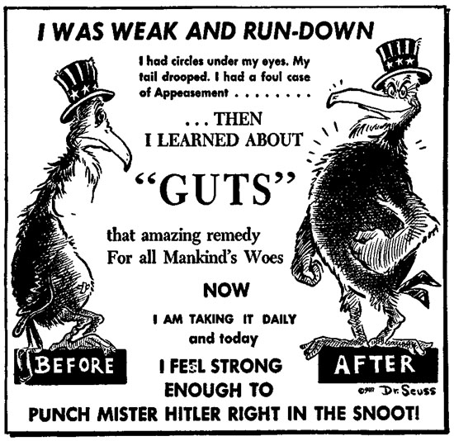

Slide 15
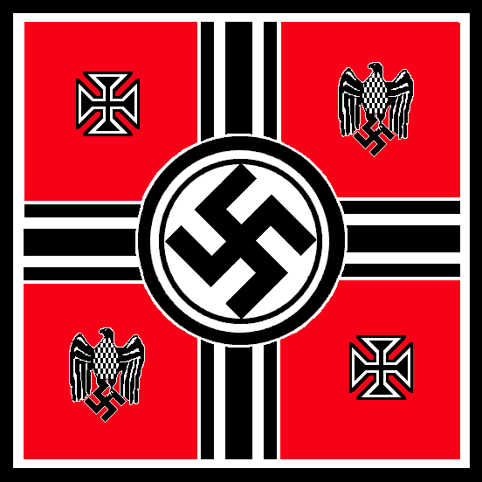
The Third Reich
1937
The German Empire
Hitler announced that he will absorb Czechoslovakia and Austria into the Third Reich or German Empire.
This Anschluss or union between Germany and Austria was forbidden by the Treaty.

Slide 16
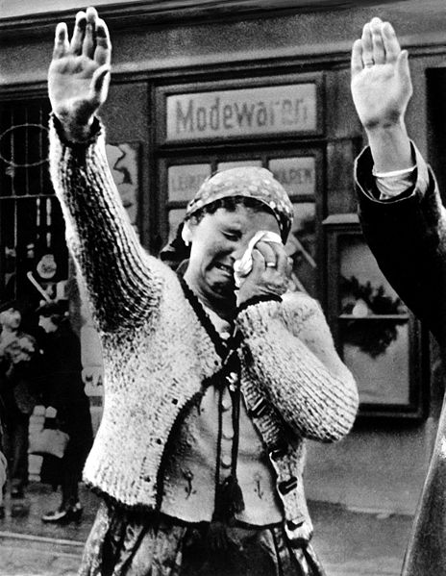
Anschluss
The Anschluss was forbidden to
Keep Germany weak
Protect Austria from German aggression
Achieved in March 1938.
REACTION
Many Austrians supported unity with Germany. (Why?)
France and Britain ignored their promise to protect Austria. (APPEASEMENT)

Slide 17
Czechoslovakia
The Sudetenland
A region on the border of Germany and Czechoslovakia with 3 million German speaking people, known as the Sudetenland
Hitler wanted land to increase Nazi power
Anschluss - raised pro-Nazi nationalism and feelings in Sudetenland
Hitler DEMANDED that the Sudetenland and all of Czechoslovakia be given to Germany
Czechs refused and begged France and Britain for help
What do you think France and Britain did?
APPEASED Hitler

Slide 18
GERMAN EXPANSION

Slide 19
The Axis Powers
Hitler’s success convinced Mussolini (Italy) and Hirohito (Japan) to seek an alliance with him.
Germany, Italy and Japan formed the ROME-BERLIN-TOKYO AXIS or AXIS POWERS.
Their goal was Global Domination
The formation of alliances raises tension

Slide 20
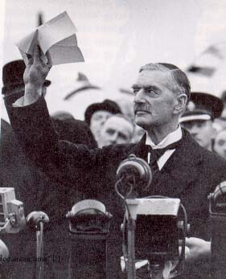
The Munich Conference

Slide 21
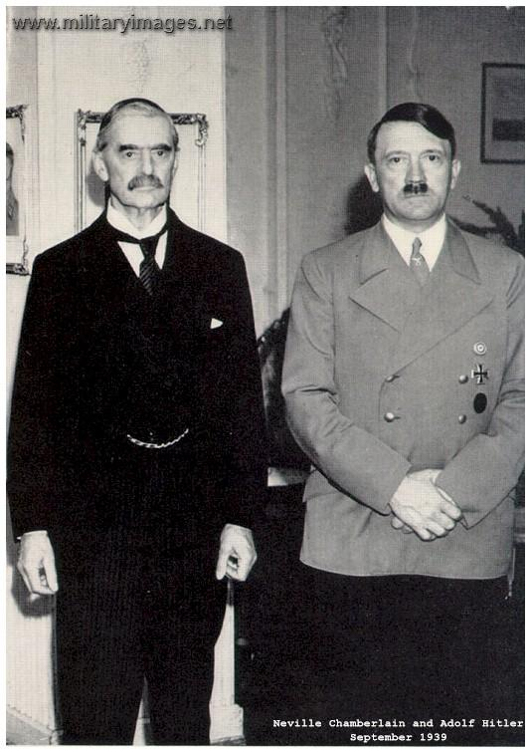
The Munich Conference
Background: Britain and France were preparing for war with Italy
In 1938 the major powers of Europe gathered in Munich to discuss the issue of German aggression in Czechoslovakia (not present).

Slide 22
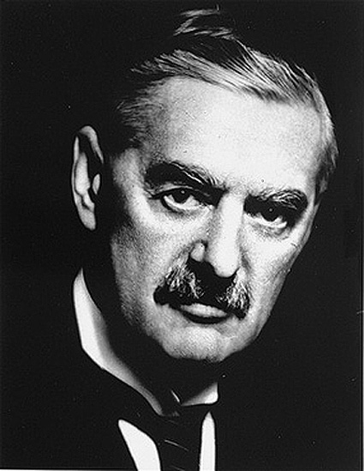
Results of the Munich Conference
RESULTS
Hitler was given the Sudetenland.
Hitler promised to respect the new border of Czechoslovakia.
Chamberlin (Britain) believed that the agreement achieved “peace for our time.”
Czechoslovakia feels betrayed and angry
British Prime Minister Neville Chamberlain believed peace could be achieved if Hitler got what he wanted.

Slide 23
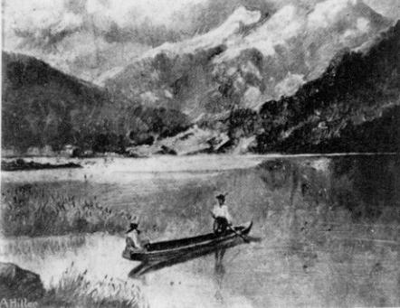

Slide 24
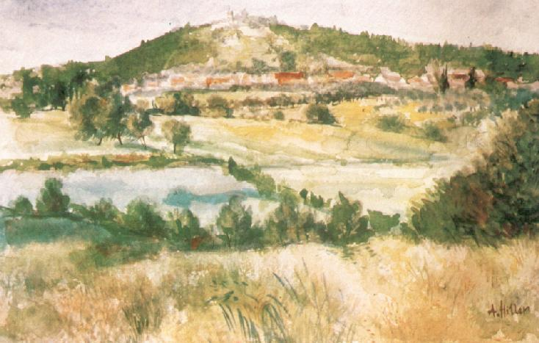

Slide 25
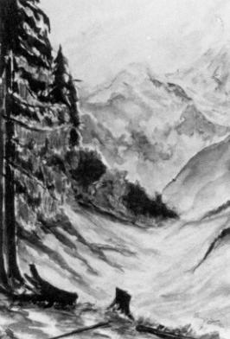

Slide 26
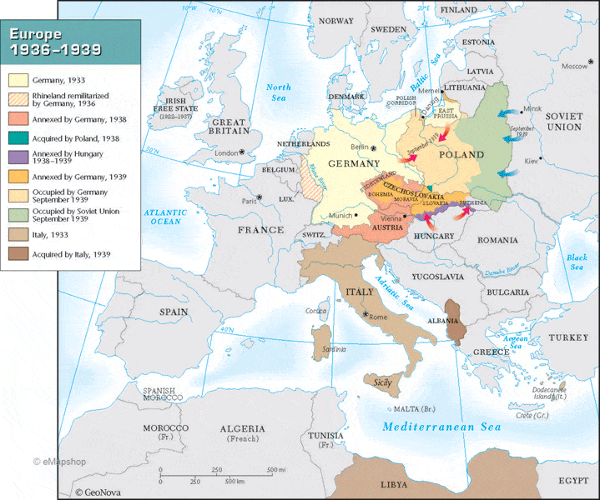

Slide 27
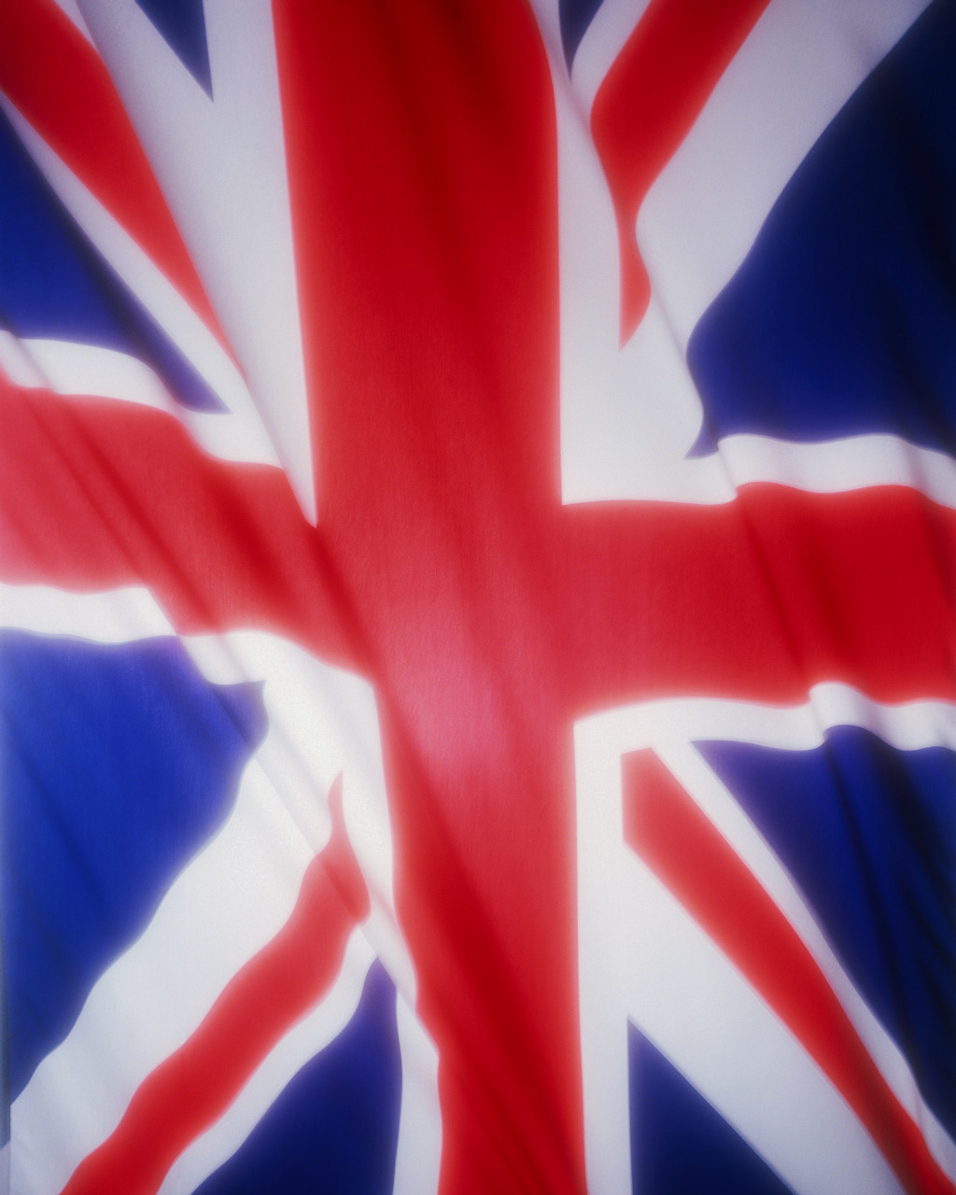
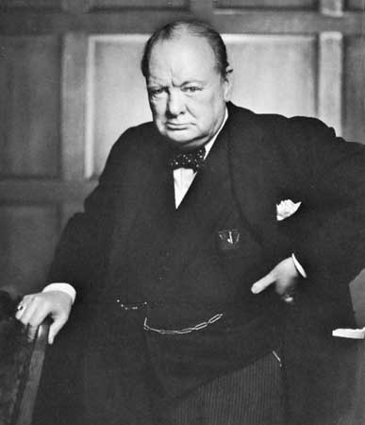
Sir Winston Churchill did not agree…
“ We are in the presence of a disaster…we have sustained a defeat without a war…This is only the first sip of a bitter cup…”

Slide 28
Hitler Wants More…
Hitler Wants More…DEMANDS Polish port of Danzig (lost by Germany in the Treaty of Versailles). Poland refused and asked Britain and France for help.
**Britain and France in turn ask the Soviet Union to help with Germany, but they say NO.
WHY do they say NO?

Slide 29
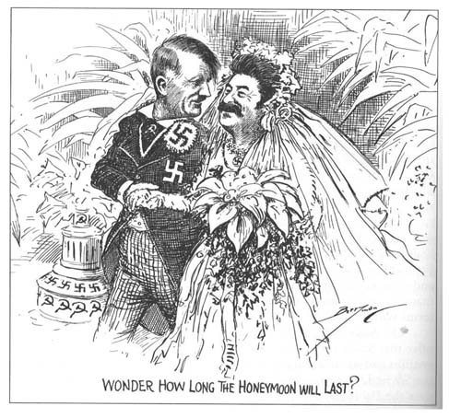
Nazi-Soviet Non-Aggression Pact -1939
France and Britain asked Stalin to form an alliance with them to stop Hitler’s aggression.
Stalin bargained with Hitler.
The two bitter enemies publically vowed not to attack each other!
Notes:
Hitler fears communism
Stalin fears fascism
Both border Poland

Slide 30
Nazi-Soviet Non-Aggression Pact -1939
The Pact: Hitler and Stalin agree not to attack each other for 10 years.
Stalin: Viewed as an opportunity to guarantee peace while he built his military.
Hitler: Viewed as an opportunity to ensure he could invade Poland unopposed.
Poland: It is agreed the Poland will be partitioned (divided) between the two powers.
Notes:
Hitler fears communism
Stalin fears fascism
Both border Poland

Slide 31
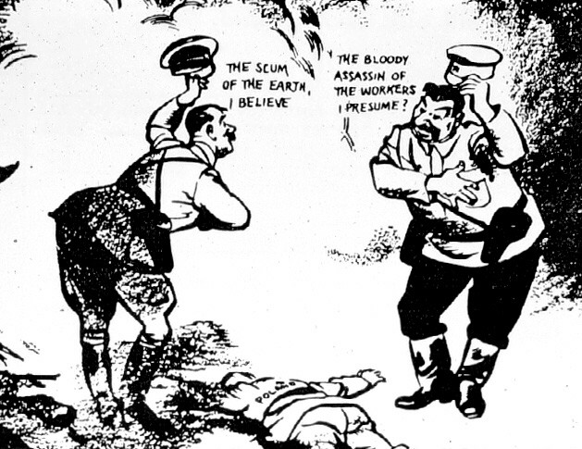

Slide 32
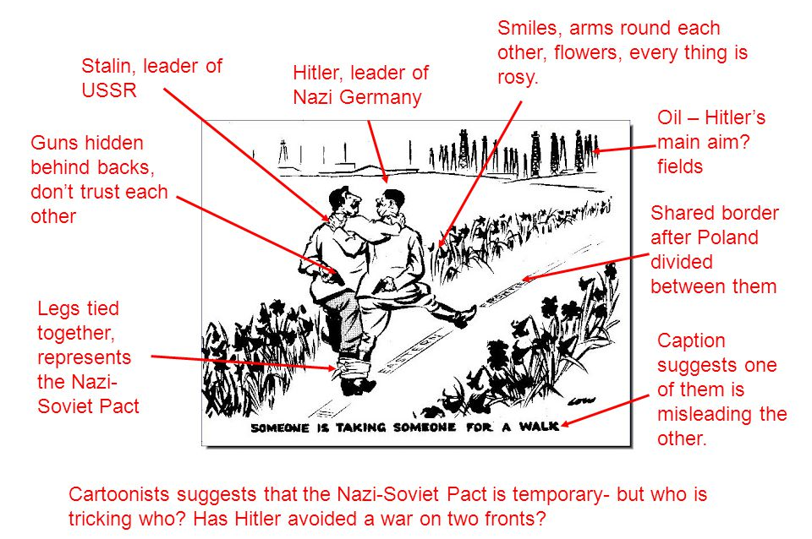

Slide 33
The German Invasion of Poland
Germany used a military strategy known as the blitzkrieg, or “lightning war”
1.5 million German troops invade Poland.
German Luftwaffe (air force) bombed Polish airfields
German warships and U-boats attacked Polish naval forces in the Baltic Sea.
On September 3, Britain and France they declared war on Germany, initiating World War II.

Slide 34
World War II

Slide 35
Key Terms
Annex – To add a region or territory
Appeasement – Making concessions to an aggressor to avoid war.
Lebensraum – “Living Space” – Germany needed more land because it was overcrowded
Isolationism– A national foreign policy in which a country refuses to involve itself with other nations.
Balance of Power- A theory in which stability is created when military power is evenly distributed among nations.

Slide 36
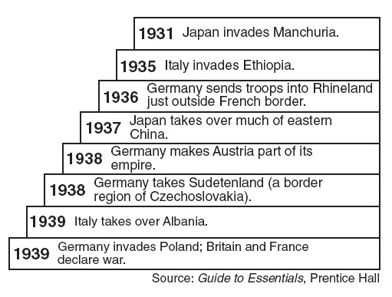
WWI Aggression

Slide 37
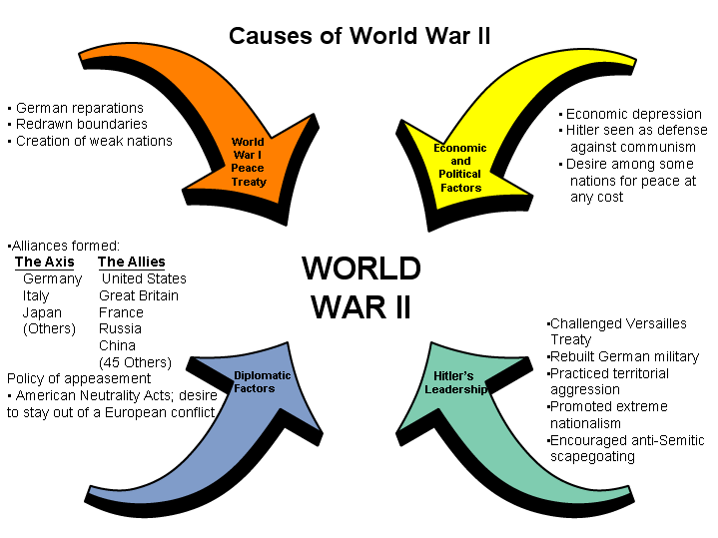

Slide 38
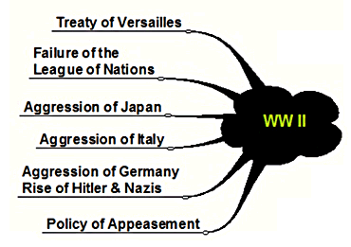

Slide 39
AXIS POWERS DOMINATE THE START OF THE WAR
Axis Powers: Germany, Italy and Japan
  Rome-Berlin-Tokyo Axis
Blitzkrieg – “Lightning War”
  Quick Strikes using Planes/Tanks/Troops
  September 1, 1939 Germany Invades Poland
  France and Britain Declare War

Slide 40
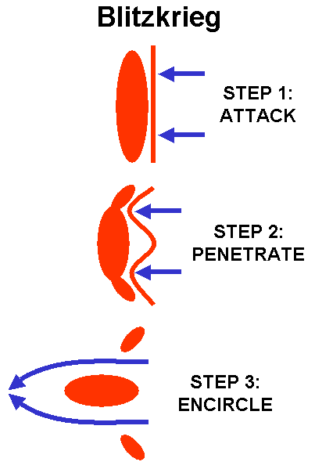

Slide 41
Fall of France (May 1940)
Hitler invades - Attacks PARIS, Germans trap allies - allies retreat to Dunkirk (Rescue at Dunkirk)
Germans controlled N. France (Puppet Government in South)

Slide 42
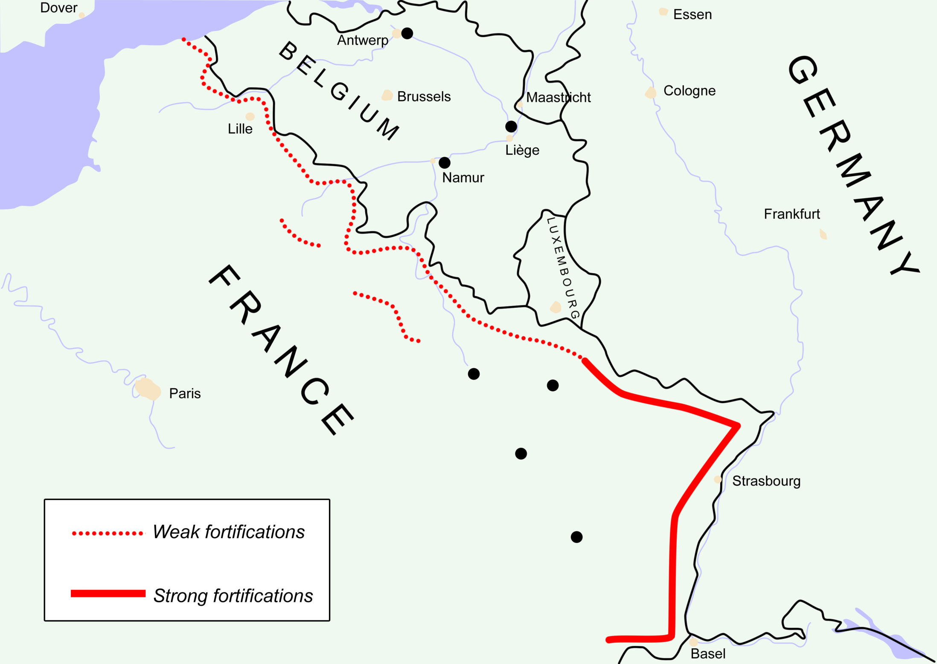

Slide 43
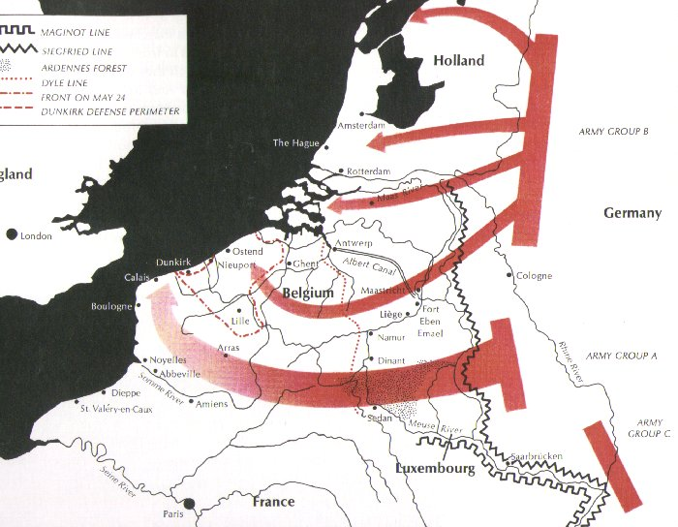

Slide 44
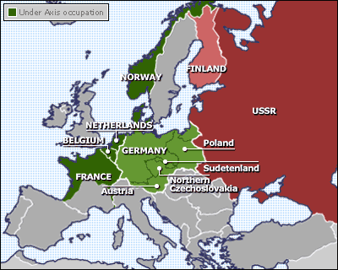

Slide 45
Battle of Britain
New British Leader – Winston Churchill (Prime Minister)
“We shall fight on the beaches, we shall fight on the landing grounds, we shall fight in the streets…we shall never surrender”
Air Battles
  Luftwaffe – German Air Force
  Royal Air Force – Britain
    Radar and Enigma (new inventions)
Hitler calls off attacks

Slide 46
War in the Balkans
Balkans are key location to attack USSR
Bulgaria, Romania and Hungary Join Axis
  Yugoslavia and Greece (Pro-Britain) are Invaded and Conquered

Slide 47
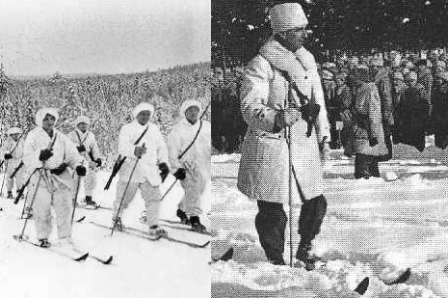

Slide 48
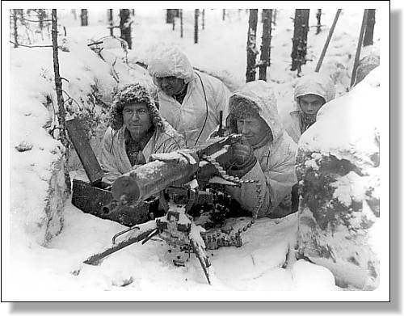

Slide 49
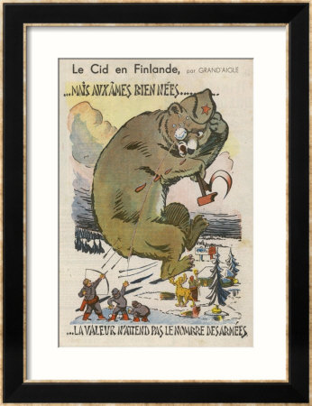

Slide 50
Aim: Why was the Battle of Stalingrad a turning point in WWII?

Slide 51
Hitler Invades USSR
OPERATION BARBAROSSA
June 22, 1941 – Surprise Attack of Russia
  Soviets Retreated – Scorched Earth
September 1, 1941– Germans attack Leningrad
  Hitler starves over 1 million – No Surrender
October 2, 1941 – Hitler Moves Toward Moscow
  Soviets Counter Attacked
    Hitler Orders “No Retreat” – Dug in
    500,000 German Lives Lost
Notes:
Soviet General Georgi Zhukov

Slide 52
Battle of Stalingrad
German Goals
  Seize Oil Fields in Caucasus Mts
  CAPTURE STALINGRAD
  Use Nightly Bombing Raids to DEMORALIZE RUSSIA (Luftwaffe – German Air Force)
    City Reduced to Rubble, Germans control 90%
    No Soviet Surrender
Russian Strategy
  COUNTER ATTACK
    Trapped Germans, Cut off supplies
  No Mercy
    Germans BEGGED for Hitler to order retreat (never happens)
    90,000 Germans surrender
Notes:
German General – Friedrich Paulus

Slide 53
Results of Stalingrad
Over 1 Million Soviets Dead
Soviets begin to push Germans West
Tide of WWII is turning toward Allies

Slide 54
Aim: What was Japan’s role in WWII?

Slide 55
Meiji Restoration: Period in which Japan WESTERNIZED and MODERNIZED
Why does Japan become imperialistic?
As they INDUSTRIALIZED there is a need for RAW MATERIALS and FOREIGN MARKETS.

Slide 56
Japanese Conquests
Manchuria and China (1st Aggression)
Guam, Wake Island and Philippines
Indonesia, Thailand, Malay, Burma
  → Strategic Location for attack on India (“Crown Jewel”)
Japanese were HARSH rulers
  No More “Asia for Asiatics”

Slide 57
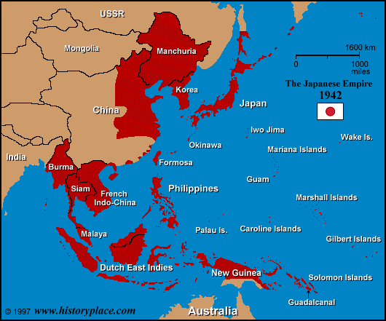

Slide 58
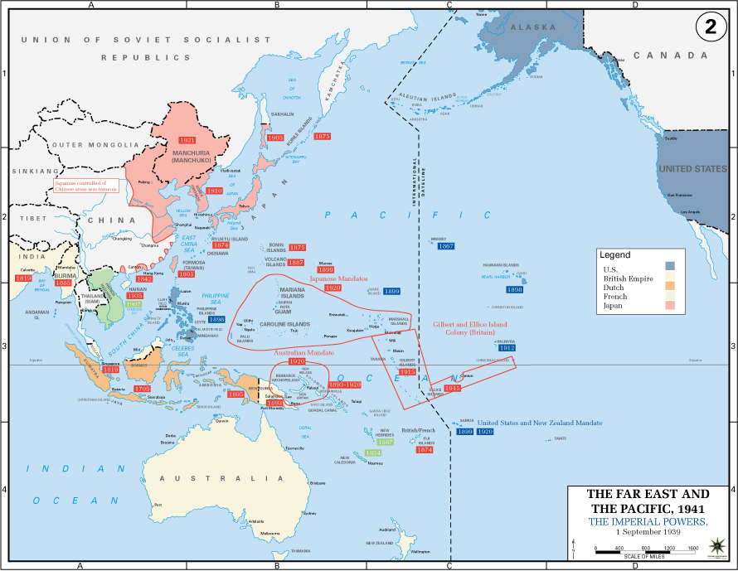

Slide 59
Why were there tensions between the US and Japan?
Japanese aggression threatened US territories (Philippines and Guam)
Japanese Conquer French Indo-China
  FDR cuts off oil shipments to Japan

Slide 60
Aim: Why did the US Get involved in WWII?

Slide 61
Why did many Americans support the policy of isolationism?
Pacifism
Great Depression
Perception that this was a “European” Problem

Slide 62
EARLY US INVOLVEMENT
Lend Lease Act – March 1941
Allowed President (FDR) to sell or lend war materials to any country whose defense was vital to US security.
Atlantic Charter – August 1941
FDR and Churchill (Britain) met secretly to set goals for the war.
“Final Destruction of Nazi Tyranny”

Slide 63
Surprise Attacks
Pearl Harbor - December 7th 1941
Events of December 7th
Japanese attacks on harbor began at dawn
Coded messages were de-coded too late
Sunk or damaged 19 Naval Ships
2,300 US killed – 1,100 US wounded
Impact of the attack on Pearl Harbor
FDR – “A Day Which Will Live in Infamy”
Congress declares war on Japan and allies
FULL POPULAR SUPPORT FOR WAR

Slide 64
A Day of Infamy
Solicitation: the act of asking for or trying to obtain something from someone
Maintenance: the process of maintaining or preserving someone or something
Commence: begin; start
Deceive: cause to believe something that is not true, typically in order to gain some personal advantage.
Implications: the conclusion that can be drawn from something, although it is not explicitly stated
Diplomatic: managing international relations in an effective way

Slide 65
A Day of Infamy
Onslaught: a fierce or destructive attack
Premeditated: think out or plan (an action, especially a crime) beforehand
Hostilities: acts of warfare.
Treachery: betrayal of trust; deceptive action or nature
Unprovoked: (of an attack, or a display of aggression or emotion) not caused by anything done or said

Slide 66
WAR IN THE PACIFIC

Slide 67
The Allied Offensive
Doolittle – Attack on Tokyo
Battle of the Coral Sea/Battle of Midway
General Douglas MacArthur - “Island Hopping”
  Battle of Guadalcanal - “Island of Death”
  Allies Win
Allies destroyed Japanese Navy
March 1945 – Allies took Iwo Jima
April 1945 – Allies took Okinawa
Notes:
MIDWAY – ALLIES KNEW ABOUT ATTACK

Slide 68
“Hell was red furry spiders as big as your fist,…enormous rats and bats everywhere, and rivers with waiting crocodiles. Hell was the sour, foul smell of the squishy jungle, humidity that rotted a body within hours…Hell was an enemy…so fanatic that it used its own dead as booby traps.” – Ralph G. Martin

Slide 69
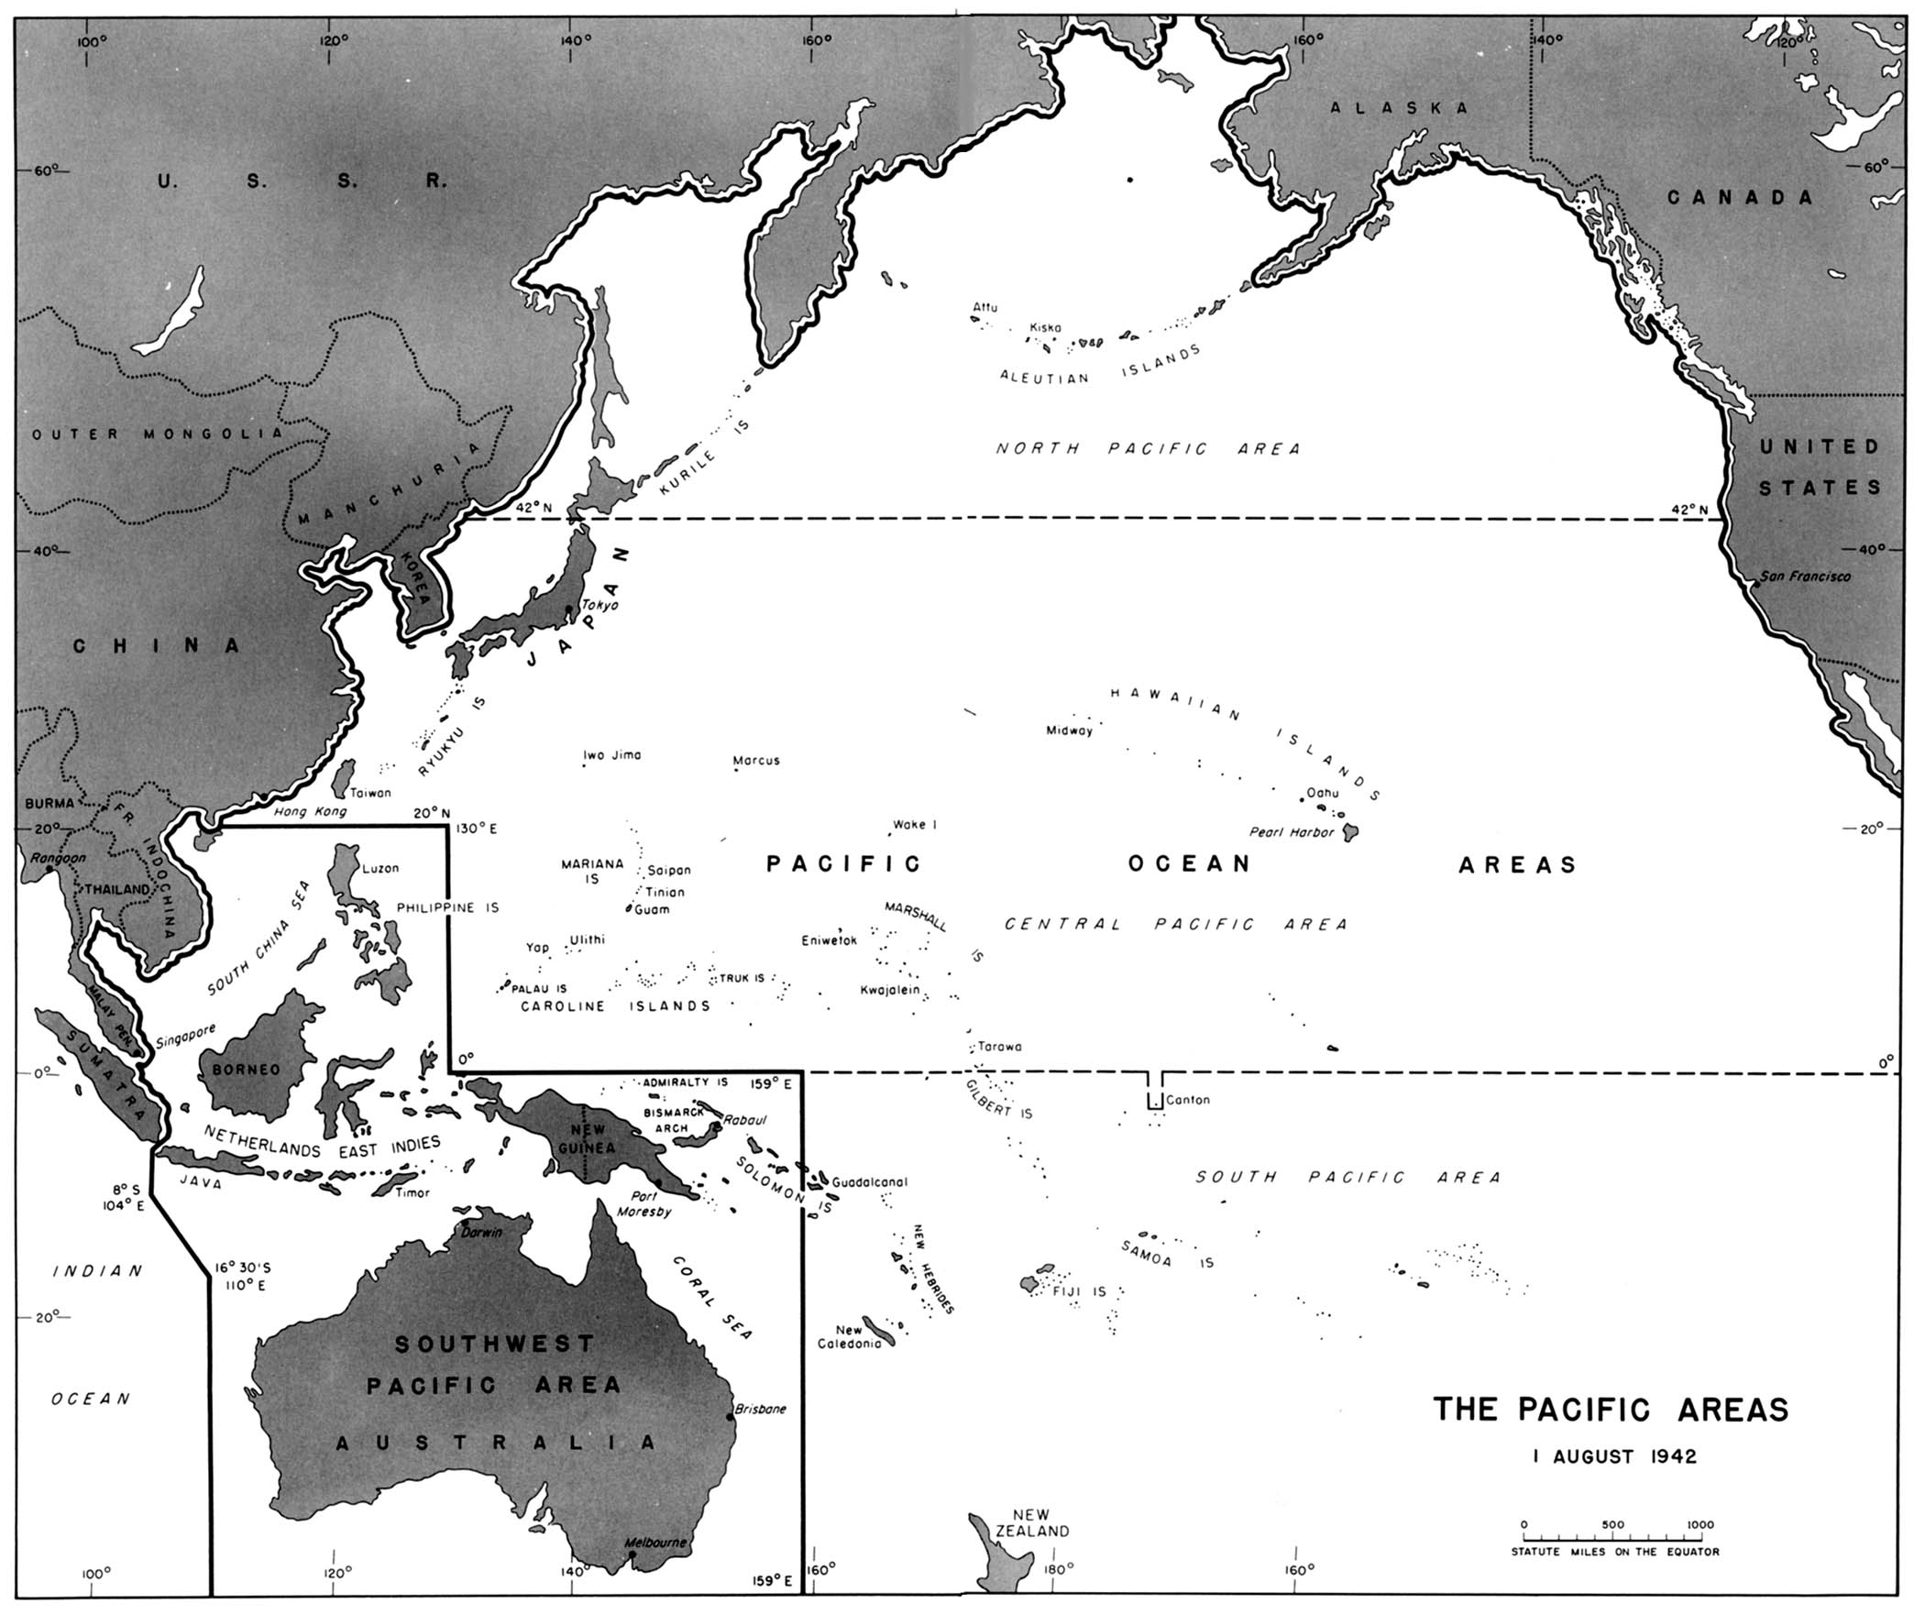

Slide 70
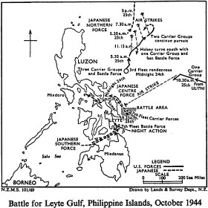

Slide 71
Japanese Surrender
FDR Dies – Harry Truman becomes President
Truman is advised on war
  Invasion of Japan would cost over 500,000 US lives
President Truman issues ultimatum to Japan – Surrender or else… “Rain of Ruin from the air”
Notes:
Manhattan Project: Gen Leslie Grove and Scientis Robert Oppenheimer

Slide 72
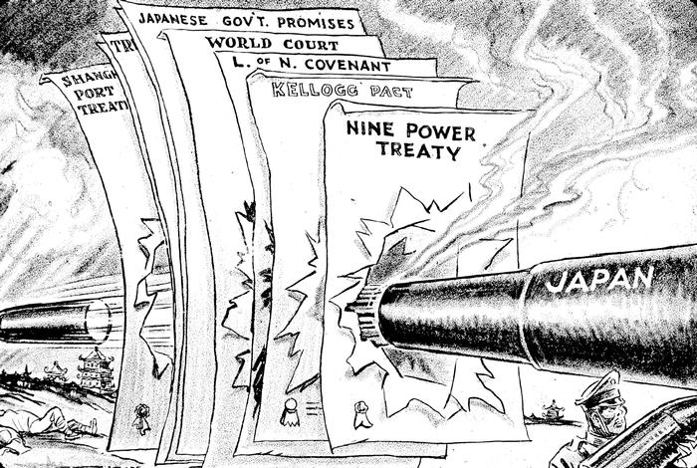

Slide 73
The A - Bomb
Manhattan Project – Secret U.S. team of scientists worked to create an ATOMIC BOMB
Japanese do not respond to Truman’s ultimatum
THE US DROPS TWO ATOMIC BOMBS ON JAPAN
  August 6, 1945 – Hiroshima
  August 9, 1945 - Nagasaki
IMPACT OF THE ATOMIC BOMB:
  Devastating, over 70,000 killed immediately in each city
  Total deaths related to bomb over 400,000
  September 2, 1945 – Japan Surrenders
Notes:
Surrender on USS MISSOURI

Slide 74
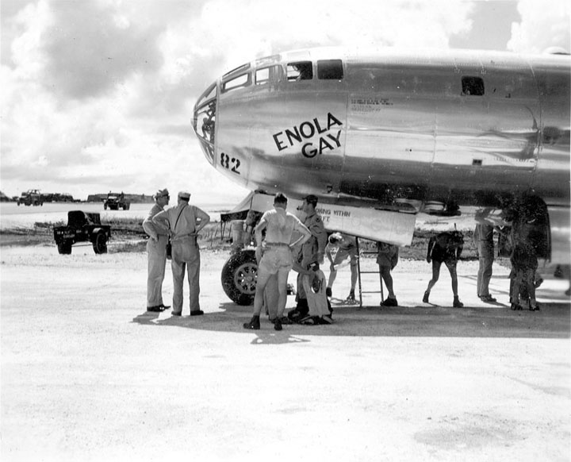

Slide 75
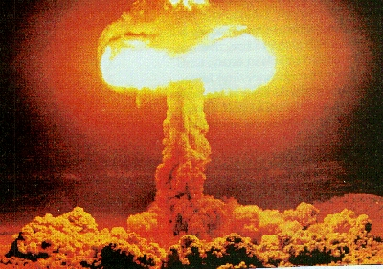

Slide 76
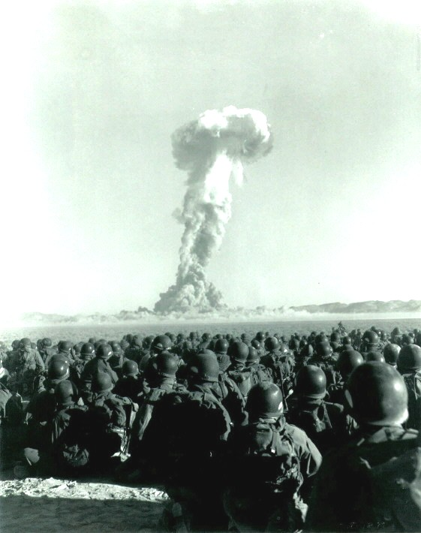

Slide 77
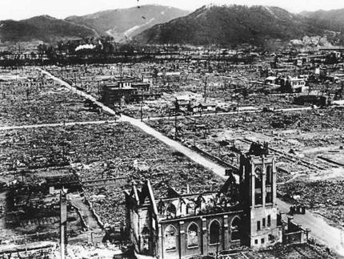
Hiroshima

Slide 78
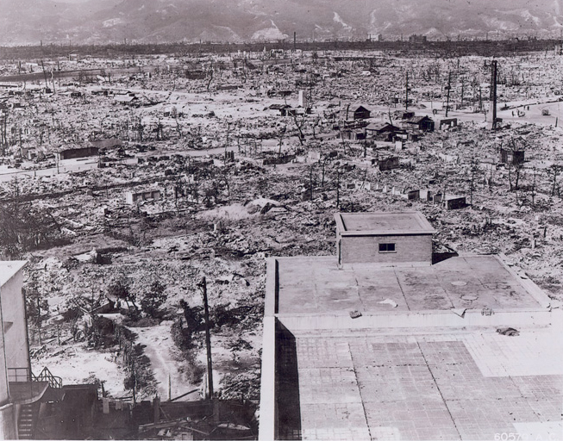
Hiroshima

Slide 79
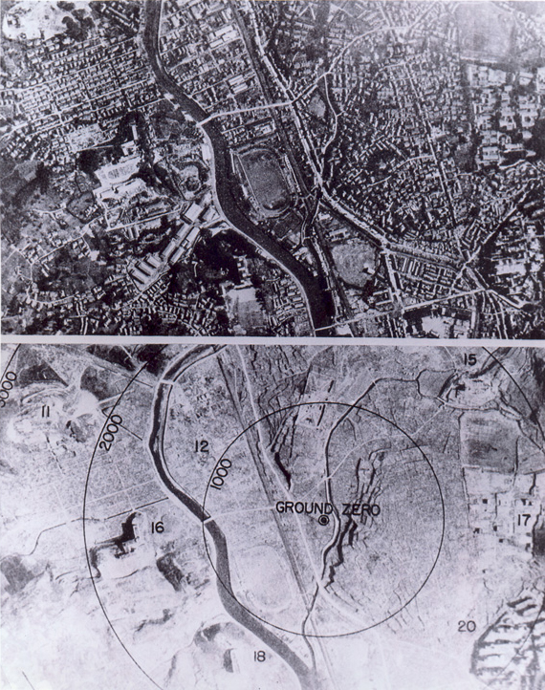
Nagasaki Before and After

Slide 80
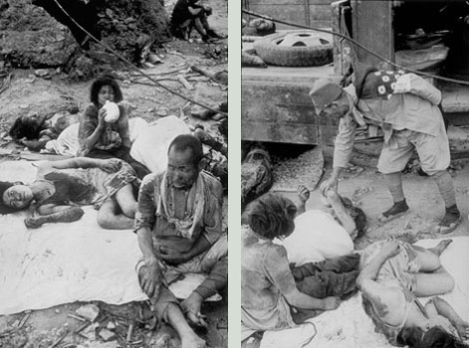

Slide 81
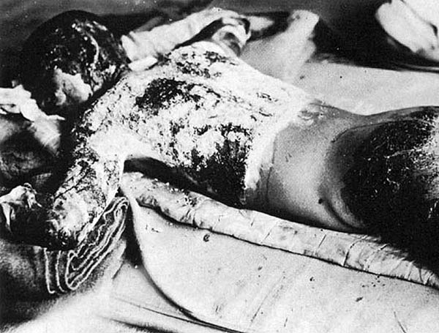

Slide 82
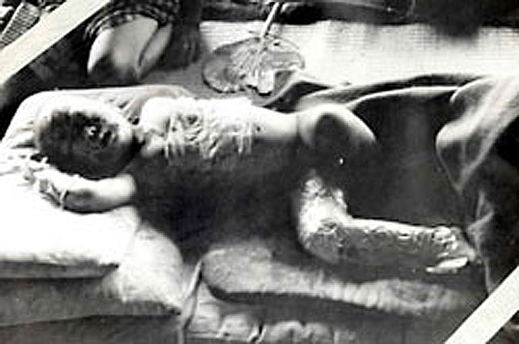

Slide 83
Aim: How was WWII Won by the Allies?
(European Theater)

Slide 84
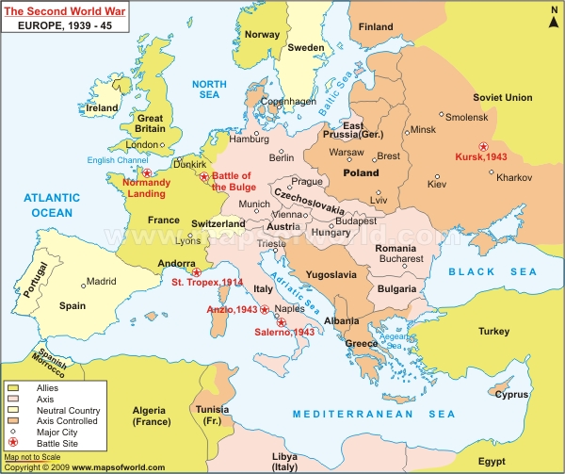

Slide 85
ALLIES ADD FRONTS TO THE WAR
NORTH AFRICA- Operation Torch
British –Gen. B. Montgomery (“Monty”)
US – Dwight D. Eisenhower
US/British Armies forced Axis surrender
ITALY
Allies conquer Sicily – Mussolini Out
Allies Control – German Resistance

Slide 86
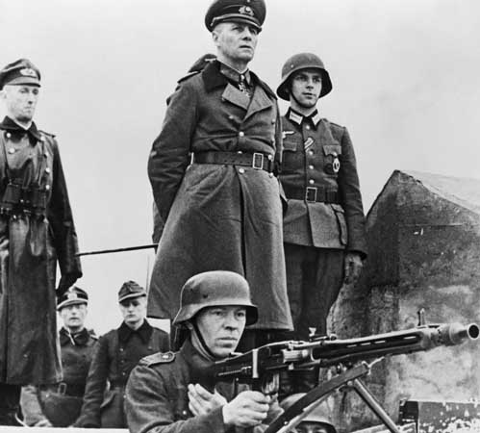

Slide 87
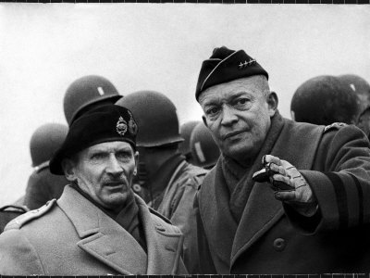

Slide 88


Slide 89


Slide 90
Allies Invade Europe

Slide 91
D – Day: June 6, 1944
Known as Operation Overlord
  Largest land sea attack in History
  Allied attack on the beaches of France (Normandy)
  Many deaths but Allies (Gen. Patton) broke through German fortifications

Slide 92


Slide 93


Slide 94


Slide 95


Slide 96


Slide 97


Slide 98
Battle of the Bulge
Germans are now fighting a two-front war AGAIN, Allies (West) – Soviets (East)
Hitler counter attacks the West
Germans broke through American defense lines but had no reinforcements – Allies eventually win

Slide 99


Slide 100


Slide 101
V–E Day May 9, 1945
Allies (3 mil) and Soviets (6 mil) close in on Berlin
Hitler and Eva Braun commit suicide
May 7, 1945 – General Eisenhower accepts unconditional surrender of the German Third Reich

Slide 102
Aim: Legacy of WWII

Slide 103
Costs of World War II
Nation | Direct War Costs | Military Killed/Missing | Civilians Killed
United States | 288 Billion | 292,131 | -
Great Britain | 117 Billion | 272,311 | 60,595
France | 111.3 Billion | 205,707 | 173,260
USSR | 93 Billion | 13,600,000 | 7,720,00
Germany | 212.3 Billion | 3,300,000 | 2,893,000
Japan | 41.3 Billion | 1,140,429 | 953,000

Slide 104
Europe is Destroyed
40 Million Dead – 2/3 are civilians
Hundreds of Cities Destroyed
  London, Warsaw, Berlin in ruins
  No water, electricity or food

Slide 105
THE HOLOCAUST
Nuremberg Laws
  Laws that deprived Jews of rights
Kristallnacht: Night of Broken Glass
  November 9, 1939 - Waves of violence against Jews begin
  Jews are forced to live in Ghettos
The “Final Solution”
  Genocide – Systematic killing of an entire people
  Concentration Camps

Slide 106
Elie Wiesel - Night
Never shall I forget the little faces of the children, whose bodies I saw turned into wreaths of smoke beneath a silent blue sky. Never shall I forget those flames which consumed by faith forever…Never shall I forget those moments which murdered my God and my soul and turned my dreams to dust…Never.

Slide 107
Country | Original Jewish Population | Jews Killed | Percent Surviving
Poland | 3,300,000 | 2,800,000 | 15%
Soviet Union | 2,100,000 | 1,500,000 | 29%
Hungary | 404,000 | 200,000 | 49%
Romania | 850,000 | 425,000 | 50%
Germany/Austria | 270,000 | 210,000 | 22%

Slide 108
Nuremberg Trials
International Military Tribune – 23 Nations
22 Nazi leaders charged with “Crimes Against Humanity”
“Just Following Orders” is not a DEFENSE

Slide 109
Aim: What was the impact of WWII?

Slide 110
Agreements between the Allies
Tehran (Capital of Iran) Conference
  D –Day/Cooperation with Stalin
  New International Organization to replace League of Nations (United Nations)

Slide 111
Yalta Conference
United States, Great Britain and Soviet Union
THE BIG 3: FDR, Winston Churchill, Joseph Stalin
Divided Germany into 4 Zones of Occupation
Germany - reparations to Soviet Union
Stalin agreed to allow free elections in Eastern Europe
Creation of the United Nations (1945)
Created to help settle international disputes
Notes:
Generaly Assembly – 50 Countries, 5 Permanent Members of Security Council: Britain, France, US, China and USSR

Slide 112


Slide 113


Slide 114
Potsdam Conference
GOAL: Germany must be disarmed, demilitarized and de-Nazified
Trials for War Criminals
  Nuremberg Trials
Germany – Reparations to Soviets
Changed boundaries in Eastern Europe
  Self Determination: Right of people to choose their own government

Slide 115
Postwar Rebuilding
Truman Doctrine
  President Harry Truman decided to provide support for countries that resisted communism
  400 Million in aid to Greece and Turkey
Marshall Plan
  Secretary of State George Marshall
  $12.5 Billion in aid to rebuild western Europe

Slide 116


Slide 117


Slide 118


Slide 119


Slide 120
One of the primary objectives of the foreign policy of the United States is the creation of conditions in which we and other nations will be able to work out a way of life free from coercion. This was a fundamental issue in the war with Germany and Japan. Our victory was won over countries which sought to impose their will, and their way of life, upon other nations. To ensure the peaceful development of nations, free from coercion, the United States has taken a leading part in establishing the United Nations. The United Nations is designed to make possible lasting freedom and independence for all its members. We shall not realize our objectives, however, unless we are willing to help free peoples to maintain their free institutions and their national integrity against aggressive movements that seek to impose upon them totalitarian regimes. This is no more than a frank recognition that totalitarian regimes imposed on free peoples, by direct or indirect aggression, undermine the foundations of international peace and hence the security of the United States.

Slide 121


