Slide 1
Unit 1 Exam Review Historical Skills The World in 1750 Age of Reason Age of Revolution Age of Nationalism

Slide 2
Unit 1 & 2 Topics
Historical Skills
Enduring Issues
Evaluating Sources
The World in 1750
Patterns of Interaction
Major Empires
Age of Reason
Scientific Revolution
Enlightenment
Age of Revolutions
French Revolution
Latin American Revolutions
Age of Nationalism
Nationalistic Leaders
Causes of Nationalism
Impacts of Nationalism

Slide 3
Enduring Issues: Issues that persist throughout history.
Ex. Conflict, Impact of Geography, Inequity, Power, Population
Primary Source – First hand account of an event, an original account.
Secondary Source – A compilation or summary of first hand accounts.
Evaluation of Sources: Historians gather multiple sources, consider bias and credibility when evaluating a source for usefulness.

Slide 4
The World in 1750
Major Empires: Ottomans, Safavid, Mughal, Tokagawa Shogunate, Britain, Spain
Key Trade Routes: Mediterranean Sea, Indian Ocean, Atlantic Ocean (Triangular Trade)
Comparison of Mughal Empire and Tokagawa Shogunate:
Mughal Empire – Tolerant and open to trade and interaction with outsiders.
Tokagawa Shogunate – Intolerant and isolated from trade and interaction (by geography and policy)

Slide 5
Scientific Revolution
Main Ideas:
Advances of Scientific Revolution made people question long established ideas and practices
Questioned concepts of Divine Right and Absolutism
Used observation and experimentation to challenge traditional ideas
Conflict with the Catholic Church (Galileo)
Important People
Copernicus – Heliocentric Theory
Galileo – Astronomy
Kepler – Elliptical Orbits
Newton - Gravity

Slide 6
Enlightenment
Main Ideas:
Questioned concepts of Divine Right and Absolutism
Used reason/logic to solve societal problems
If government failed to protect Natural Rights → People should overthrow the gov’t
Encouraged Political Reform
Important People
Hobbes – “Leviathan”/Absolute Monarchy
Locke – Natural Rights, Social Contract Theory
Rousseau – “General Will”
Voltaire – Free Speech, Religion
Montesquieu – 3 Branches of Government/Separation of Powers

Slide 7
French Revolution: Causes
Causes: Political, Social, and Economic factors
Absolutism: Overspending, Weak leadership, No political power for 3rd estate
Social Inequality: 3 Estate System (social classes)
Economic Injustices
Huge gap between the rich and the poor
Unfair tax system
Food shortages and poor harvests
The Enlightenment
English & American Revolutions

Slide 8
French Revolution: Phases
Stages of the Revolution
Old Regime - Conservative
National Assembly – Moderate
Tennis Court Oath
Storming of the Bastille
Declaration of the Rights of Man and Citizen
Reign of Terror – Radical
Maximillian Robespierre and Jacobins
Directory – Moderate
Napoleon – Conservative
Return to Stability
Mistakes: Continental System, Peninsular War, & Russian Invasion

Slide 9
French Revolution: Effects
Congress of Vienna: establish lasting peace in Europe
Inspires Latin American Revolutions
“Subjects” become “CITIZENS”
French Nationalism

Slide 10
Latin American Revolutions
Causes of Latin American Revolutions
Enlightenment ideas
American and French Revolutions
Social Injustices
Leaders:
Toussaint L’Ouverture-Haiti
Simon Bolivar-Venezuela, Peru, Colombia
Jose de San Martin-Chile
Dom Pedro-Brazil
Mexican Revolution
Father Hidalgo, Emilio Zapata, Pancho Villa
Effects of Latin American Revolutions
Independence from European nations

Slide 11
The Age of Nationalism
Nationalist Leaders
Germany: Otto Von Bismarck
Blood and Iron – Unify Germany by building a powerful military state and fighting for UNITY.
Italy: Giuseppe Mazzini (The Soul), Giuseppe Garibaldi (The Sword), Count Camillo Cavour (The Brains)

Slide 12
Main Ideas – Nationalism
Nationalism can be a powerful force for UNITY
Germany and Italy are UNITED by Nationalism
Nationalism can be a powerful force for DIVISION
Balkans – “Powder Keg of Nationalistic/Ethnic Tension
Austro-Hungarian Empire
Ottoman Empire (Multi-National Empire)
Common culture, values, language, religion can bond people together
Nationalism causes people to fight for independence or revolt against oppressive Governments.
Nationalism leads to CONFLICT in Europe

Slide 13
“. . . . The work of Toussaint, Dessalines, Christophe, and Pétion endures in Hayti [Haiti], but what they did went far, far beyond the boundaries of the island. The Haytian revolution has had a profound influence on the history of the nineteenth century. . . . So far the negative aspect. There were others more positive. Hayti gave the impulse to and subsidised [supported] the first national revolutions in Spanish America. When the Spanish American colonies saw that such a small and weak community could win and keep its freedom, they took courage to fight for their own emancipation from European imperialism. In dark days, Bolivar the Liberator, ill and in distress, was welcomed by Pétion, nursed to health and given courage to lead the struggling nationalities against Spain. He failed and returned to Hayti. He was once again befriended. Pétion supplied him with arms, munitions, men, money, and printing material, and thus fortified he left Hayti to begin the campaign which ended in the emancipation of the Five States. Pétion asked nothing in return but the freedom of the slaves. . . .”C. L. R. James has stated that the success of the Haitian Revolution was almost entirely the result of the leadership of Toussaint L’Ouverture.

Slide 14
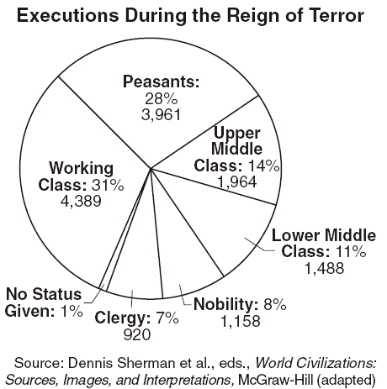

Slide 15
We are moreover neither Indians nor Europeans, but a race halfway between the legitimate owners of the land and the Spanish usurpers—in short, being Americans by birth and endowed with rights for Europe—find ourselves forced to defend these rights against the natives while maintaining our position in the land against the intrusion of the invaders. Thus we find ourselves in the most extraordinary and complicated situation…The idea of merging the entire New World into a single nation with a single unifying principle to provide coherence to the parts and to the whole is both grandiose and impractical. Because it has a common origin, a common language, similar customs, and one religion, we might conclude that it should be possible for a single government to oversee a federation of different states to eventually emerge. However, this is not possible because America is divided by remote climates, diverse geographies, conflicting interests and dissimilar characteristics.
Source: Jamaican Letter, Simon Bolivar 1815.

Slide 16
