Slide 1
Aim: The World of Islam

Slide 2
Islam Vocabulary
Islam – Monotheistic religion rooted in Judaism and Christianity
Muslim – Follower of Islam
Arab – Speaker of an Arab language (Middle East)
Allah – Arabic word for “God”
Mecca – Holy city of Islam (Saudi Arabia)
Hajj (Pilgrimage) – Trip to a holy site
Koran (Quran) – Holy Text of Islam
5 Pillars – Code of Conduct for Muslims

Slide 3
Why is Islam so spreadable?
Islam is a way of life
Legal system
All people are spiritually equal
Code of conduct (5 Pillars)
Common Culture/Identity (Arab World)
Islam spreads through conquest
Conquers land in Middle East, Africa and Spain
Great military (cavalry)
Jihad (Holy Wars)

Slide 4
Why was Islam’s spread such a SUCCESS?
Weak Enemies
Byzantine and Persians
Strong Military
History of Brave and skilled warriors
Common Cause – ARAB EMPIRE

Slide 5
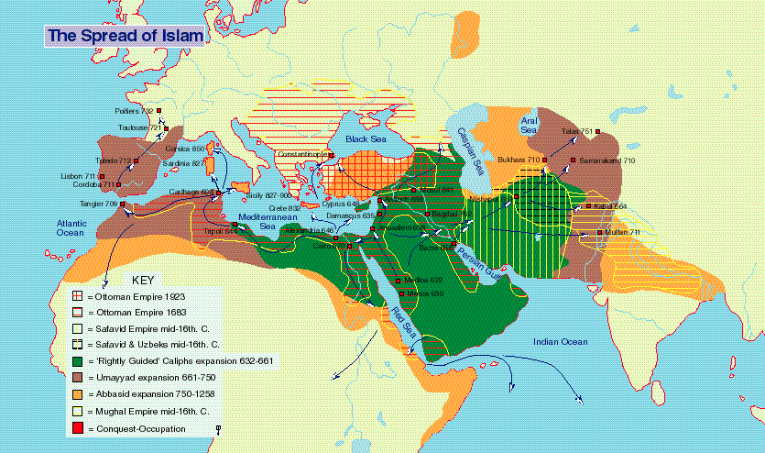

Slide 6
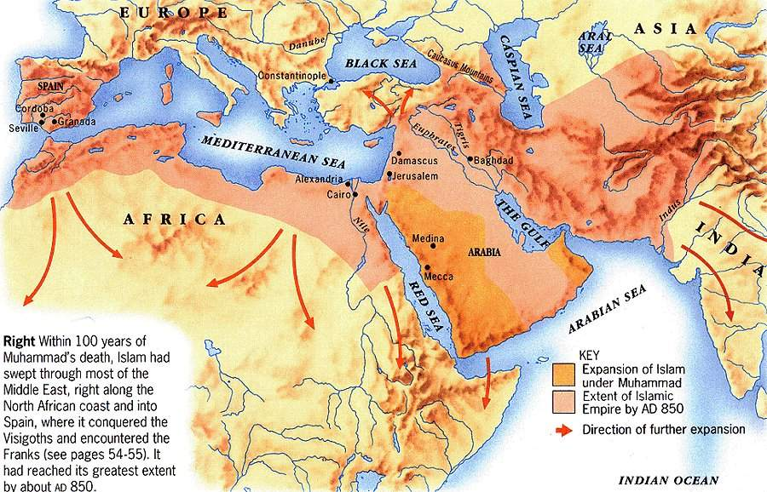

Slide 7
How Did Muslims Treat Conquered People?
Christians and Jews are “PROTECTED PEOPLE”
Non-muslims had to pay heavy taxes
Slave class (NO MUSLIMS)
Social mobility
Why convert?

Slide 8
THE GOLDEN AGE OF ISLAM
INTERNATIONAL TRADE
Merchants are honored (Muhammad)
Banking systems (checks)
Trade with India and China
CULTURAL DIFFUSION

Slide 9
THE GOLDEN AGE OF ISLAM
ART/ARCHITECTURE
Mosaics and Calligraphy
Thousand and One Nights
Advanced Cities (Damascus)
Mosques
Learning
Elementary Education
Reading and Writing
Preservation of Ancient Learning

Slide 10
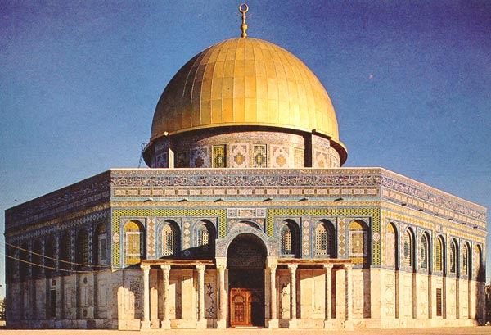
Dome of the Rock

Slide 11
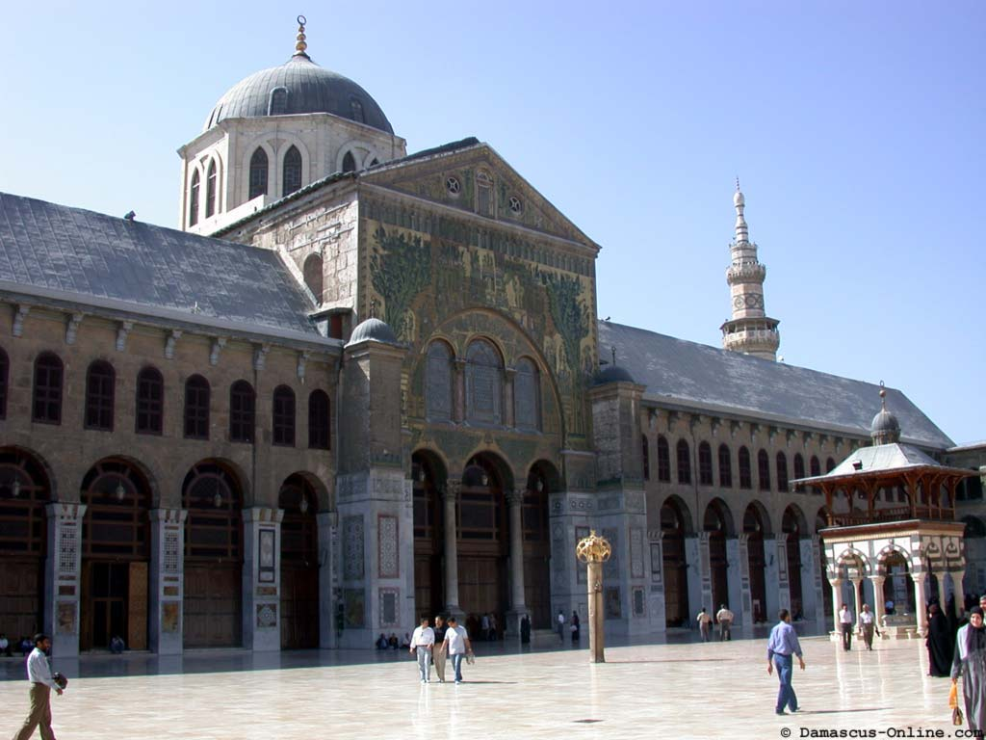

Slide 12
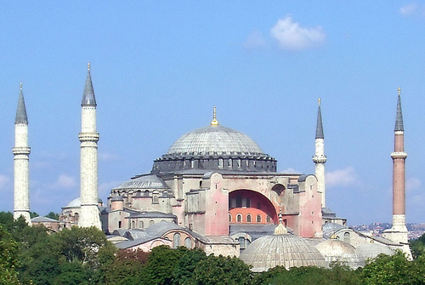
Do you see any similarities?
HAGIA SOPHIA in the Byzantine Empire

Slide 13
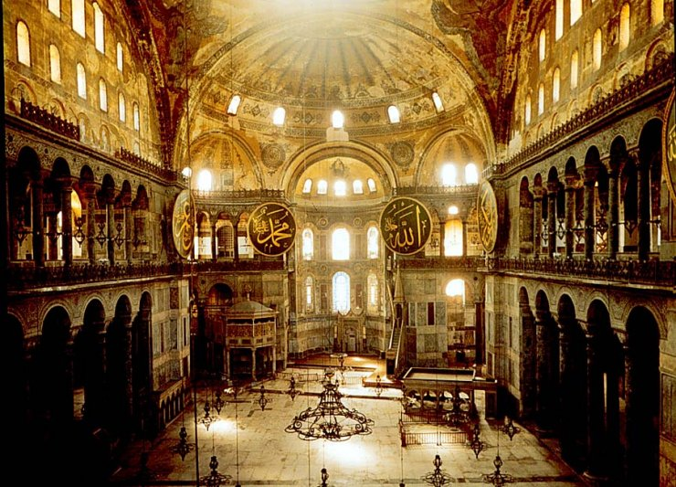
The Hagia Sophia

Slide 14
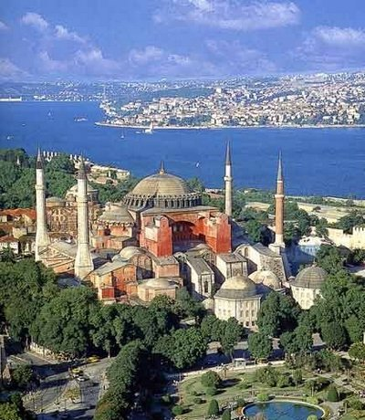
The Hagia Sophia

Slide 15
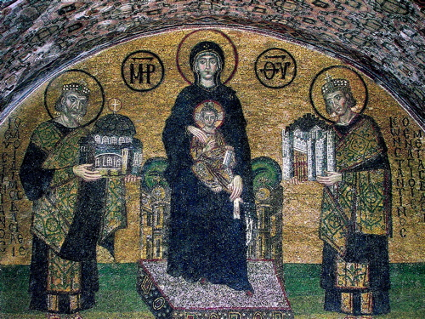
A mosaic at the Hagia Sophia

Slide 16
Islamic Decline
Religious Tension
Sunni and Shiite Sects
Weak Leadership
Problem of Succession
Invasions
Crusades
Turks/Ottomans
MONGOLS!!!

Slide 17
WORD ASSOCIATIONS
BYZANTINE EMPIRE
Preservation of Greco-Roman Culture
Justinian’s Code (law, stability, order)
Similar to Hammurabi’s Code & Twelve Tables
Cultural diffusion (art, architecture, trade) with Russia made Kiev a cultural center!
ISLAMIC (MUSLIM) EMPIRES
Math
Science
Technology
Diversity
Religious Toleration

