Slide 1
Aim: How has NATIONALISM been a source of UNITY?
German + Italian Unification

Slide 2
Nationalism: Feeling of strong loyalty and pride to one’s country and culture.
Militarism: Glorification of the military for use in building National Power.
Xenophobia: Intense fear or dislike of people from another country.

Slide 3
Nationalism as a source of UNITY
How can nationalism bring people together?

Slide 4
Nationalism as a source of DIVISION
How can nationalism drive people apart?

Slide 5
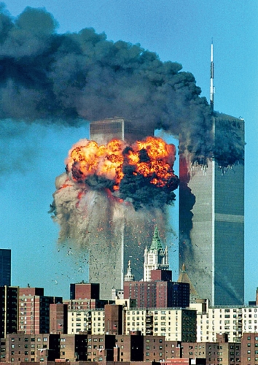
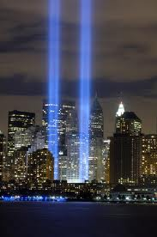
What inspires nationalism?
Tragedy -Triumph

Slide 6
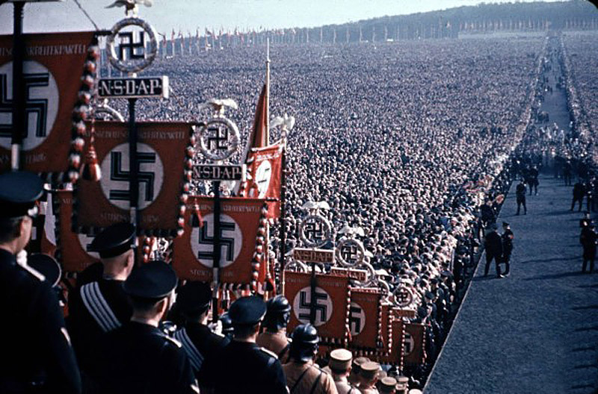

Slide 7
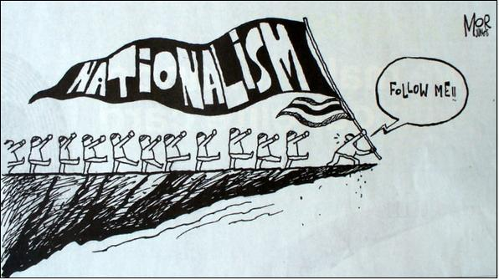

Slide 10
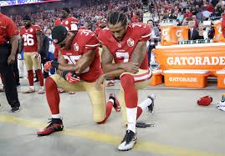

Slide 11
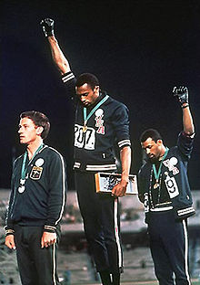
Add some perspective…
When "The Star-Spangled Banner" played, Smith and Carlos delivered the salute with heads bowed, a gesture which became front page news around the world. As they left the podium they were booed by the crowd. Smith later said "If I win, I am American, not a black American. But if I did something bad, then they would say I am a Negro. We are black and we are proud of being black. Black America will understand what we did tonight.” 1968

Slide 13
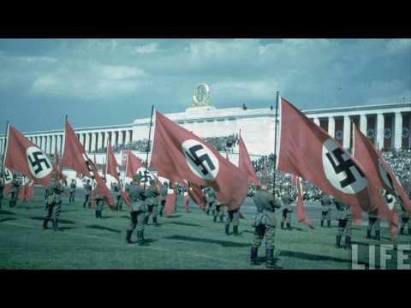
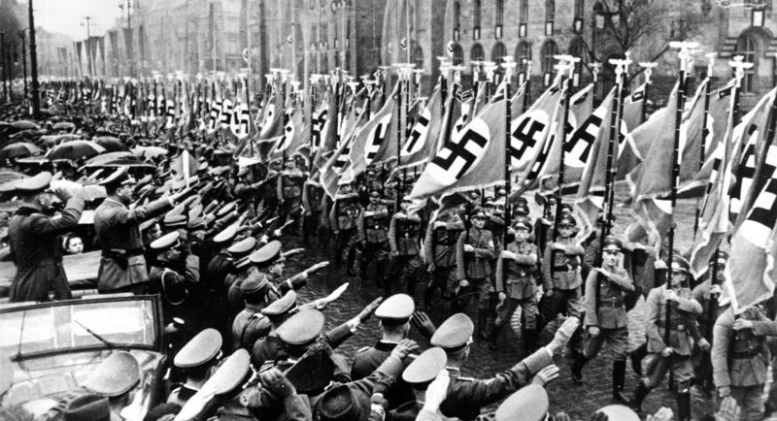

Slide 14
Germany is NOT UNIFIED….WHY NOT?

Slide 15
Otto Von Bismarck
“BLOOD AND IRON” = Germany will be united through Militarism
NATIONALISTIC GOALS
UNIFICATION and POWER for Germany (by WAR)
The STATE is more important than the INDIVIDUAL
Foreign Allies: Build links to Austria and Russia, Keep France Weak (Why?)
Realpolitik
Realistic Politics – Strengthen military and economy
Economic Strengths: Industry, Resources, Workforce
“The End Justifies the Means”

Slide 16
Abdicate – renounce one's throne
Parliament – the supreme legislative body of a nation/state which is comprised of representatives (elected or appointed)
Dictatorship – A government ruled by an ABSOLUTE authority.
Opposed – eager to prevent or put an end to; disapproving of or disagreeing with.
Perish – suffer complete ruin or destruction

Slide 18
Italian Nationalism
Risorgimento - Italian Nationalist Movement
Guisseppe Mazzini: THE SOUL
Count Camillo Cavour: THE BRAINS
Giuseppe Garibaldi: THE SWORD
“Red Shirts”(Militant Group) → Took over Sicily

Slide 21
Aim: How has NATIONALISM been a source of DIVISION?
Ottoman Empire

Slide 22
What problems does a multinational empire pose?
Ethnic Tensions/Nationalistic Rivalries
Group Identity vs. State Identity
“POWDER KEG OF EUROPE”
Why is the GEOGRAPHY of the Ottoman Empire Important?
BALKAN PENINSULA
Strategic Location for TRADE and RESOURCES
European want access to MEDITERANEAN, SUEZ CANAL, INDIAN OCEAN
3 Continents

Slide 23
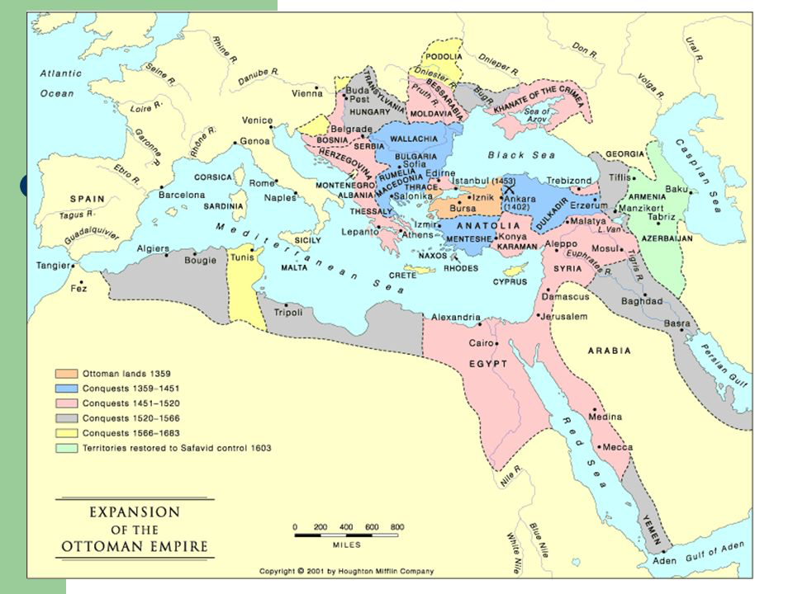

Slide 24
What do the Austro-Hungarian and Ottoman Empires have in common?
The are both Multi-National Empires
Why is Nationalism such an important force in Europe?
Small space, many Nations → Potential for conflict and tension
Expansion for one → Reduction for others
What factors can keep people together in the face of nationalism?
What factors can drive people apart in the face of nationalism?

Slide 26
