Slide 1
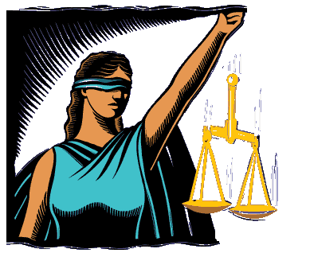
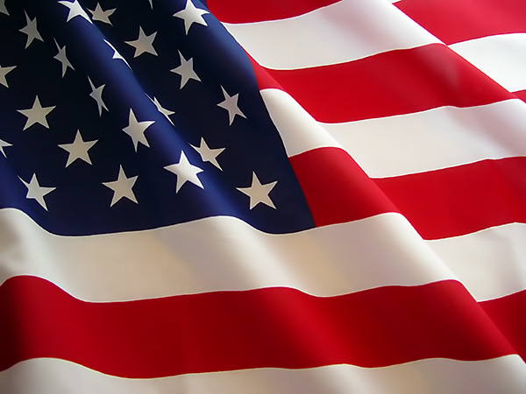
The Rule of Law & The American Criminal Justice System

Slide 2
Aim: The Rule of Law
Rule of Law- principle that all people are subject to and accountable to written law codes that are enforced fairly.
Ex. Hammurabi’s Code (3000 B.C.)- oldest written law code

Slide 3
II. Laws- rules & regulations made to control conduct of citizens and promote desirable behavior.
Reflect the values of society
Promote order and stability
Protect human rights (life & property)
Resolve conflicts
Promote fairness (newer concept)
F) Represent the will of the majority
G) Protect minorities (newer concept)

Slide 4
III. Federalism- concept of having Federal, state, and local laws.
A) Lawmakers
1. Federal- Congress
2. State- NYS Legislature
3. *Local- County Legislature & Town
Councils
*affects your daily life the most

Slide 5
B) Law Enforcers
1. Fed- U.S. Department of Justice
2. State- Police Departments
3. Local- Sheriffs, etc.
C) Courts- decisions interpret laws & decide how they are applied.
Common Law- system where courts follow the decisions of other courts in similar cases (Aka. Case Law).
1. Criminal Courts- charges for crimes
2. Civil Courts- lawsuits

Slide 6
notes
D) Gov’t Agencies- make specific policies to carry out laws.
Ex.
1. N.Y. State D.E.C. (Dept. of Environmental
Conservation)
2. I.C.E. (Immigration & Customs Enforcement)

Slide 7
Justice System - Key Terms
Jurisdiction- area in which a court has the authority to rule.
B) Original Jurisdiction: Authority to hear cases that arise within a specified geographic area or that involve particular kinds of violations.
C) Appellate Jurisdiction: Authority to review a decision made by a lower court. (*Appeals)

Slide 8
State Court System
A) Trial Courts- hear cases for the first time
1. District Courts- misdemeanor cases
2. County Courts- felony trials
3. Family Court- child abuse, family violence, child
support, custody, adoption, juvenile
delinquency cases.
3. Surrogate Courts- affairs of deceased
(wills, estates)
4. Court of Claims- lawsuits against the state of N.Y.

Slide 9
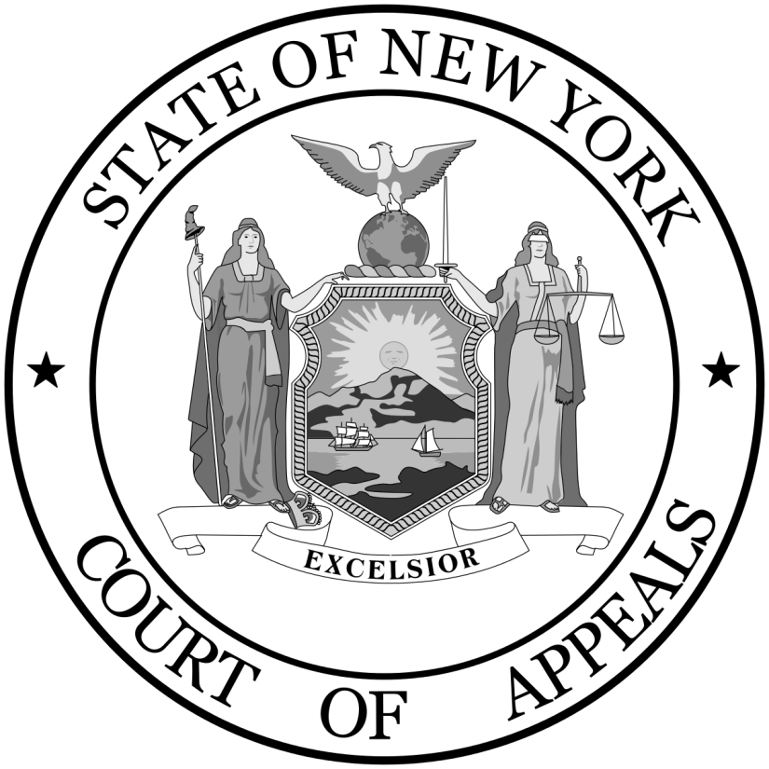
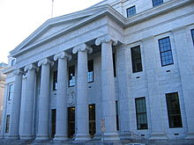
B) Appellate Courts- hear appeals
1. N.Y.S Supreme Court
2. N.Y.S. Court of Appeals- highest court in N.Y.; final appeals

Slide 10
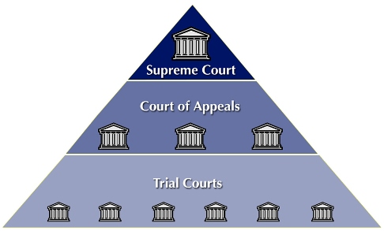
The Federal Court System- only hears cases involving federal & Constitutional laws

Slide 11
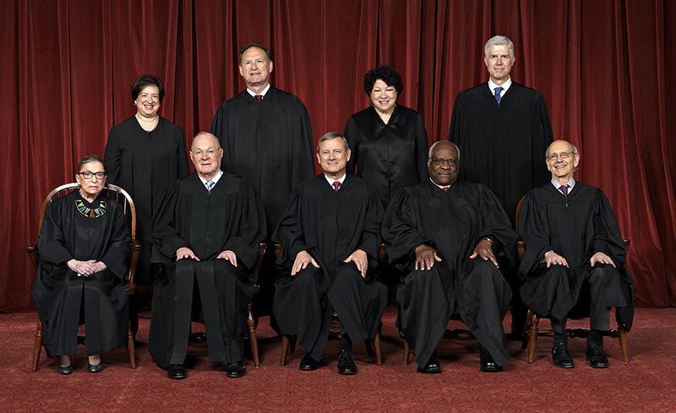
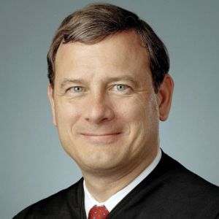
B) U.S. Supreme Court
1) 9 Justices; Chief Justice John Roberts
2) Appointed for Life-terms
3) Biggest power: JUDICIAL REVIEW- can
decide if laws are unconstitutional.
John Roberts

