Slide 1
Aim: The Bill of Rights & Criminal Justice

Slide 2
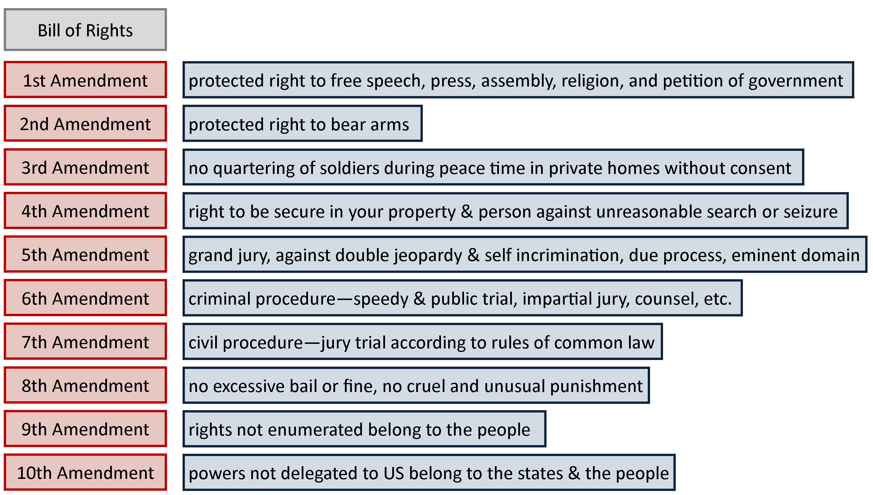

Slide 3
1st Amendment
Free Speech
Free Press
Establishment Clause – Free Religion
Right to Assemble Peaceably
Right to Petition Government

Slide 4
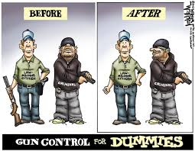
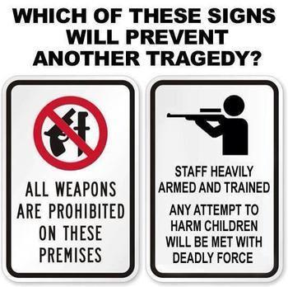
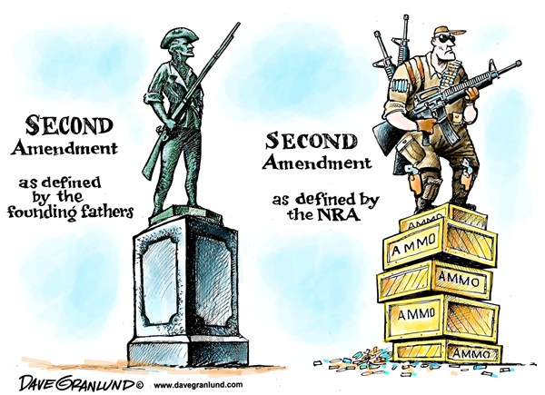
2nd Amendment
Right to keep and bear arms
"A well regulated Militia, being necessary to the security of a free State, the right of the people to keep and bear Arms, shall not be infringed."

Slide 5
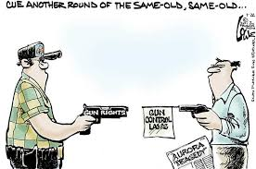

Slide 6
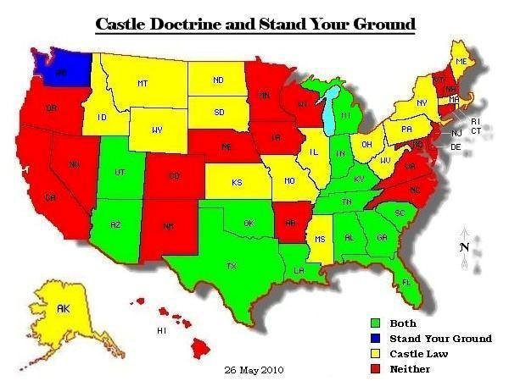

Slide 7
THE CASTLE DOCTINE VS. STAND YOUR GROUND
CASTLE DOCTRINE
STAND YOUR GROUND
Are you INSIDE your home? YES
Is someone attempting UNLAWFUL ENTRY? YES
Are you in danger of BODILY INJURY? YES
Can you RETREAT to safe area? NO
Are you in DANGER? YES
NO DUTY TO RETREAT

Slide 8
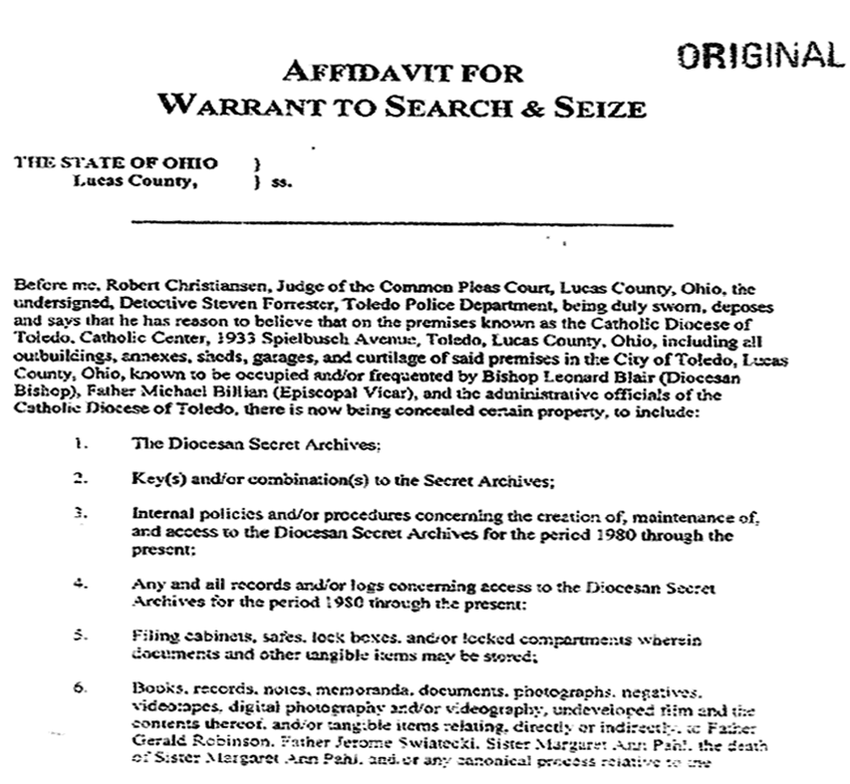
4th Amendment
PROTECTS AGAINST UNREASONABLE SEARCHES & SEIZURES
WARRANTS MUST BE ISSUED UPON PROBABLE CAUSE

Slide 9
5TH AMENDMENT
RIGHT TO DUE PROCESS – procedural fairness
(AKA Miranda Rights)
RIGHT TO NOT-INCRIMINATE-
(“pleading the fifth” or stay silent)
RIGHT TO GRAND JURY
NO DOUBLE JEOPARDY-
(tried for same crime twice)

Slide 10
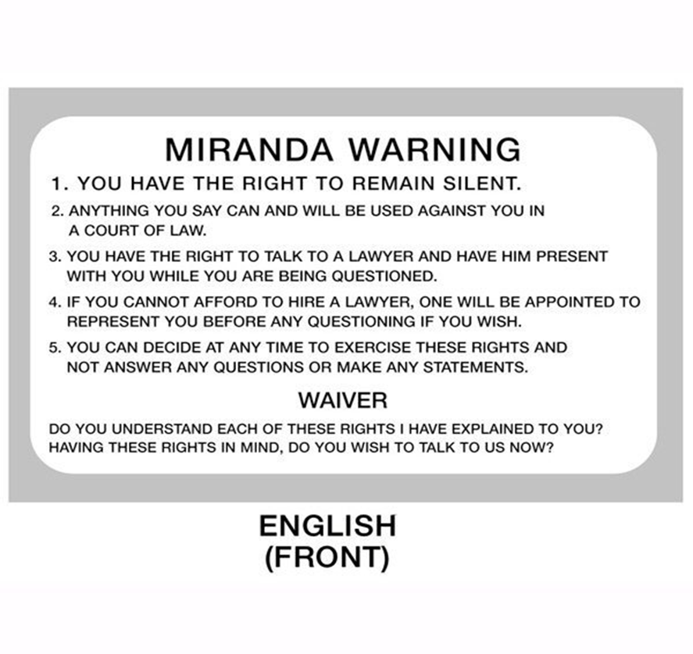
Due Process

Slide 11
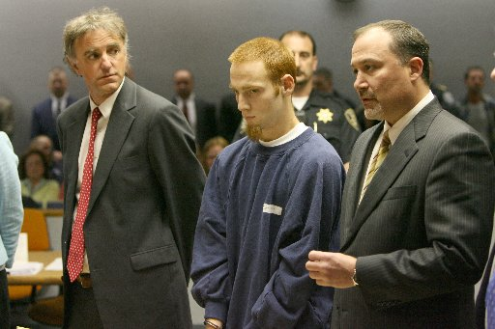
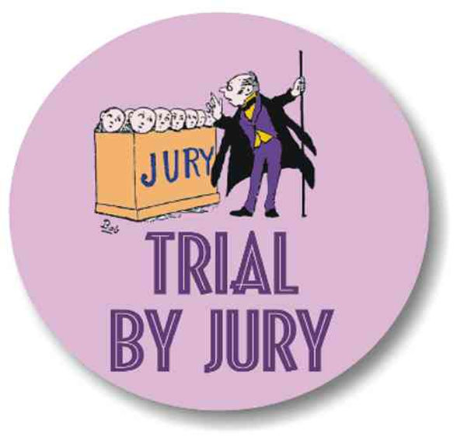
6th AMENDMENT
RIGHT TO SPEEDY & PUBLIC TRIAL
RIGHT TO AN ATTORNEY
RIGHT TO TRIAL BY JURY
MUST BE INFORMED OF CHARGES AGAINST YOU

Slide 12
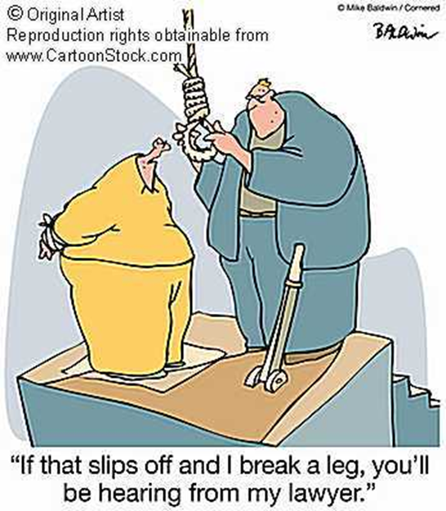
7th AMENDMENT
RIGHT TO JURY TRIAL IN CIVIL LAWSUIT

Slide 13
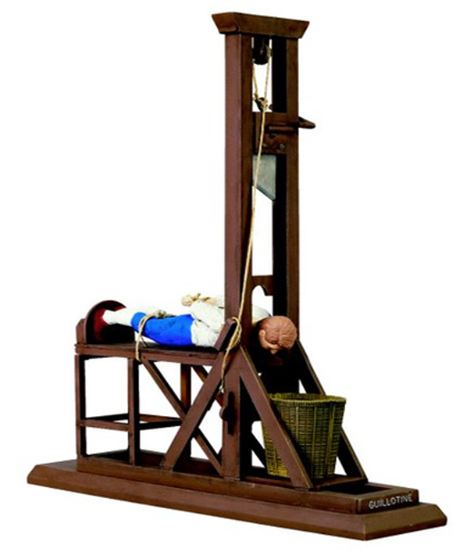
8TH AMENDMENT
NO EXCESSIVE BAIL, OR FINES, NOR CRUEL AND UNUSUAL PUNISHMENT

