Slide 1
Chapter 23: Transoceanic Encounters and Global Connections

Slide 2
Periodization
Pre-History→ 600 BCE
600 BCE → 600 CE
600 CE → 1450 CE
1450 CE → 1750 CE

Slide 3
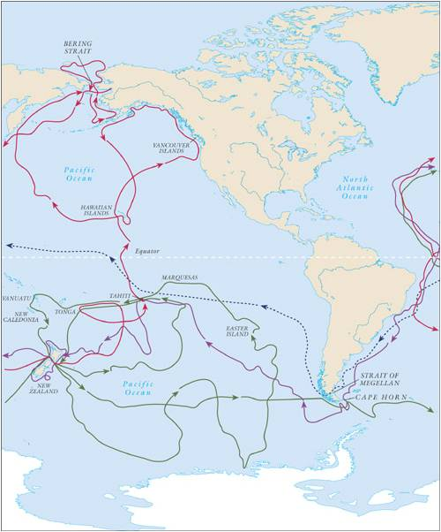
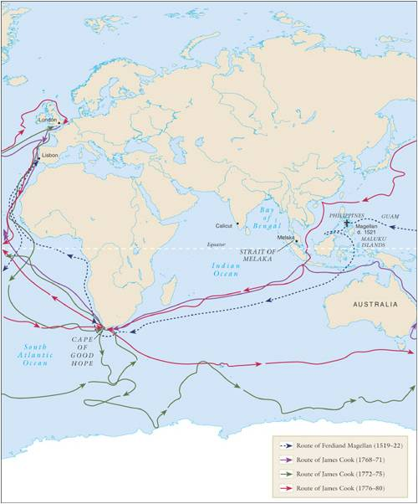

Slide 4
Trading Post Empires
Portuguese are 1st
Based on charging trade duties – Aggressive tactics
Arabs continue to operate
Portuguese role declines over time – why?

Slide 5
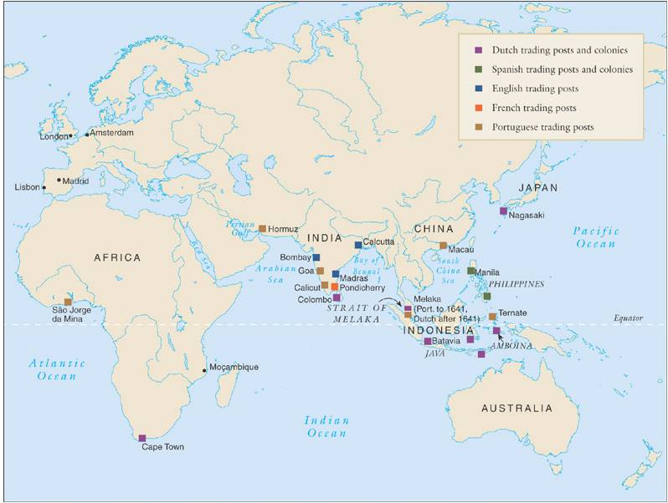

Slide 6
English/Dutch Trading Posts
Rival/Parallel Trading Networks
English in Indian Ocean
Dutch in Africa and South Pacific
Dutch/English have an advantage over Spanish/Portuguese

Slide 7
Trading Companies
English East India Trading Company
Dutch United East India Company (VOC)
Private Ownership + Government Support
Broad Powers
EXTREMELY PROFITABLE

Slide 8
Europeans in Southeast Asia
Spanish in the Phillipines
MANILA
Influx of Chinese – Resented by Spanish, Filipinos
Strong Missionary Activity
Dutch in Indonesia
Island of Java
Less Emphasis on Religion

Slide 9
Russian Expansion
Take over Mongol Khanates in 16th Century
Expansion into Siberia (16th, 17th) and Caucasus (18th)
Eastern Orthodox Christianity has little success
Rebellions/Resistance → Movement East
Russians exiled to Siberia
Astrakhan – Major Trading City
Major Increases in Population

Slide 10
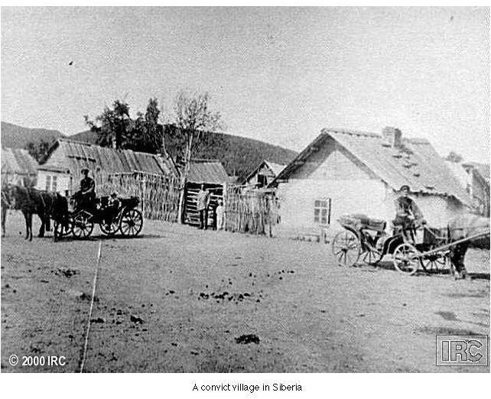

Slide 11
The Seven Years War
Commercial rivalries between empires at sea
Global conflict erupts: multiple theatres in Europe, India, Caribbean, North America
North America: merges with French and Indian War, 1754-1763
British emerge victorious, establish primacy in India, Canada

Slide 12
The Columbian Exchange
Global diffusion:
Plants and crops
Animals
Human populations (forced migration)
Disease pathogens
Permanently alters human geography, natural environment

Slide 13
Epidemics and Demographics
Smallpox
1519 smallpox in Aztec Empire
Population declines 90% within 100 years (17 million to 1.3 million)
Increases overall food supply
Introduction to European animals to Americas
Horses, cattle, pigs, chickens, etc.
Introduction of American foods to Europe, Asia, Africa
Maize, potatoes, beans, etc.

Slide 14
World Population Growth

Slide 15
Global Trade
Transoceanic trade in Atlantic Ocean basin
Manufactured goods from Europe
Raw goods from Americas
The Manila Galleons
1565-1815 Spanish galleons dominate Pacific Ocean trade
Chinese luxury goods for American raw materials, esp. silver

Slide 16
Environmental Impact of Global Trade
Fur-bearing animals hunted to extinction or near-extinction
Also whales, codfish, other animals with industrial uses
Relentless human exploitation of the natural environment

