Slide 1
Aim: What caused the Protestant Reformation?

Slide 2
Protestant Reformation Vocabulary
Purgatory – A condition or place where the dead suffer punishment for their sins in order to purify their souls.
Indulgence – Reduction of the time that will be spent in purgatory.
Relic – Body, body part or personal property of a religious figure (ex. Skull of a Saint)
Reformation – Movement for religious reform

Slide 3
Heretic – A person that goes against the church.
Excommunication – An act that kicks a person out of the church.
Recant – Take back a statement or action
Inquisition – An official church investigation of an individual.
Vernacular – The common spoken language of a region.

Slide 4
Causes of the Reformation
Renaissance Ideas (ie. Questioning Spirit) inspire people to challenge church authority
Kings/Princes resent the Pope’s power
Merchants resented church taxes and were jealous of Church wealth.
Clergy became very corrupt

Slide 5
Who was Martin Luther?
German Monk
Recognized problems in the church
Wrote 95 Theses
Problems that the Church needed to fix
The big problem is the sale of INDULGENCES
Printing Press (Johann Gutenberg) helps to spread ideas quickly

Slide 6
Luther vs. Tetzel
Johann Tetzel – Sold indulgences to earn money for the church to build St. Peter’s Cathedral in Rome.
Luther took a public stand against Tetzel
Thought it was wrong that people had to pay money for forgiveness.

Slide 7
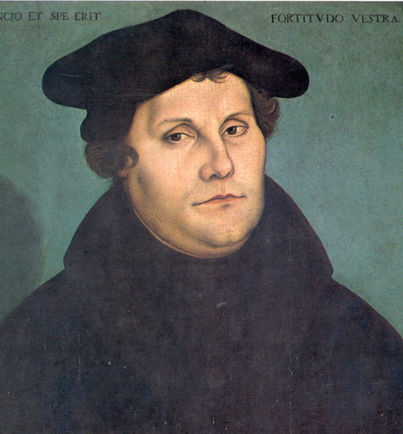
Martin Luther

Slide 8
Luther’s Teachings
Martin Luther | Catholic Church
Salvation achieved by faith alone | Salvation by faith and “GOOD WORKS” (Charity)
All people of faith are equal | Priests and Clergy had to interpret the Bible for people
The bible should be printed in Vernacular (ex. German) | The bible should be printed in Latin

Slide 10
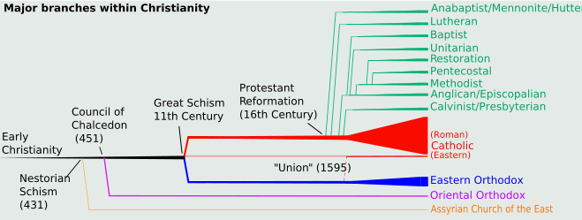

Slide 11
Aim: What happens when Reformation Ideas Spread?

Slide 12
England Becomes Protestant
Henry VIII wants a son
Asked Pope to Annul his marriage – Pope said NO
Henry gets Parliament to declare an ACT OF SUPREMACY
The act makes the King head of the Church in England
Anglican Church – Church of England

Slide 13
The Reformation Continues
John Calvin
Calvinism
Predestination – God has known since the beginning of time who will be saved.

Slide 14
Other Reformers:
John Knox
The Anabaptists
Catholic Reformation – St. Ignatius of Loyola

Slide 15
Aim: What was the Counter – Reformation?

Slide 16
A Reform Movement by the Catholic Church
The Council of Trent (1545 – 1563)
Ended the Sale of Indulgences
Pope is Supreme Power of the Church

Slide 17
The Inquisition
- Church Courts to find Heretics (Spain)
Jesuits
- Started by St. Ignatius of Loyola
- Missionaries and Teachers
- Spread Christianity to New Areas

Slide 18
Aim: How did the Protestant Reformation Impact Europe?

Slide 19
Impacted Western Europe: Socially, Politically, Religiously andEconomically
Destroyed Religious Unity
Developed New Religions
Created Religious Tension (Catholics/Protestants)

Slide 20
Church Power Monarch Power
Rise of Nation-States (Countries)
Education Increased

