Slide 1
Classical China
Qin and Han Dynasties

Slide 2
THINK!!!!
What happened at the end of the pre-classical period in East Asia? What is life like?

Slide 3
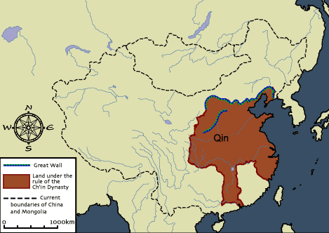

Slide 4
Qin Dynasty (221 – 207 BCE)
Legalism
Powerful Army – Iron Weapons
Capital City – Zian Yang
STRONG CENTRAL GOVERNMENT
Ends in rebellion

Slide 5
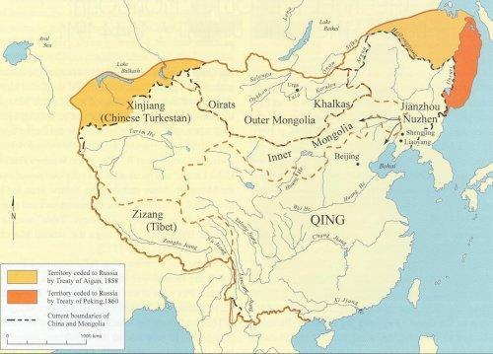

Slide 6
Shi Huangdi
Divided empire into districts
Built roads and walls
Censorship – Book Burning
Standardized weights and measures
TOMB

Slide 7
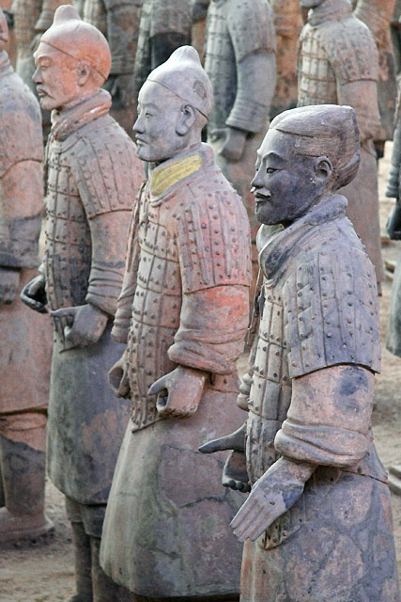

Slide 8
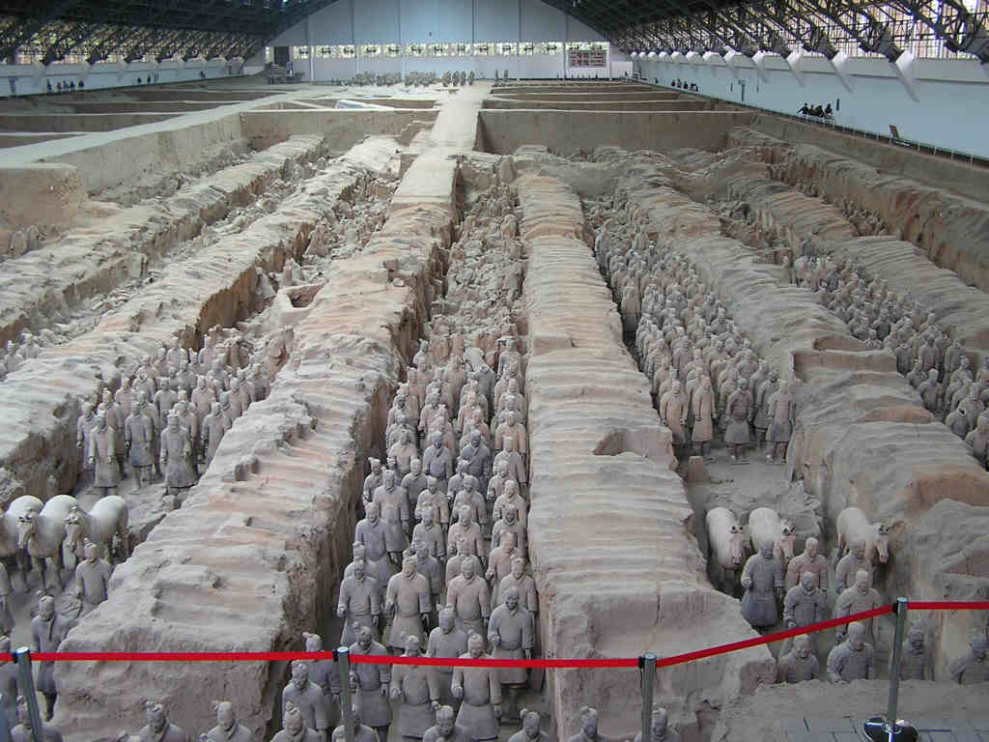

Slide 9
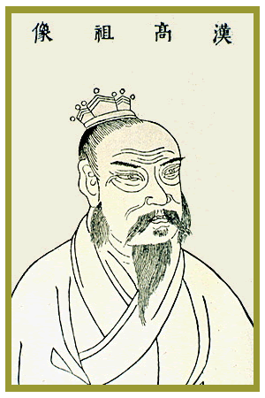
Liu Bang

Slide 10
Han Dynasty (206 BCE – 220 ce)
Complex Bureaucracy
Government Monopolies in salt and iron
Confucianism
Sericulture

Slide 11
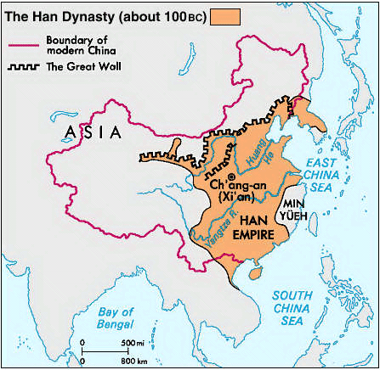

Slide 12
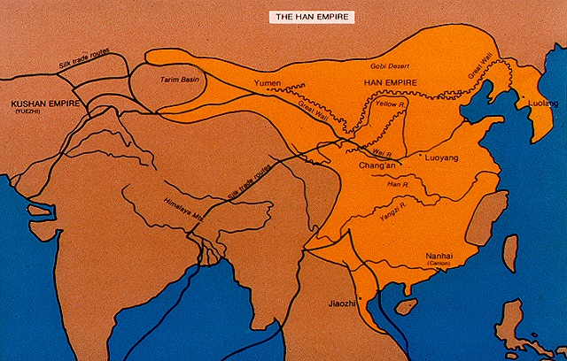

Slide 13
Leadership
Liu Bang
Restored centralized rule
Capital and Chang’an
Wood Construction
Han Wudi
“Martial Emperor”
Centralization and Expansion
Imperial University
Maodun
Wang Mang – “Socialist Emperor”

Slide 14
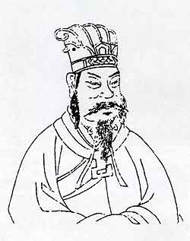
Han Wudi

Slide 15
Han Society
Patriarchal Society
Filial Piety
Aristocrats – Extended Family
Peasants – Nuclear Households

Slide 16
Problems of Han Rule
Military Expansion
Raised taxes – seized land
Social Tension
Gap between rich and poor
Unequal land distribution
Nomads

Slide 17
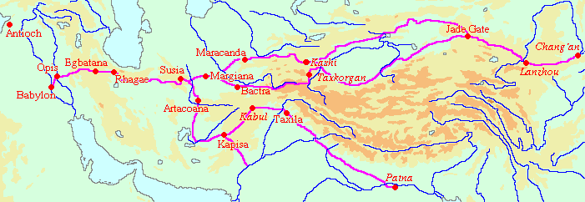

Slide 18
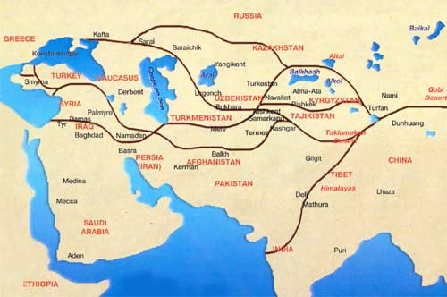

Slide 19
Confucianism
Daoism
Family and Education
Merit Based Bureaucracy
Lead by Example
Civil Service Examples
5 Basic Relationship
Filial Piety
The Analects
Golden Rule
“It is a man that makes the way great”
Nature Based Philosophy
Balance and Harmony in Nature
Simple Life
Tao – “The Way”
Tao Te Ching
The government that governs best governs least
“It is the way that makes a man great”

Slide 20
East Asia DISCUSSION QUESTIONS
Why did the political chaos in the Period of Warring States give rise to the philosophies such as Confucianism, Legalism, and Daoism? EXPLAIN
The Legalists held that the foundations of any state were agriculture and armed forces. Why would they believe this? Is there any truth to this statement?

