Slide 1
Chapter 22: Cross Cultural Interactions

Slide 2
Patterns of Long-Distance Trade
The Rise of Cities
  High Value/Low Weight-Land Trade
  Bulk Items-Sea Trade
  Rapid Urbanization throughout Indian Ocean
Marco Polo (Italian Merchant/”Historian”)
  Mediterranean West to Asia – Increase Interactions
Ibn Battuta (Arab Traveler/Historian)
  Africa west to Asia-Increase

Slide 3
Political, Religious, Diplomatic Interactions
Increased interactions create need for diplomatic relations
  Rabban Sauma
Religious Exchanges
  Sufi Mystics
  Christian Missionaries
    John of Montecorvino – Expatriate communities and conversion in China (Why was Christianity never successful in China?)

Slide 4
Cultural Exchanges
Agricultural Crops
  West Africa gets: Rice (from Asia), Cotton (from Arab)
  Muslims spread sugarcane
  Diets enriched, Economies Helped
Technology
  Compass
  Gunpowder

Slide 5
The Plague “Black Death”
Asian Origins
  Spreads from Asia → Mongol Exchanges
  Poor sanitation, hygiene facilitate spread
Impact on Europe
  25% of population is killed (10% in China)
  Labor shortages-workers demanded higher wages
    Authorities froze wages → worker rebellion/social unrest
  Skewed demographics

Slide 6
The Renaissance
Brought on by demographic recovery, state-building and increased prosperity.
A New Standard in Art
  Patrons of the Arts: Medici, Vatican
  Ninja Turtles
Humanism
  Christianity and High Moral Standards
  Classical learning and language (REBIRTH)
  Morality and Secularism were not mutually exclusive (change from Medieval Europe)-Reconciled Christian Values with Modern World
  Connect Europe with the larger world

Slide 7
The Renaissance
Brought on by demographic recovery, state-building and increased prosperity.
A New Standard in Art
  Patrons of the Arts: Medici, Vatican
  Ninja Turtles
Humanism
  Christianity and High Moral Standards
  Classical learning and language (REBIRTH)
  Morality and Secularism were not mutually exclusive (change from Medieval Europe)-Reconciled Christian Values with Modern World
  Connect Europe with the larger world

Slide 8
Where does the Renaissance begin?
Northern Italy
  Venice
  Florence
  Milan
  Genoa
Wealthy Patrons of the Arts
  Medici Family
  Vatican
Later spreads to N. Europe
  Greater emphasis on religion

Slide 9
Renaissance Values
W – Wealth
I – Individualism
S – Secularism
H – Humanism
C – Classics
Q – Questioning Spirit

Slide 10
Medieval Art vs. Renaissance Art

Slide 11
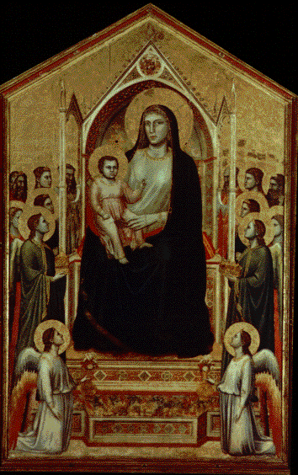
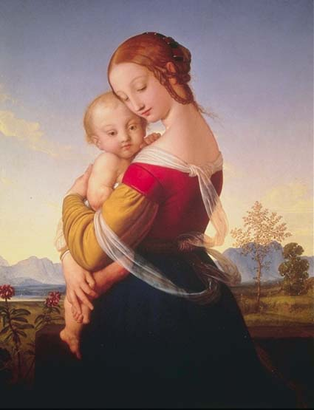
Which is Which?

Slide 12
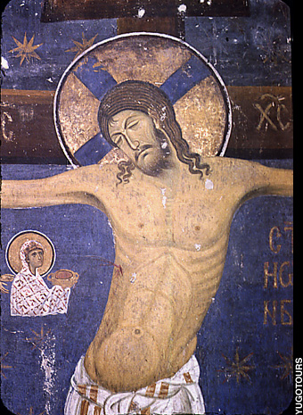

Slide 13
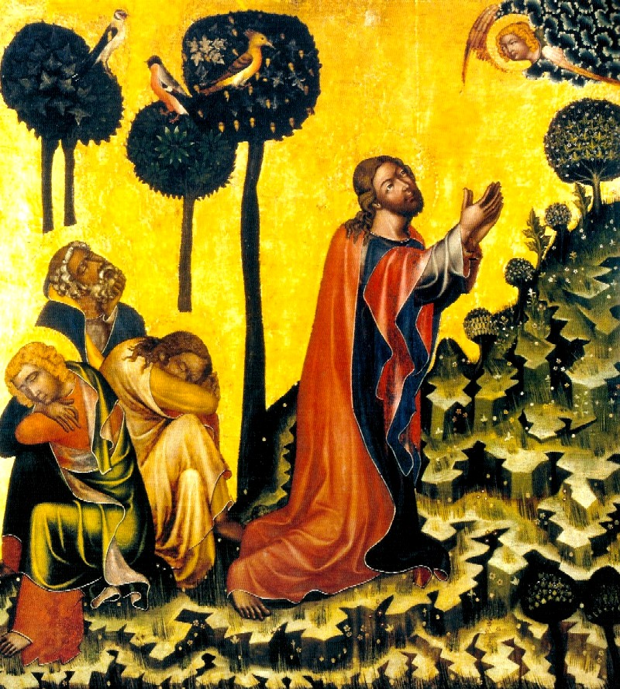

Slide 14
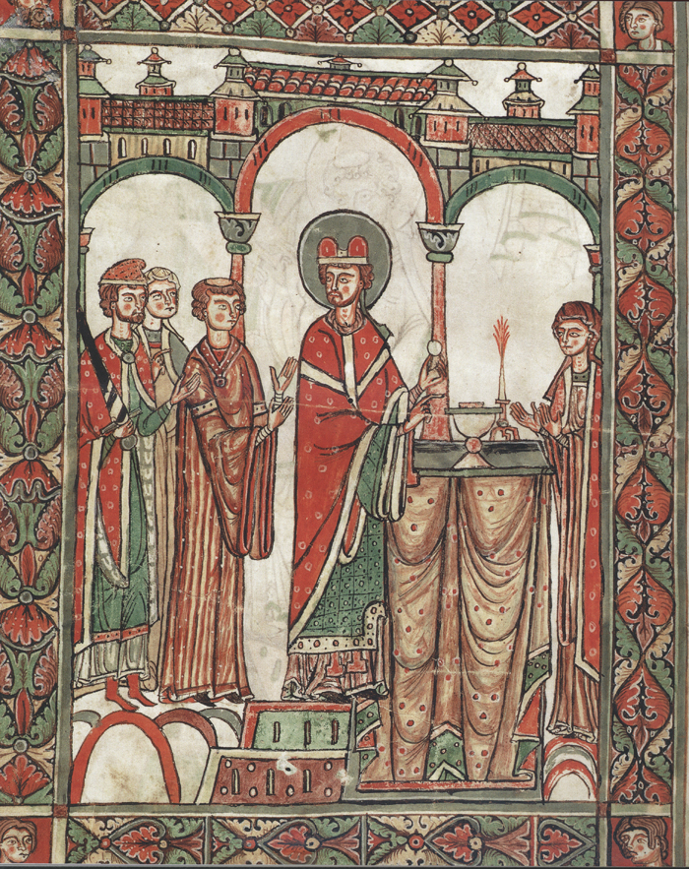

Slide 15
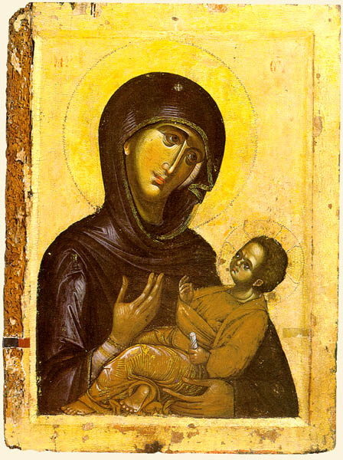

Slide 16
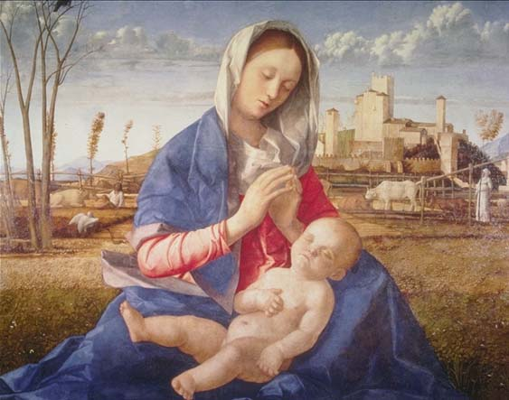

Slide 17
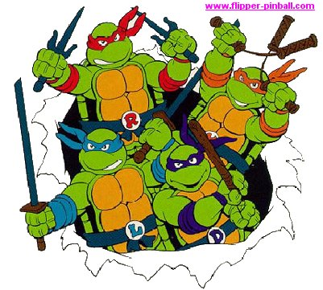
Renaissance Art
The Ninja Turtles

Slide 18
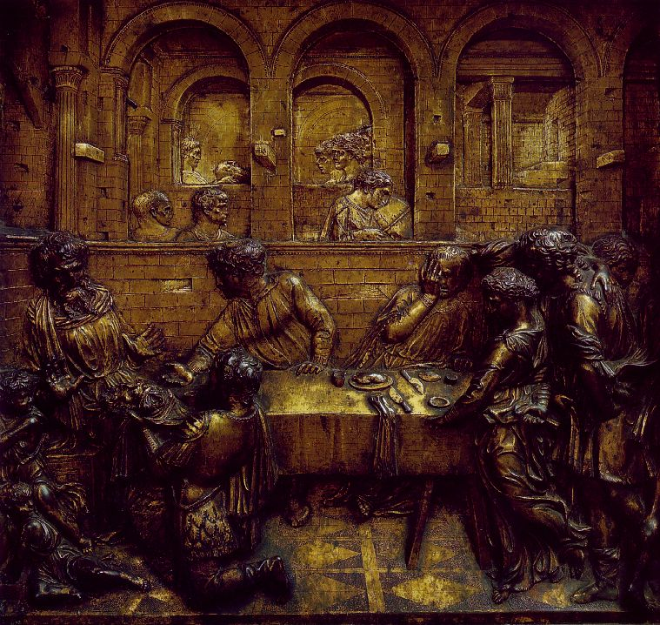
Donatello

Slide 19
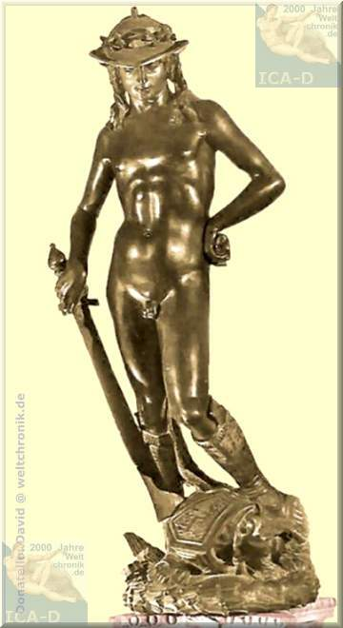

Slide 20
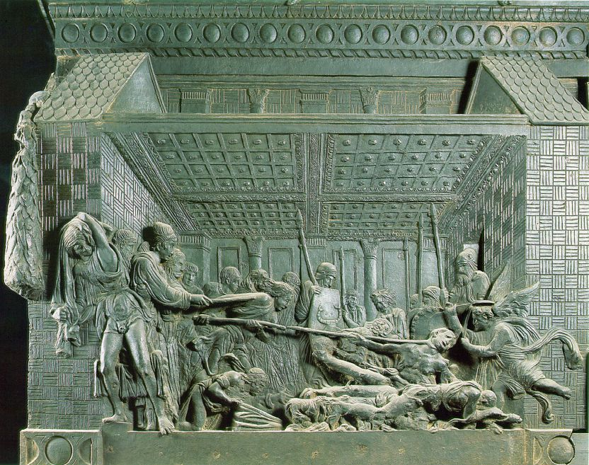

Slide 21
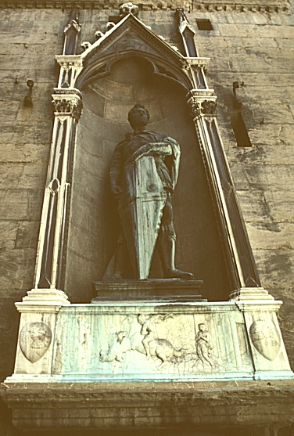

Slide 22
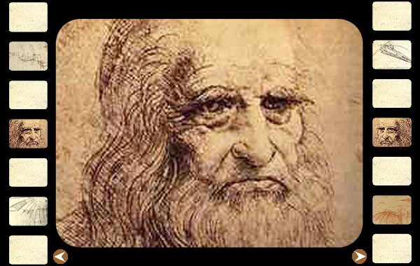
Leonardo DaVinci
(1452 – 1519)

Slide 23
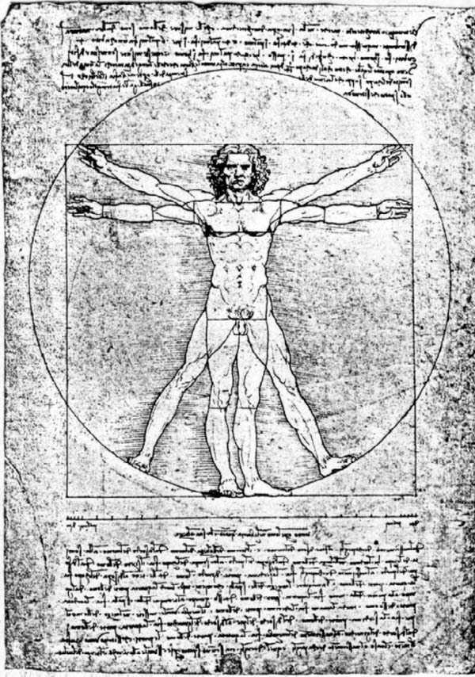

Slide 24
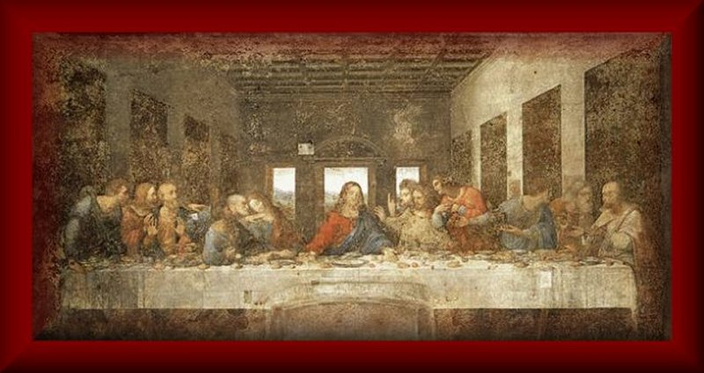

Slide 25
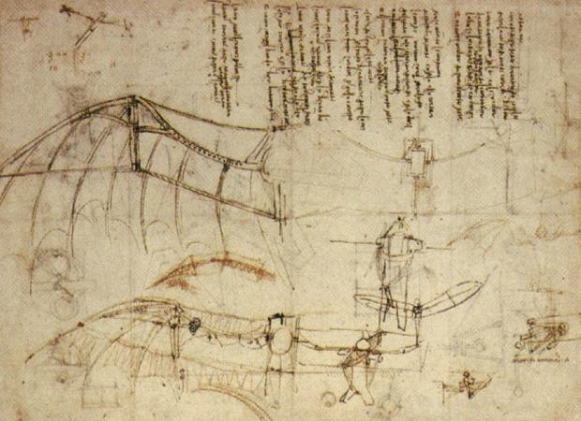

Slide 26
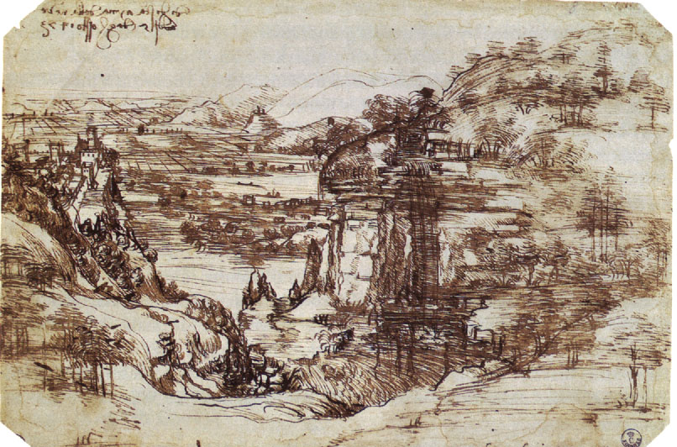

Slide 27
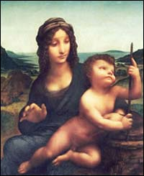

Slide 28
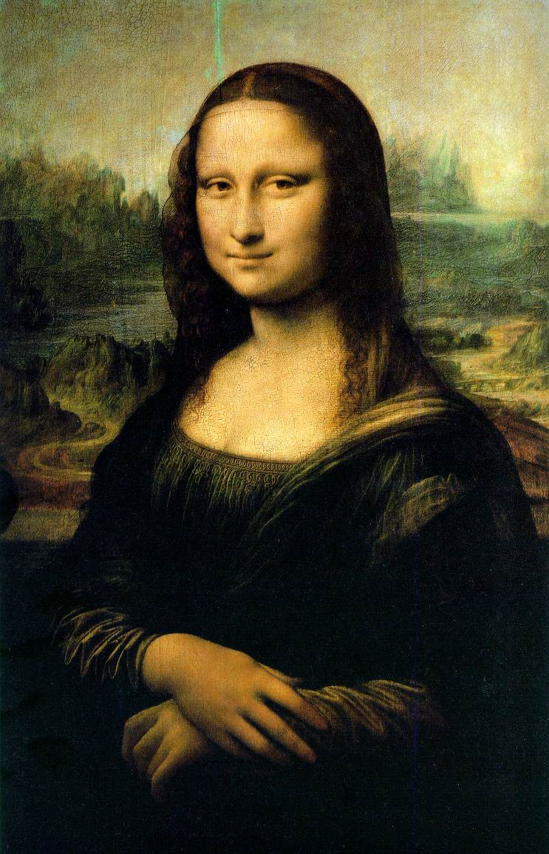

Slide 29
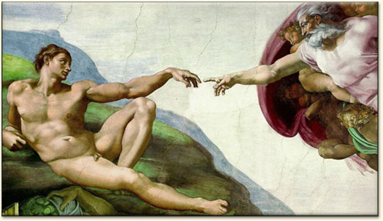
Michelangelo Buonarroti
(1475 – 1564)

Slide 30
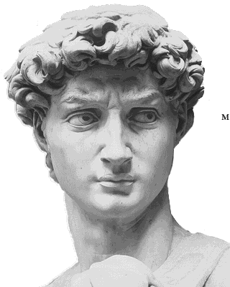

Slide 31
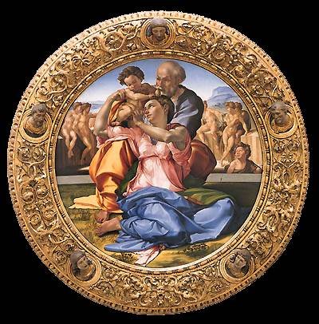

Slide 32
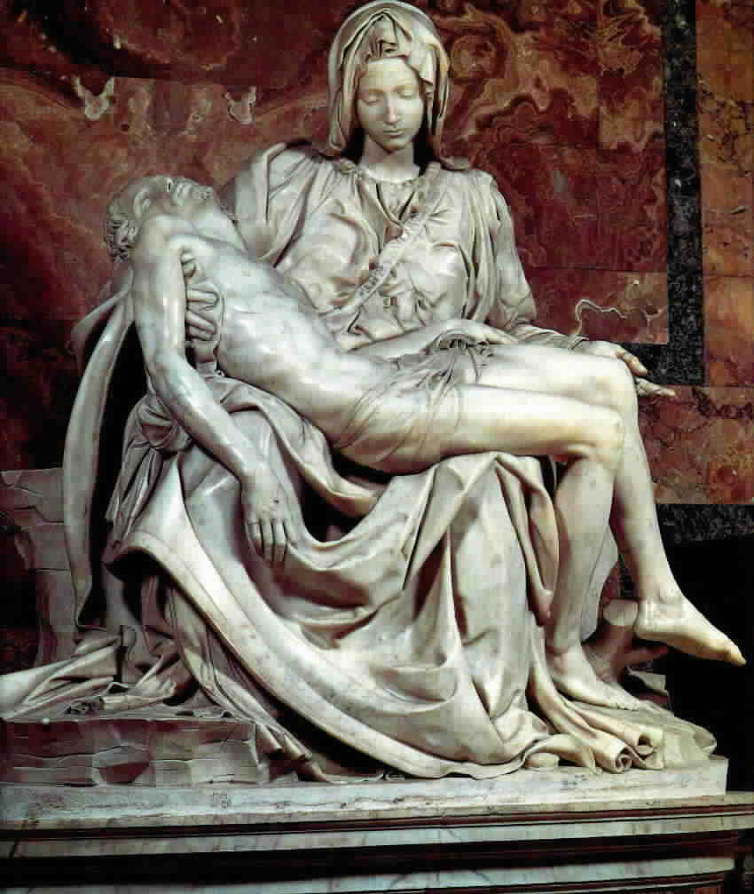

Slide 33
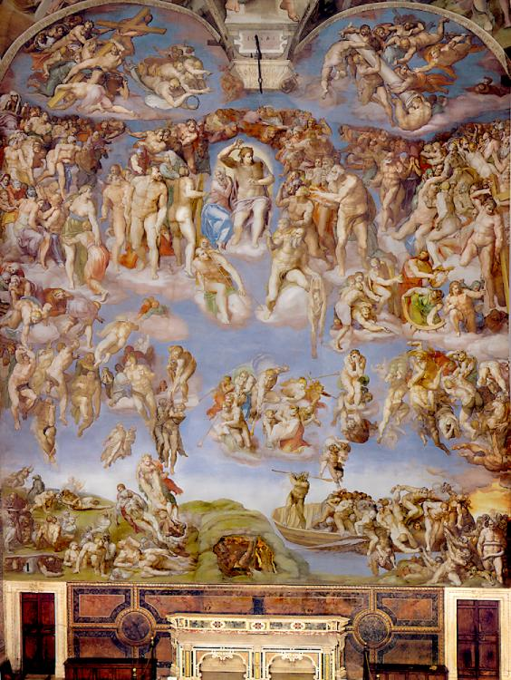
Sistine Chapel

Slide 34
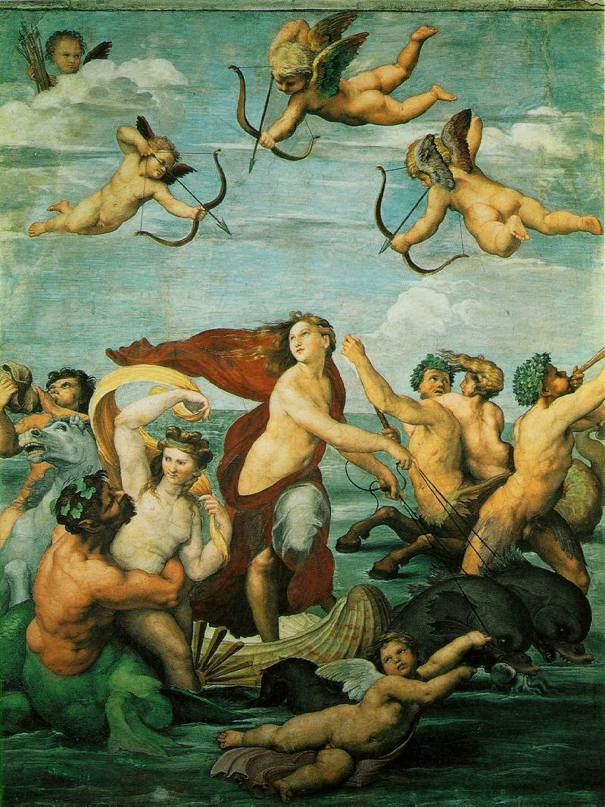
Raphael
(1483 – 1520)

Slide 35
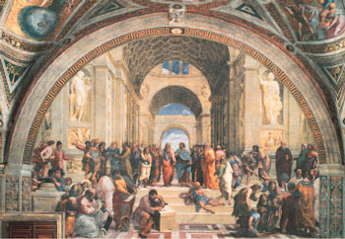

Slide 36
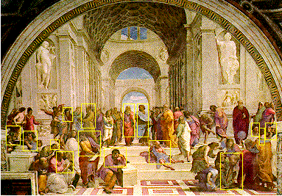

Slide 37
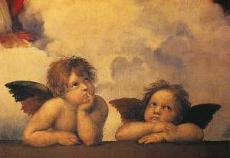

Slide 38
Leonardo DaVinci
(1452 – 1519)
Notes:
38

Slide 39
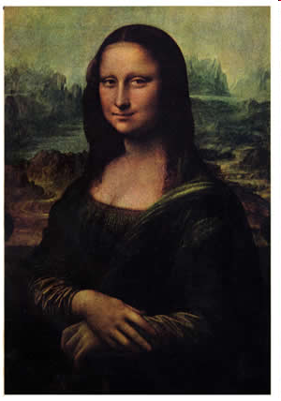

Slide 40
